Slide 1
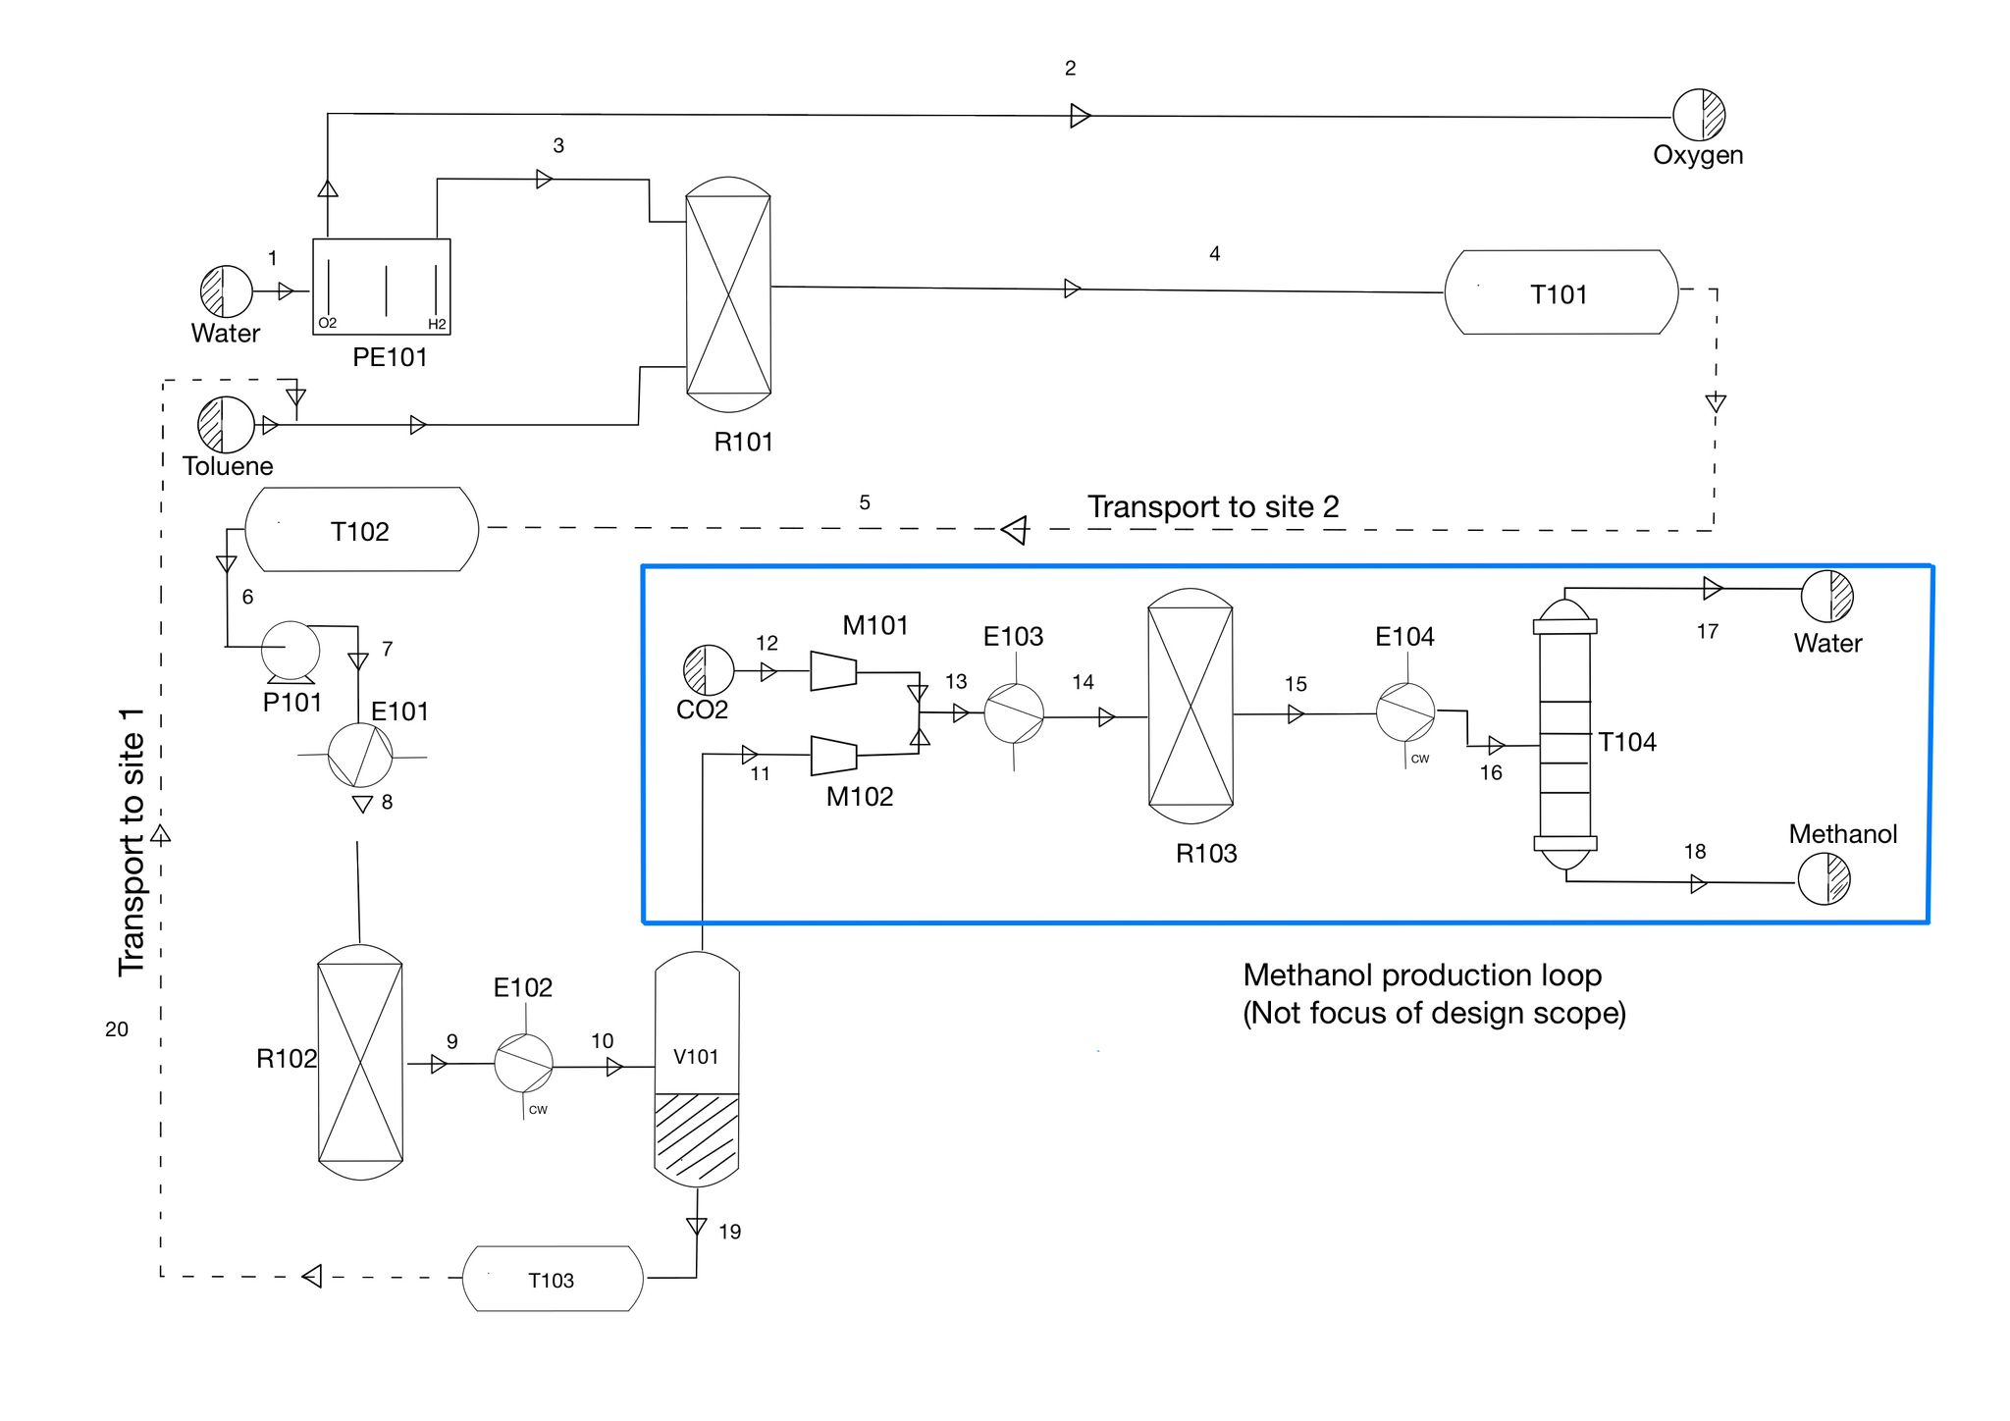
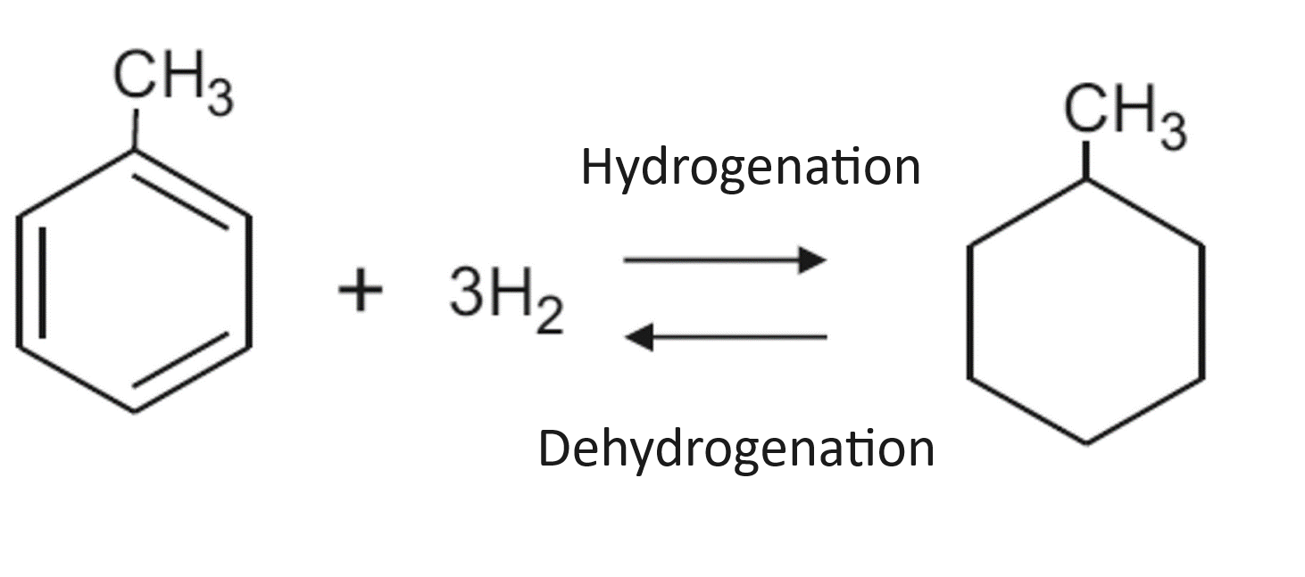
Hydrogen Production: Methylcyclohexane as a Storage and Transport Solution
Neel Dodhia, Sean Mcintosh, Faris Alkhaldi
Faculty Advisor(s): Dr. Jonathan E Whitlow, Dept. of Chemistry and Chemical Engineering, Florida Institute of Technology
ABSTRACT
Employing AspenONE V14 Aspen Plus simulation with the Peng-Robinson property method, this research proposes a streamlined Methylcyclohexane-Toluene-Hydrogen (MTH) System for efficient hydrogen storage and sustainable methanol production. The innovative system harnesses toluene hydrogenation to store hydrogen as methylcyclohexane (MCH), which can be transported safely and dehydrogenated to methanol at a secondary location. Integrating renewable energy-powered hydrogen production and strategic placement near carbon capture facilities, the dual-site setup offers a solution to traditional hydrogen storage constraints.
The MTH-System promises improved safety, energy density, and feasibility compared to conventional methods. Preliminary financial analysis, including capital cost estimation using Turton’s methodology, supports the economic viability of methanol production. This approach aligns with environmental objectives by utilizing clean energy inputs and contributing to the circular economy in the energy sector."
PROCESS FLOW DIAGRAM
MAIN REACTIONS
Hydrogenation of Toluene to Methylcyclohexane (MCH)
Reaction: 3H2+C7H8→C7H143H2​+C7​H8​→C7​H14​
(Hydrogen + Toluene → Methylcyclohexane)
Conditions:
Temperature: 30°C (Low temperature)
Pressure: 0.1 MPa (approximately 1 bar)
Catalyst: Platinum and rhodium (Pt+Rh) with a ratio of 200:1. Dehydrogenation of Methylcyclohexane to Toluene and Hydrogen
Reaction: C7H14→C7H8+3H2C7​H14​→C7​H8​+3H2​
(Methylcyclohexane → Toluene + Hydrogen)
Conditions:
Temperature: 380°C (High temperature)
Pressure: 9 bar
Catalyst: Platinum on alumina (Pt(0.6)/Al2O3).
EQUIPMENT
MOTIVATION
The transition to a low-carbon future is hindered by the challenge of safely storing and transporting hydrogen, a clean but volatile energy source. Addressing this, our research introduces the Methylcyclohexane-Toluene-Hydrogen (MTH) System, a novel approach utilizing liquid-phase storage to circumvent the risks and inefficiencies of conventional high-pressure and cryogenic methods. This system aligns with sustainability goals by integrating with carbon capture and renewable energy, promising a safer, cost-effective pathway to harness hydrogen's potential and stimulate its adoption across energy-dependent sectors. The MTH-System is a stride towards a circular carbon economy, leveraging existing infrastructures and advancing the global mandate for carbon emission reduction.
Equipment Number | Equipment
P101 | Centrifugal Pump
R101 | Jacketed Agitated reactor
R102 | Jacketed non-agitated reactor
R103 | Process Vessel
V101 | Separation flash vessel
V102 | Separation flash vessel
V103 | Separation flash vessel
T101 to T103 | Storage and transportation vessel
T104 | Distillation tower
M101 | Compressor
M102 | Compressor
M103 | Compressor

