Slide 1
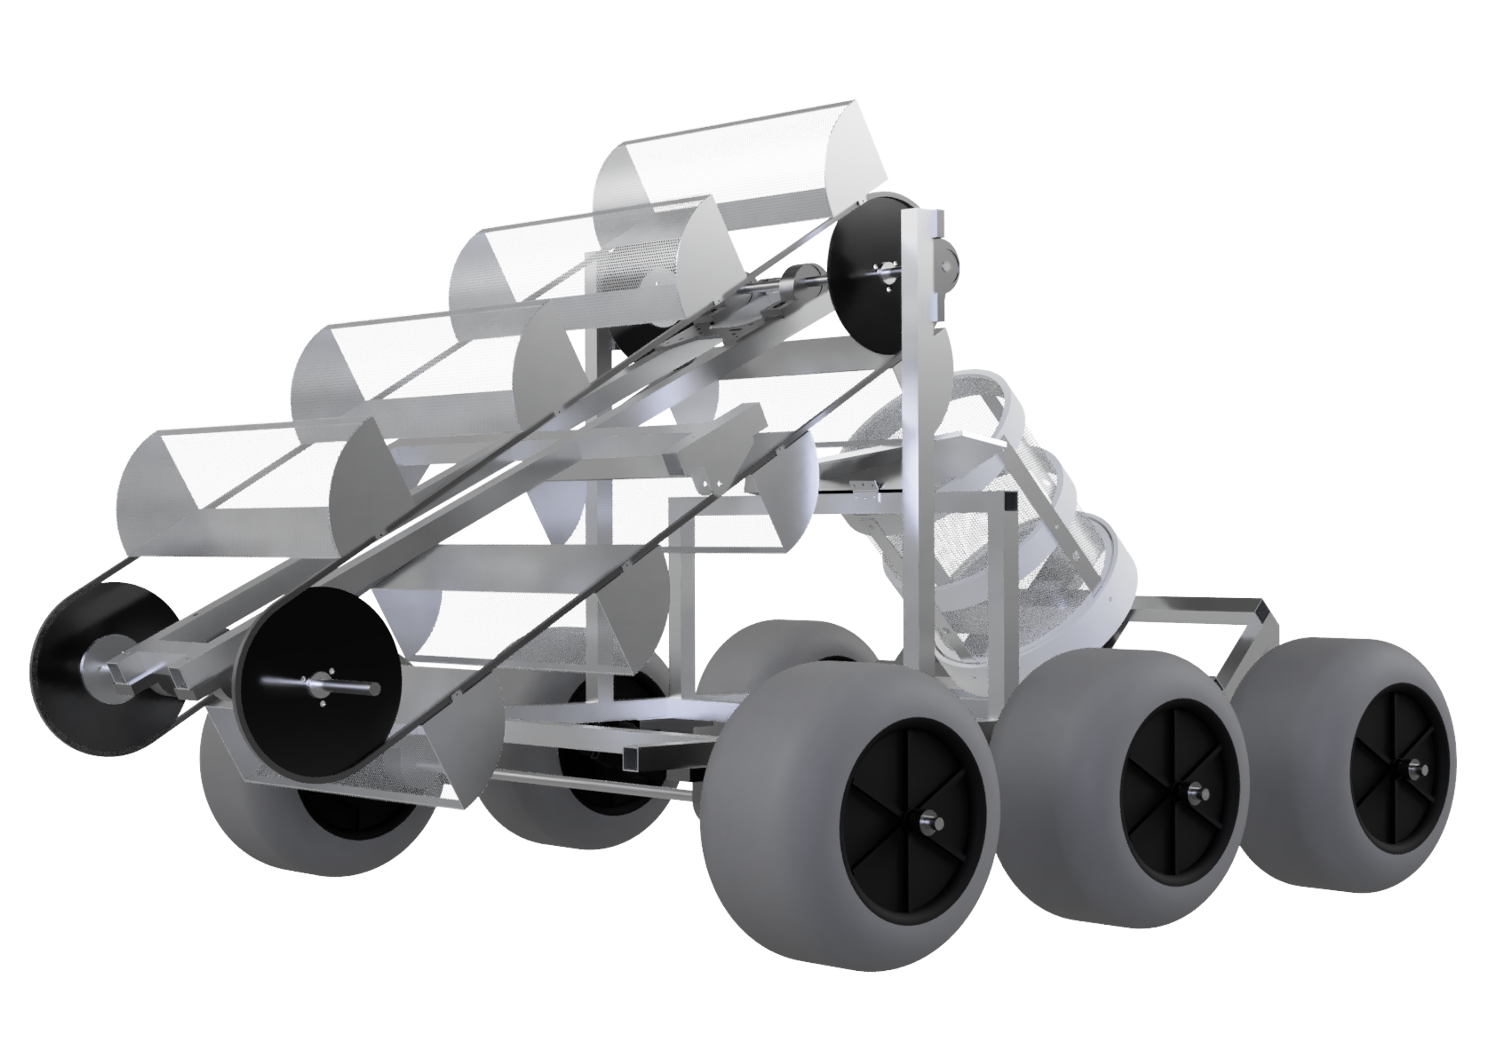
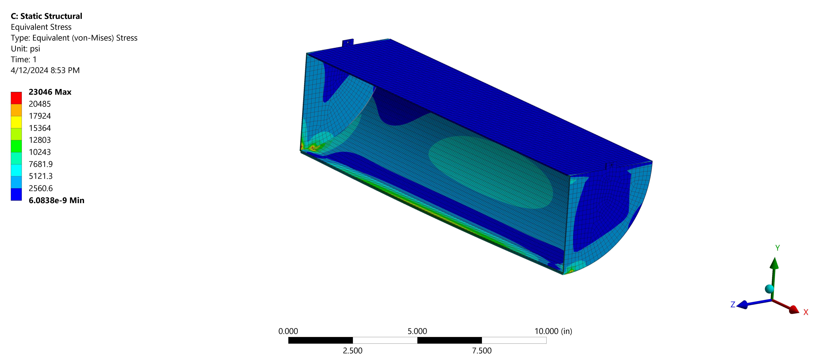
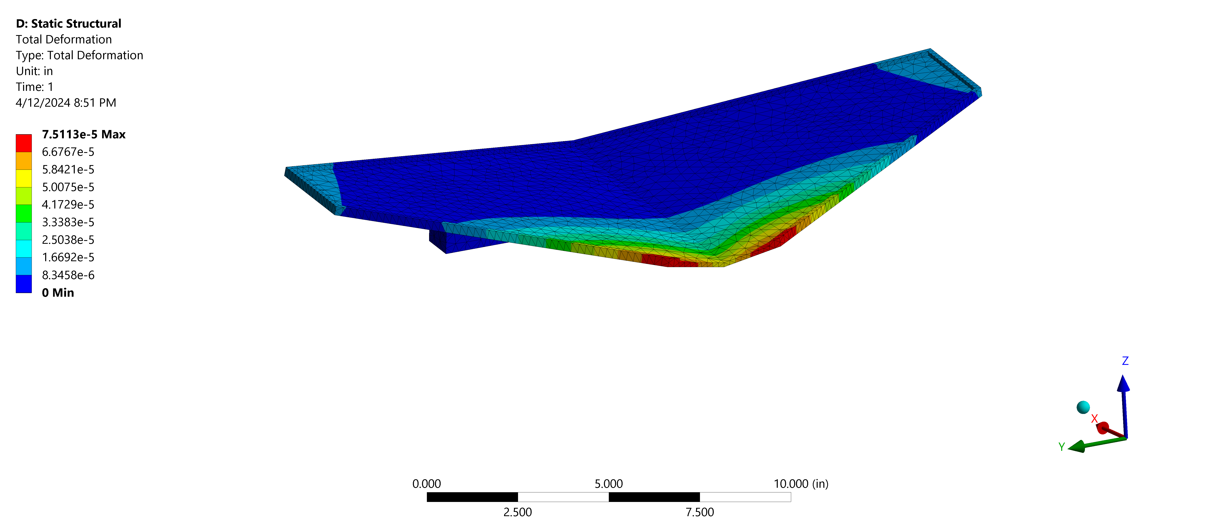
Beach Cleanup: SeAshore Navigator for Debris Excavation and Extraction (SANDEE)
Austin Harris, Sebastian Donall, Alisha Patel, Brandon Albert, Ryan Sendall, Val Shirley, Truman Davis, Krish Kalpeshbhai Parekh,
Faculty Advisor: Dr. Darshan Yadav, Dept. of Mechanical and Civil Engineering,
Florida Institute of Technology
Problem Statement
All Up Round
Although specialized beach cleaning systems already are available, they are often expensive and designed to remove specific trash from the sand. There remains a need for a simple cost-effective device that is easy to operate and maintain while also removing a variety of trash debris from the sand.
Front-End Collection
Eight mesh buckets
2:1 gear ratio
Adjustable height to depth of 1”
Rear-End Collection
Ramp funnels debris into drum
Angled at 45º to dump out excess sand
Removable mesh holding drum
Objectives
Design, build, and test a semi-autonomous beach trash collecting rover prototype
The machine shall be 100% electric and eco-friendly
Deliver a trash collection system that can separate and filter sand from debris
Controls
Eight motors and two linear actuators
Variable speed for all motors
Remote control produces inputs to vehicle
Drivetrain
All-wheel drive with tank-drive steering
Operation speed of 3.2 mph
Custom wheel adaptors for gearbox
Environmental and Societal Impacts
Environmental - Preserves marine life, reduces ingestion or getting caught up in trash and debris.
Economical - Allows local governments to improve the economy by attracting more beachgoers with clean beaches.
Societal – Parts made of non-toxic materials that can withstand extreme temperatures, making the device safe to operate in society.
Analysis
Acknowledgements
Special thanks to Ricardo Aguilar from Florida Sheet Metal, our industry advisor Richard Leake, Joseph Gervais from the City of Indialantic, the L3HSDC staff, and our GSA Ethan Bair.

