Slide 1
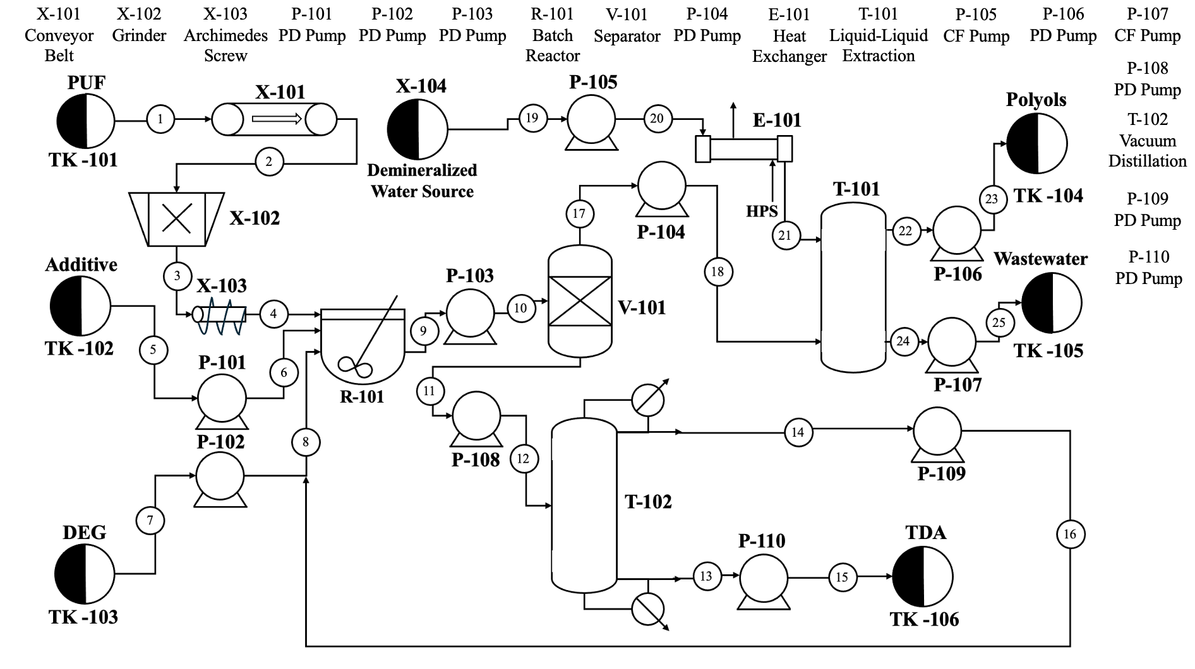
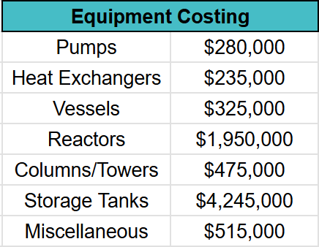
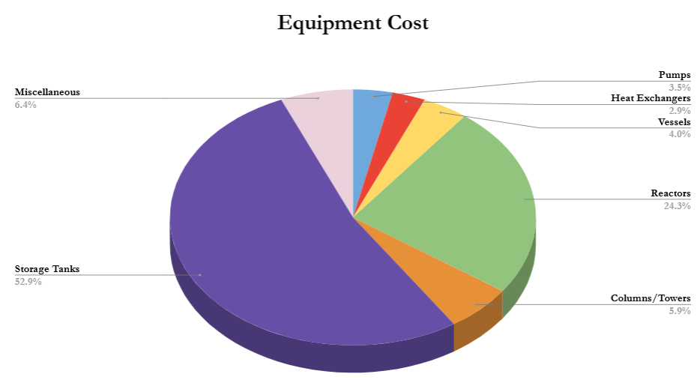
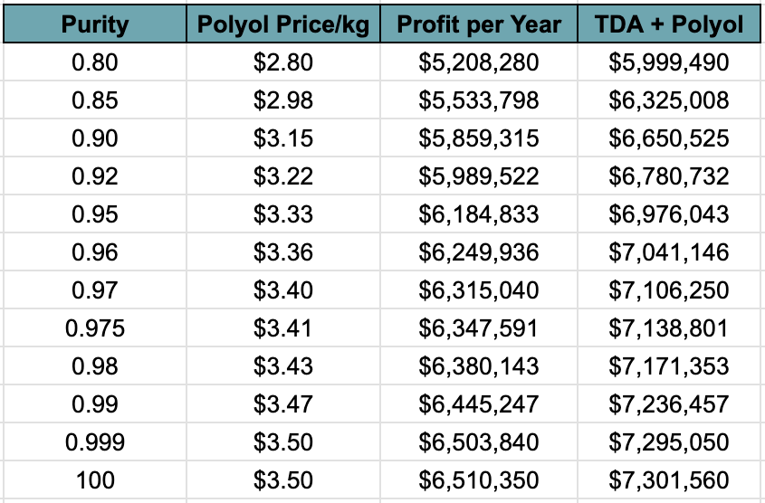
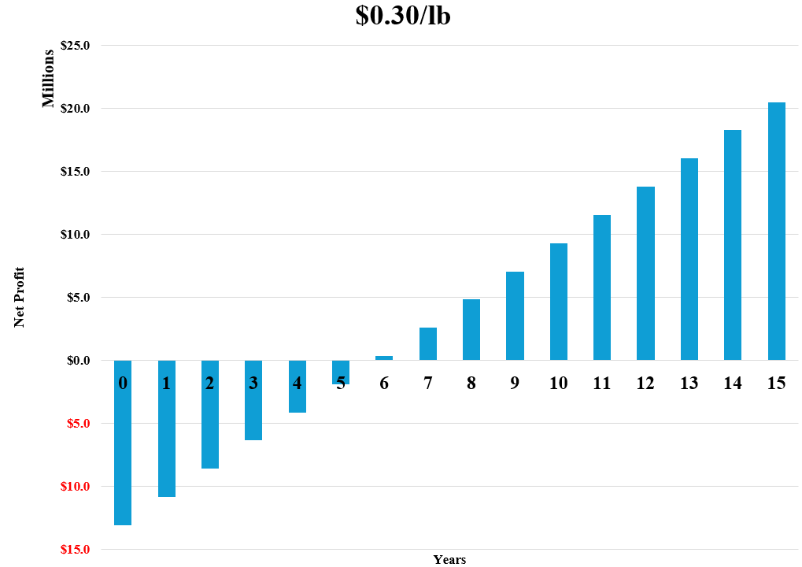
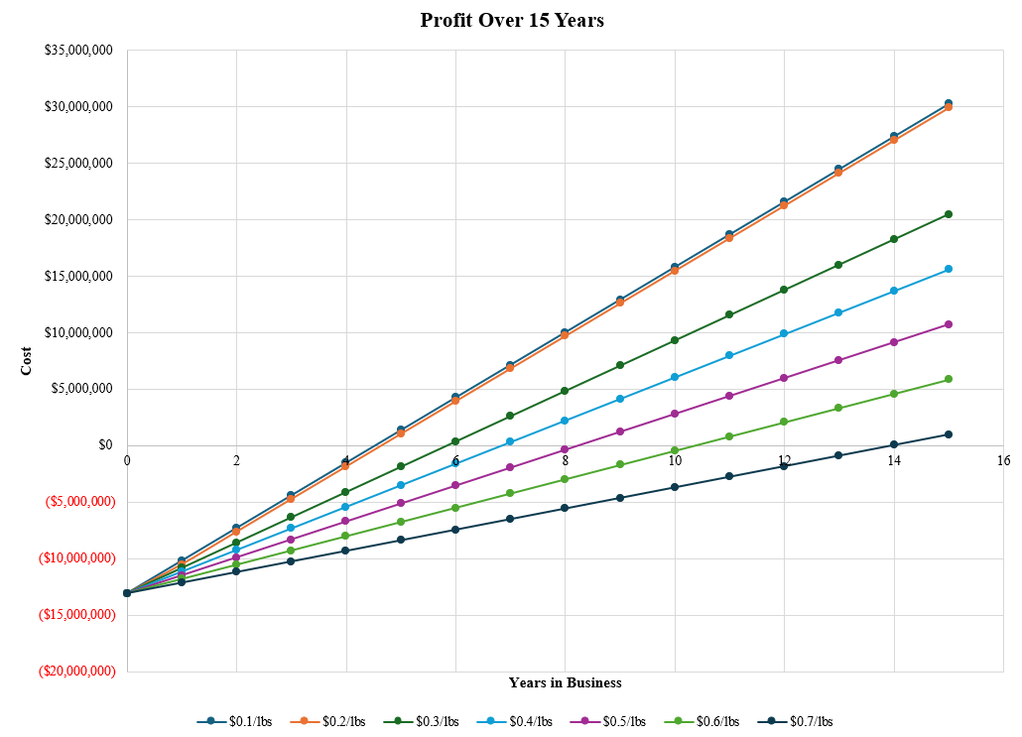
Recycling of Flexible Polyurethane Foams Using Glycolysis
Sarah Pezzenti, Tyler D’Amato, Susan Nelson and Antonella Merola
Faculty Advisor: Dr. Jonathan Whitlow, Dept. of Chemistry and Chemical Engineering, Florida Institute of Technology
Abstract
Process Flow & Identification Diagram
Equipment
Polyurethane (PU), commonly used in products like mattresses, furniture, and insulation, is often landfilled at end-of-life, especially in bulky, non-degradable forms like mattresses. This project explores industrial-scale recycling of PU foam from discarded mattresses using a split-phase glycolysis process.
Novelty
Industrial-Scale Split-Phase Glycolysis: Enables efficient separation of polyol and byproducts, improving material recovery quality.
Batch Reactors: Enhance control over reaction kinetics and product consistency, especially with post-consumer waste.
Consumer Incentive System: Encourages public participation, promoting a sustainable consumer–producer feedback loop.
Economics & Sensitivity Analysis
The processes uses a buy back system to be able to receive PUF and 3,254,162 lbs. of PUF from mattresses is the expected amount to be collected each year from drop offs and other methods.
The cost was analyzed from a range of $0.10 per pound to $0.70 per pound. $0.30 per pound was found to be the most effective cost based on profitability.
Motivation
Environmental Necessity: Repurposes non-compacting, slow-degrading waste that would otherwise occupy landfill space.
Technological Opportunity: Leverages chemical recycling advances and explores innovative reactor setups and incentive models for scalable solutions.
Multiple sensitivity analyses were performed to determine which purity of the TDA, purity of the polyols, and price per pound would result in the most profitable option.
Summary
Recovering high-purity polyol from post-consumer PU foam
Batch reactors ensuring consistent yields and reaction control
Demonstrating scalability of split-phase glycolysis for industrial use
Initial findings support a circular recycling model
Potential economic and environmental benefits with incentive-based collection

