Slide 1
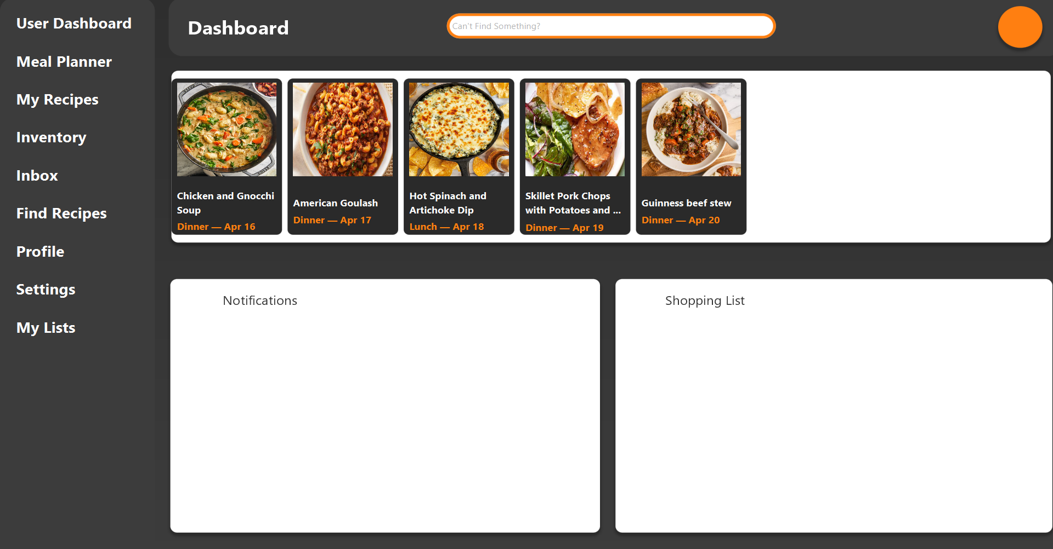
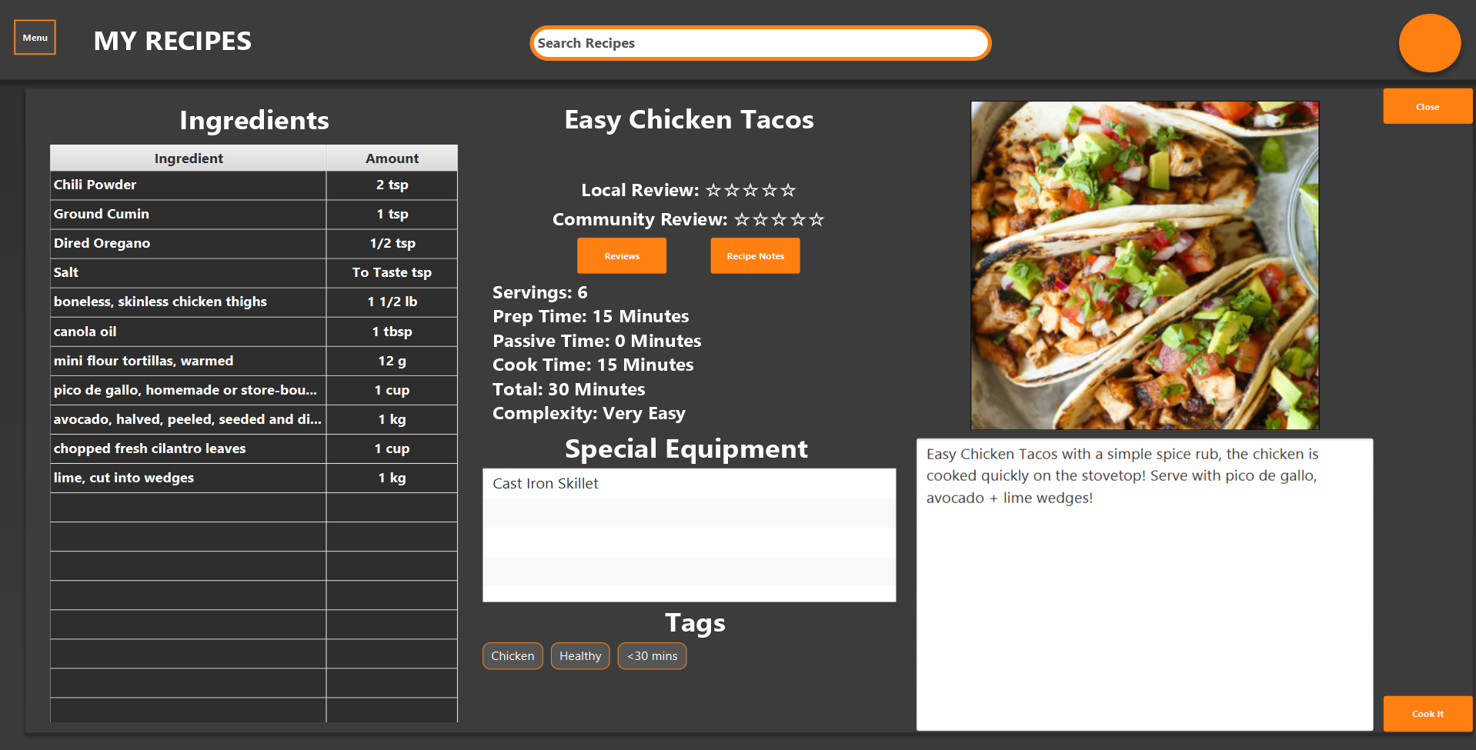
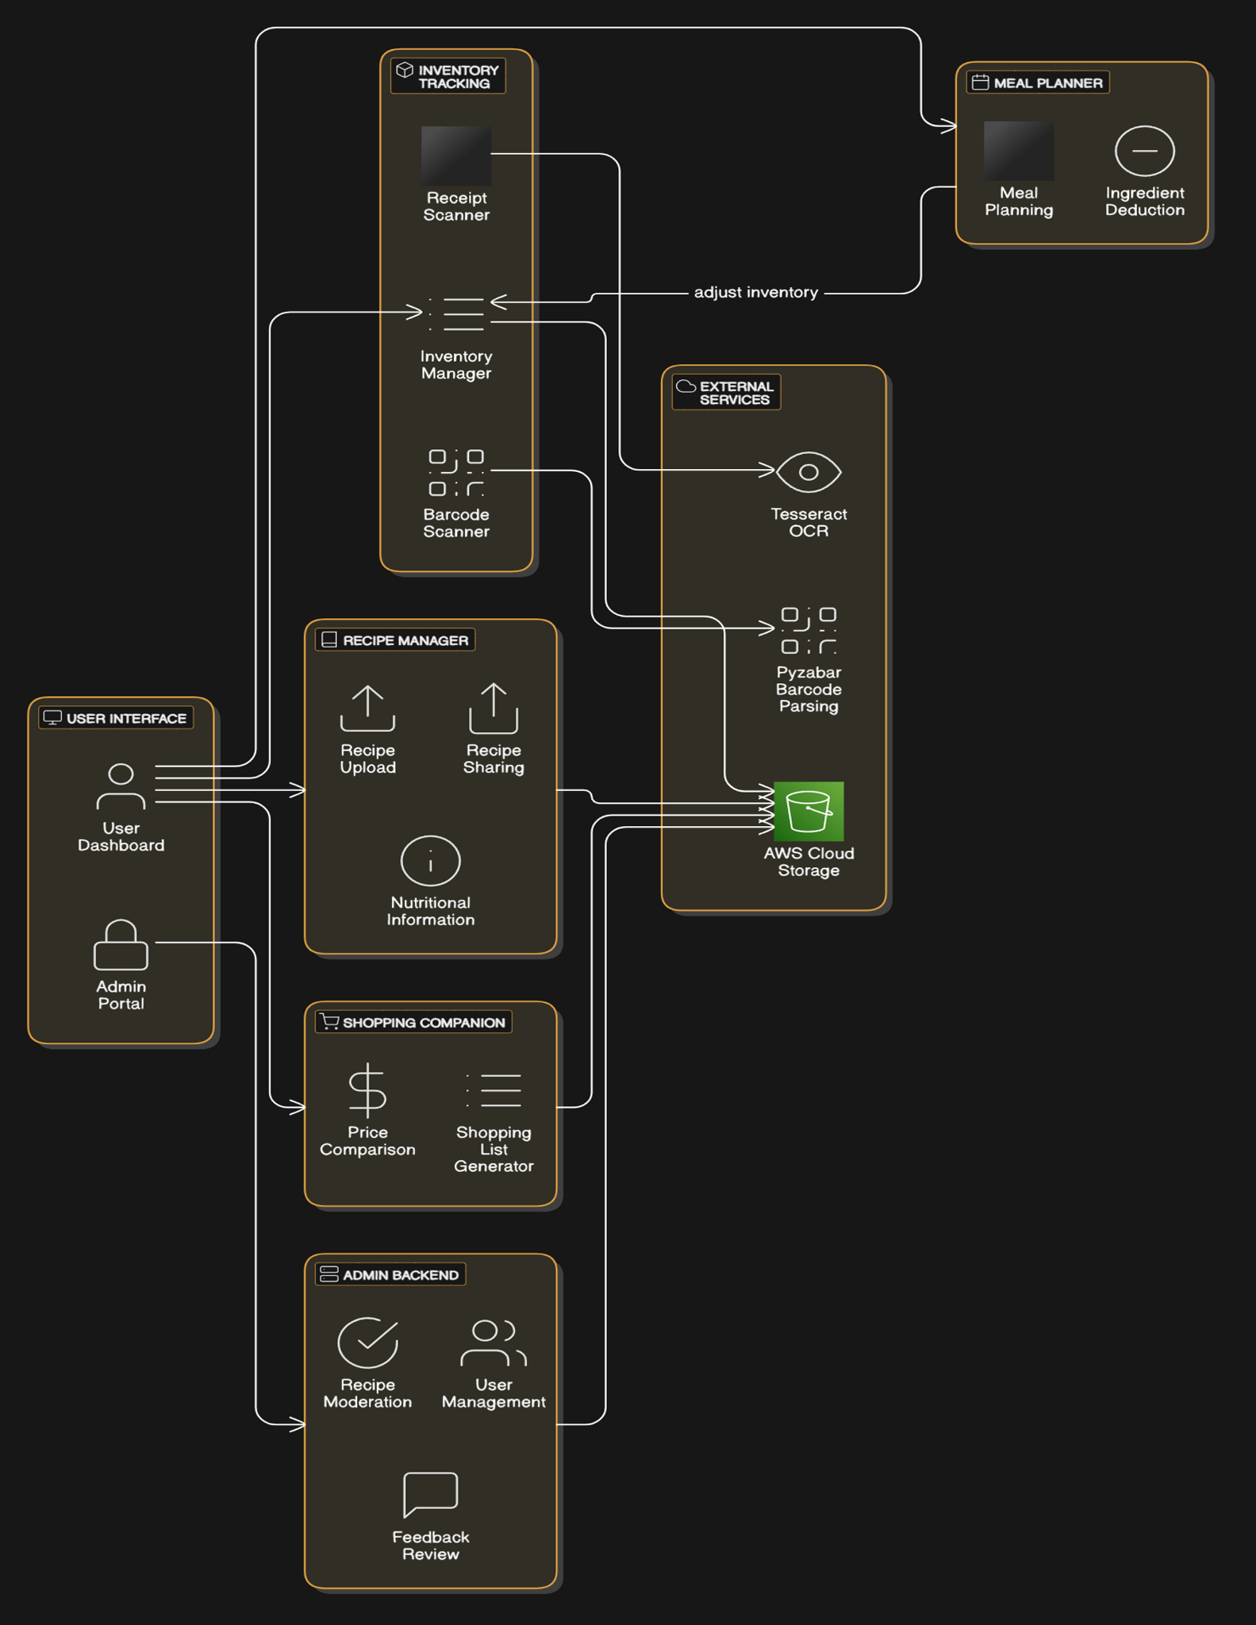
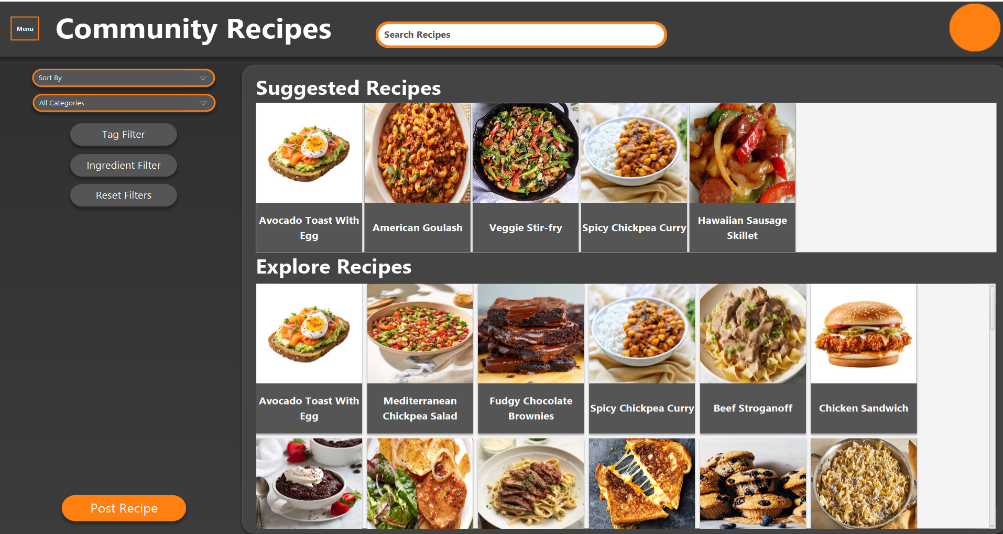
KitchenSync: A Pantry and Recipe Companion
Tyler Son, David Tran, Chris Nederhoed
Faculty Advisor: Dr. Fitzroy Nembhard, Dept. of Computer Science, Florida Institute of Technology
Background
Why KitchenSync? Global household food waste: > 1.3 billion tons per year—home cooks need better visibility on what’s on hand Fragmented toolchain: recipe apps, grocery lists, and inventory trackers all separate Time‐pressed users: busy families, students, professionals struggle to plan meals efficiently
Approach
System Architecture
JavaFX desktop UI ↔ Python microservices ↔ AWS DynamoDB (data)
OCR & barcode modules (pyzbar, pytesseract)
REST calls to Open Food Facts, USDA Food Data Central
Price‐scraping microservice for store APIs
Algorithms & Tools
Inventory‐to‐recipe matching via set‑difference + substitution heuristics
Tag‐based filtering and recommendation ranking
DynamoDB tables: Users, Inventory Items, Recipes, Meal Plans, PriceData
Implementation
User Dashboard
Key Features of KitchenSync
The user can track inventory by updating the pantry’s information based on whether an item was removed or added. Items can be tagged based on what the user wants. While shopping, a barcode can be scanned and uploaded into the kitchen’s inventory. Key information such as where it is location in the kitchen and the expiration date can be inputted by the user.
The user can manage and share recipes by storing all recipes in one place. The user can also upload their own recipes and rate other recipes. Recipe cards can recommend alternative ingredients as needed. In addition, nutritional information will be provided next to recipes and recipes can be tagged based on that and other information like time to cook, complexity, and cost.
The user can plan their meals through placing recipe cards onto a meal planning calendar..
Recipe Details Screen
System Diagram
Community Page
Software Tools Used

