Slide 1
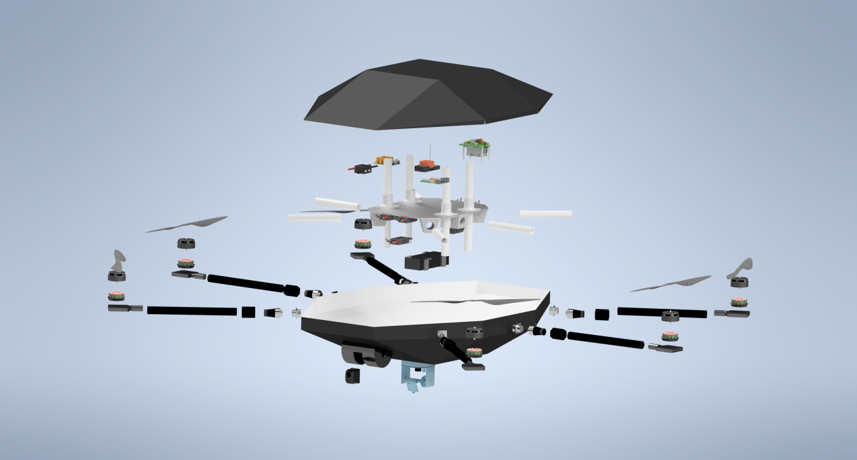
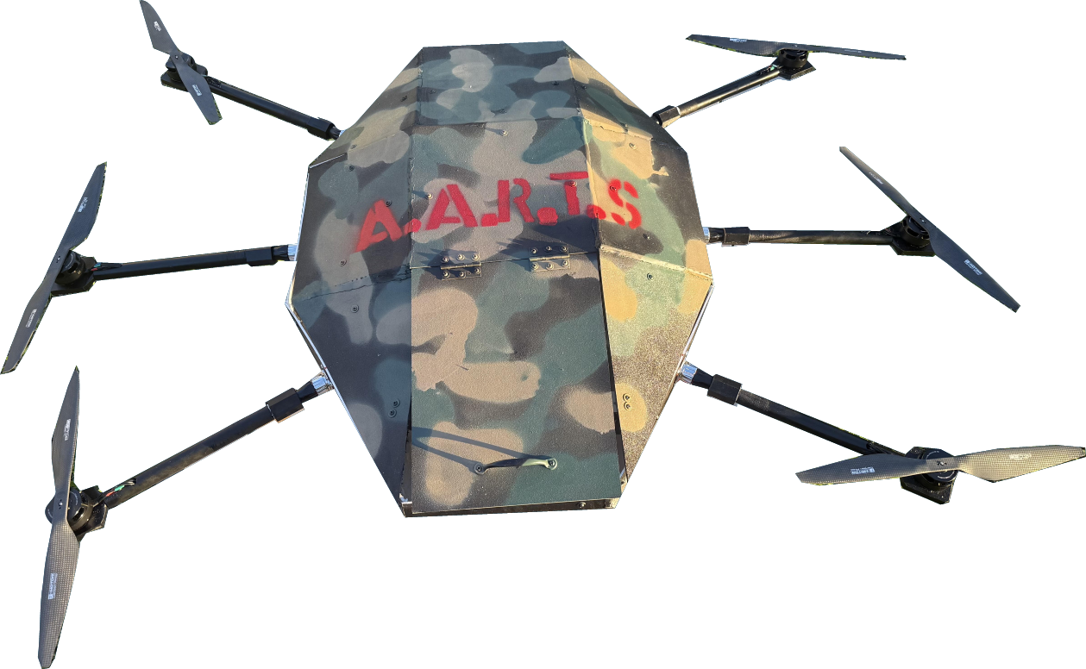
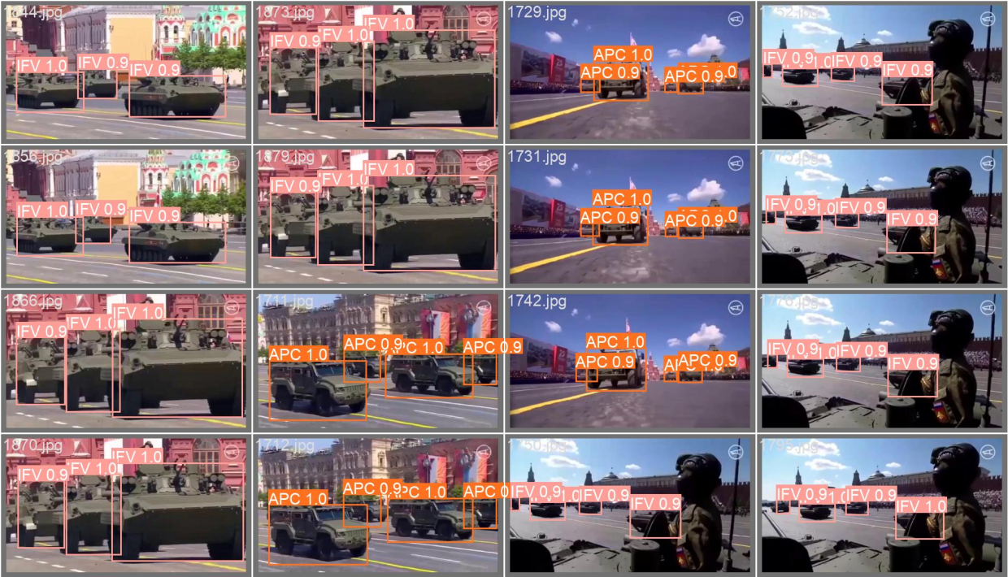
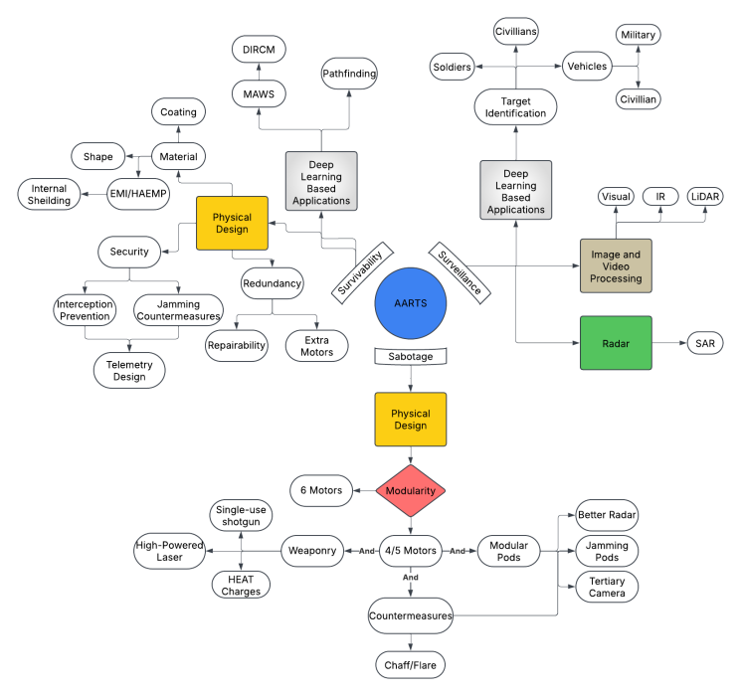
Aerial Automatic Recon and Targeting System (AARTS)
Cade Miles, Jackson Jurevich, Benjamin Stompor, Colton McReynolds
Faculty Advisor(s): Dr. Lee Caraway, Dept. of Electrical Engineering, Florida Institute of Technology
Summary:
A fully modular recon and support drone that can travel with and provide support to tank units and infantry divisions. The drone will be sent from its armored vehicle or infantry unit where it will be controlled by an operator. The image capture system will collect visual and LWIR thermal data which will be fed to a learning model to identify the target. If the operator is in a turreted vehicle, they can use the drone's laser range finder to help adjust turret rotation. The position of the target will be triangulated, and the turret will move accordingly.
Software:
Target Identification Models: Trained visual and thermal deep learning models to identify targets
SAR Modeling: Simulated aerial Synthetic Aperture Radar images for target recognition in poor weather and through thin objects
Targeting System: Acquire the target based on the target ID models, then triangulate the position of the target using the laser range finder, and relay information to the user
Automatic Flight Control/Flight System: Execute preprogrammed flight paths, preform automatic maneuvers, set positions, trace paths, etc.
Figure 1: Exploded Diagram of AARTS
Electronics:
Flight Controller: Helps maintain consistent flight, has programmable flight actions, connected with GPS, has communication telemetry, and provides fine motor control
Visual Systems: Uses EO/IR camera, IR camera for Missile Approach Warning System, and has omni-directional camera pod
Computer Systems: Visual processing, diagnostic microcontrollers, and secondary computer to run deep learning models
Laser Range Finder: Mounted to a camera pod to triangulate target position up to one kilometer
Figure 2: Completed Assembly of AARTS
Figure 4 : Visual Target Identification Model
Future Research:
Mechanical and Electrical:
  Updating DIRCM module to be slimmer with additional functionality
  Adding modular attachments and sensors
  Software:
  Increasing capabilities of Deep Learning models
  Testing:
  Performing more test flights to evaluate in-air performance
  Flexibility:
  Widen the scope of capabilities to broaden flexibility to other industries
Mechanical Design:
Body: Aluminum mounting plate and ABS plastic shell
Motors: Maximum total lift of 60 pounds
Material Study: Done to determine the best material/coating combination
Modular Arms: Hot swapable arms that allow for endless modular possibilities
Figure 3: System Overview Diagram

