Slide 1
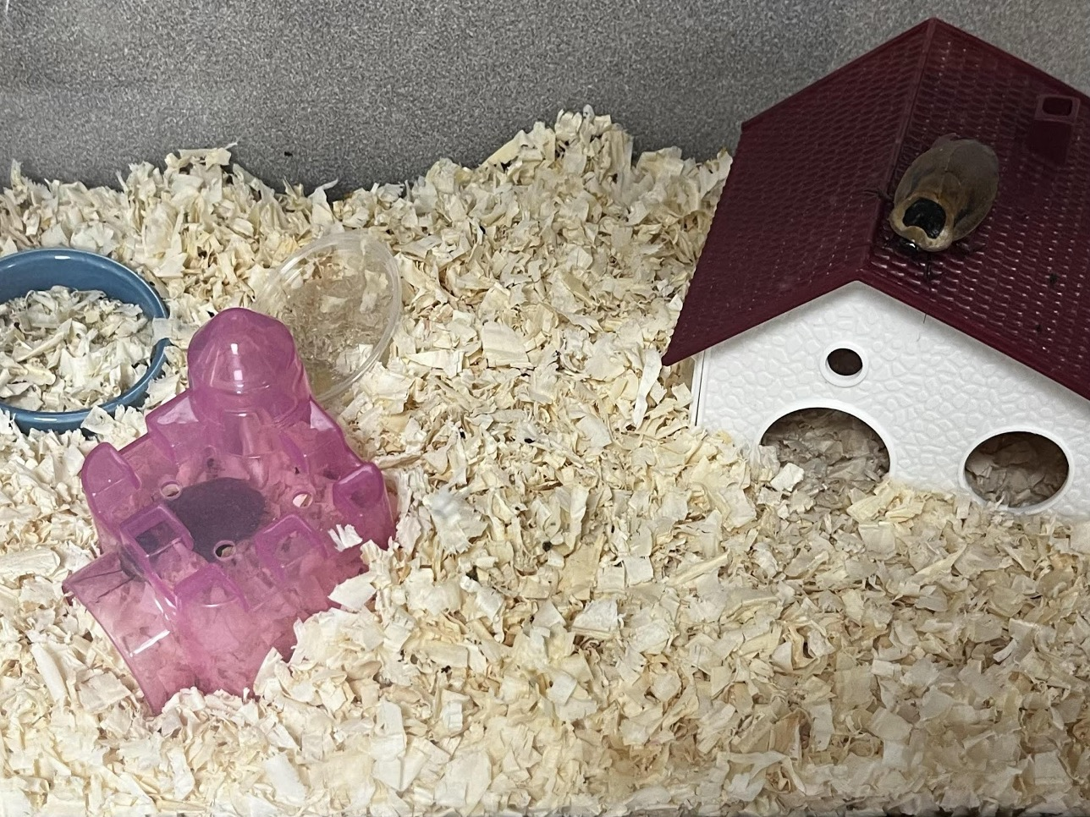
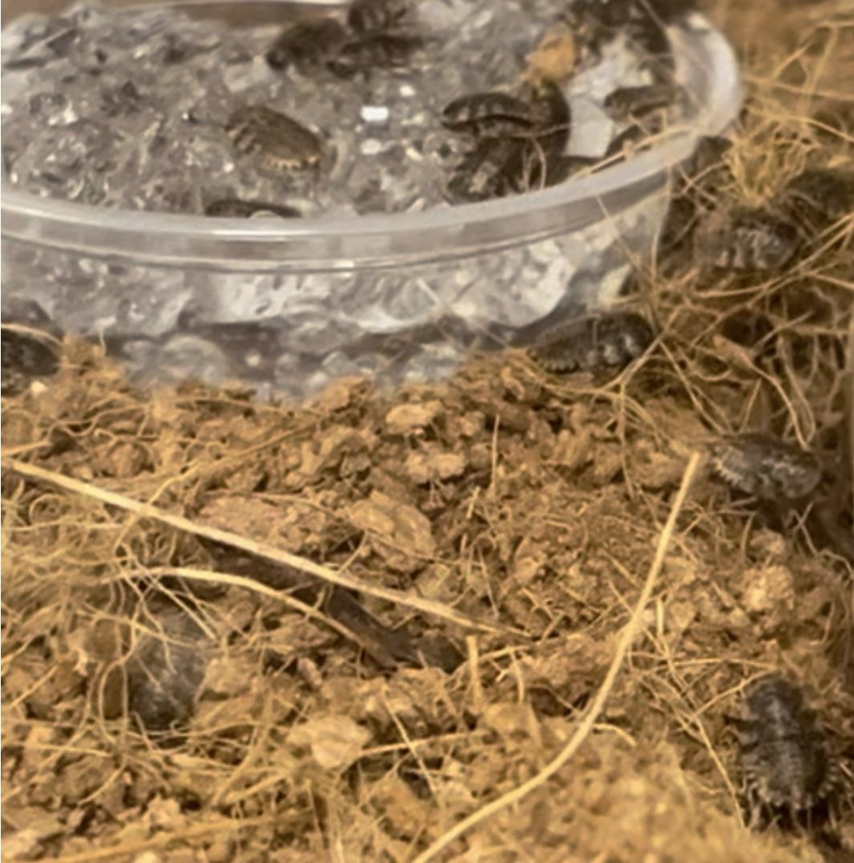
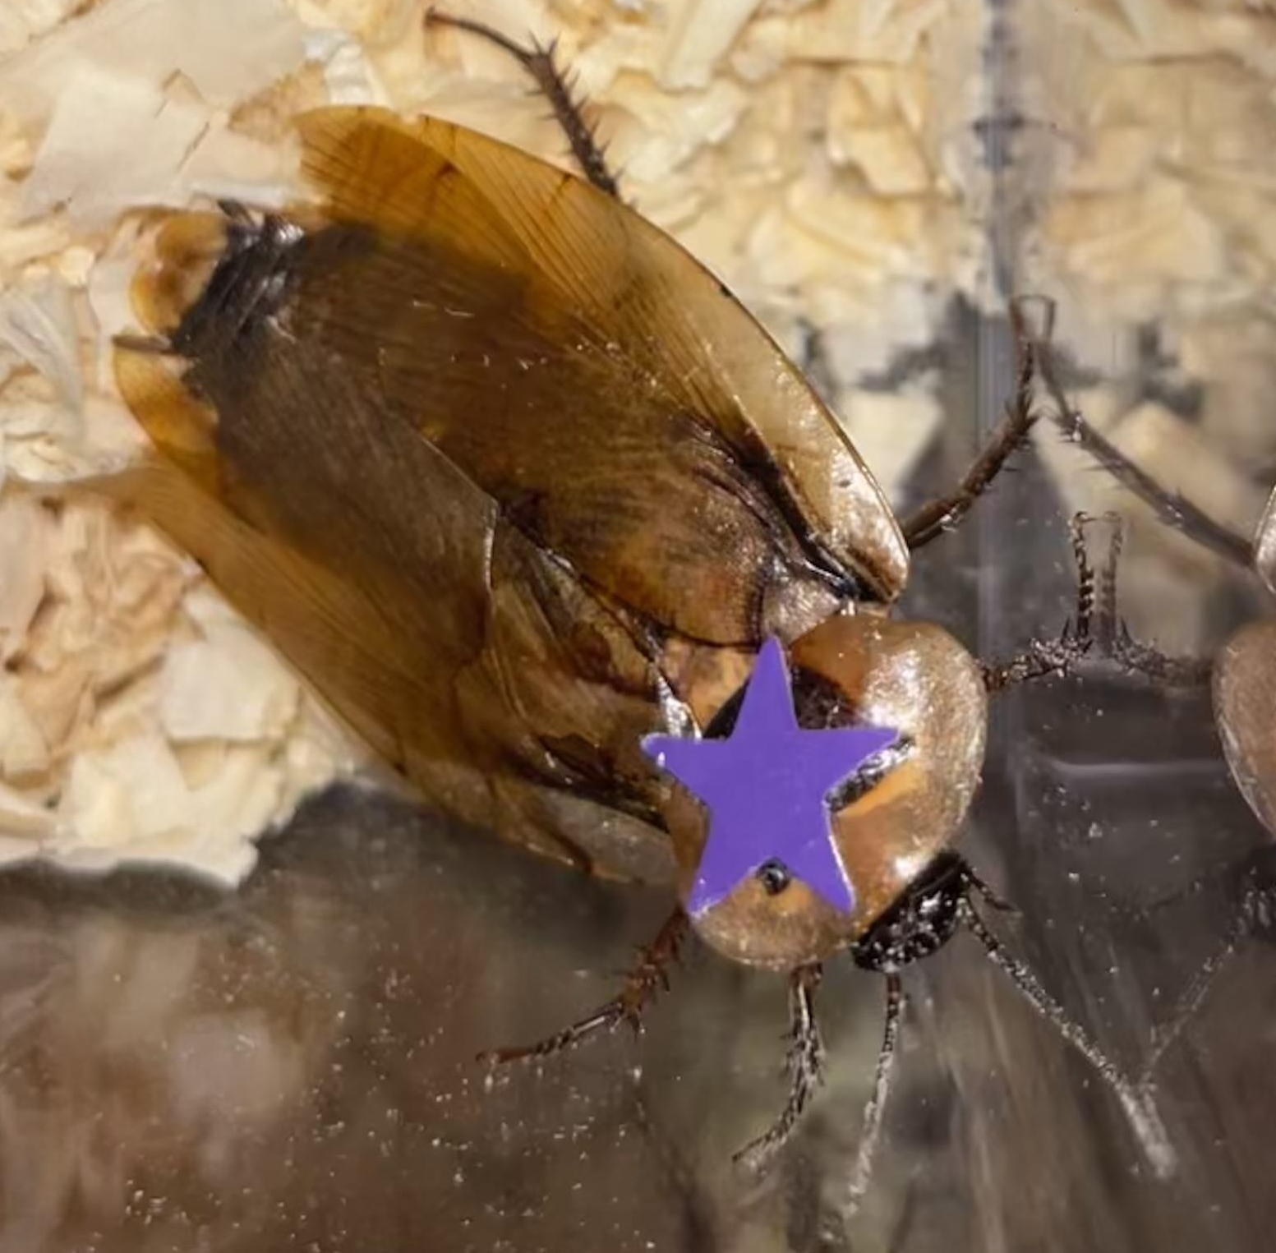
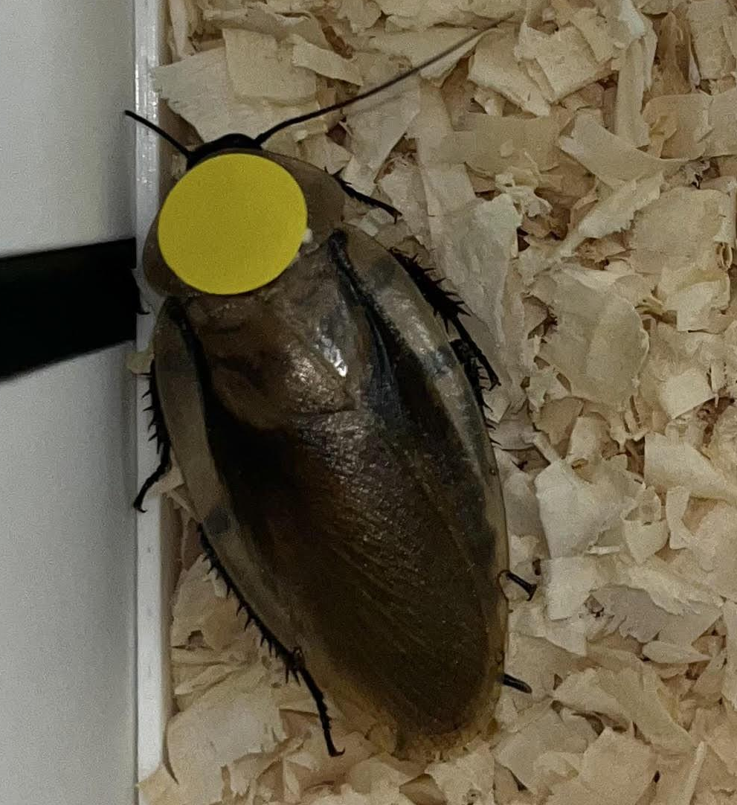
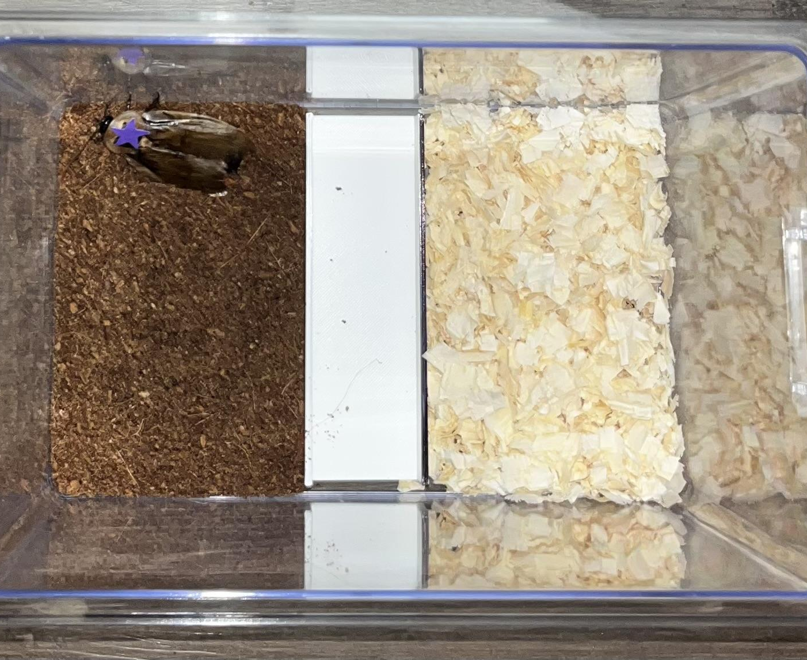
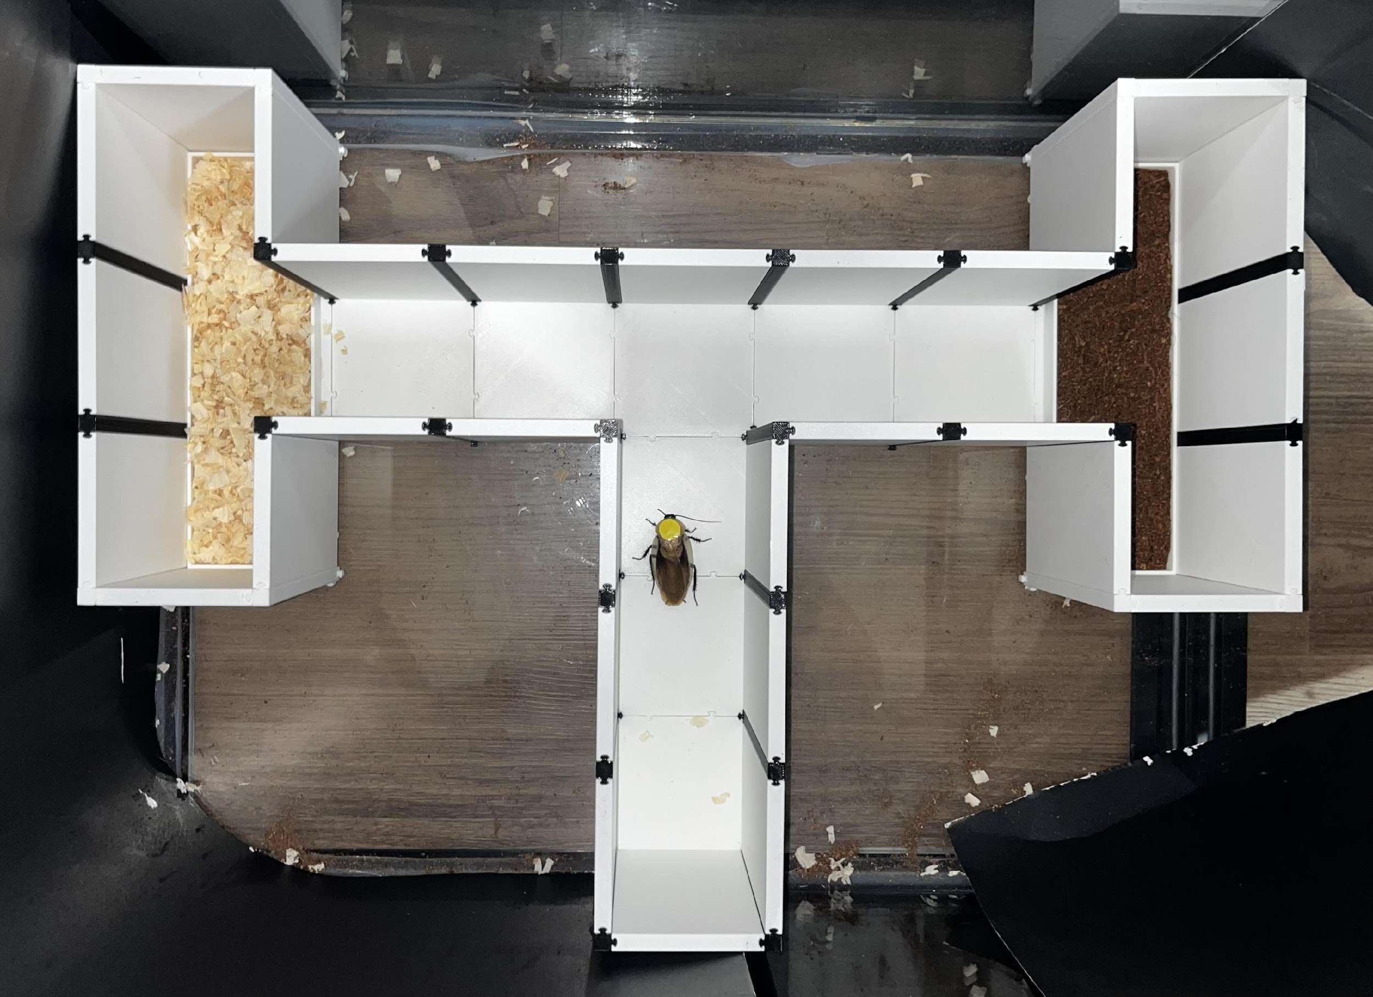
Bug brains: Are discoid cockroach (Blaberus discoidalis) substrate preferences fixed or plastic?
Lauren Lewis
Faculty Advisor: Dr. Darby Proctor, Dept. of Psychology, Florida Institute of Technology
Introduction
Results
Discussion
With over 4,500 species, cockroaches are one of the most widespread animal groups, thriving in diverse environments across nearly every continent. Despite their abundance, relatively little is known about their behavior and cognitive abilities. Blaberus discoidalis is a burrowing species found in substrates like decaying logs, and leaf litter^{1,2}, making it a valuable model for investigating habitat choice through substrate preferences. Here, we explored whether these preferences are fixed or influenced by rearing history by raising cockroaches in pine bedding (commonly used in animal care), coconut fiber (recommended for burrowing), or without a burrowing substrate (direct from a breeder). We also examined how testing environment (arena vs. T-maze) might shape behavior (Figure 1).
To assess substrate preference, the percentage of time spent in fiber was subtracted from the spent in pine, with positive values indicating a preference for pine. An independent t test showed no significant difference in preference between cockroaches tested in the arena (M = 0.30, SD = 0.27) or the maze (M = 0.30, SD = 0.57), t(32.6) = 0.04, p = .97, d = 0.01, so the conditions were combined for the remaining analyses.
There were no significant differences between cockroaches raised in fiber (M = 0.32, SD = 0.47), pine (M = 0.30, SD = 0.44), or no substrate (M = .28, SD = .42), one-way, between-subjects ANOVA F(2, 45) = 0.03, p = .97, 𝞰² < .001, indicating that rearing history did not influence substrate preference, Figure 3.
However, roaches spent a significantly greater proportion of time in pine (M = 0.65, SD = 0.21) than in fiber (M = 0.34, SD = 0.22), paired t(47) = 4.77, p < .001, d = 0.69. This indicates that discoid cockroaches demonstrate a species level preference for pine shavings, Figure 4. This appears to be an effect of experience, as there was no initial contact bias for one substrate over the other (54% pine, 46% fiber, binomial test, p = .66) and this did not vary by rearing history (χ² = .17, p = .92).
Discoid cockroaches showed a species-level preference for pine bedding, likely due to its structural similarity in interstitial spaces⁴ to leaf litter, their natural habitat, Figure 5. This preference does not appear to be driven by factors like scent, as initial contact with substrates was equally likely, indicating roaches explored the maze and then settled on a preference. These findings suggest a fixed bias toward substrates resembling leaf litter, though further testing is needed. Importantly, the use of pine bedding may enhance cockroach welfare in labs by promoting behaviors aligned with their wild counterparts.
However, substrate preference may also be influenced by environmental factors such as humidity, pointing to potential behavioral plasticity. Given the uniform, climate-controlled conditions of our lab, future research should explore how varying environmental contexts affect preference. Such work would clarify the role of local environmental cues in habitat selection and deepen our understanding of cockroach adaptation.
Figure 1: Pine bedding vs. coconut fiber
Figure 3: No effect of rearing history
Figure 5: Cockroaches in pine bedding
Methods
Subjects were 48 discoid cockroaches, equally split by sex and rearing history (pine, fiber, none) and tested in either an arena or T-maze, Figure 2, across two five-minute trials with counterbalanced substrate locations. Video recordings were used to code time spent in contact with each substrate. Proportions were calculated based on total time spent in contact with any substrate.
Figure 4: Cockroaches prefer pine bedding
Figure 2: Testing environment
References
¹Maekawa et al., 2003; ²Bell et al., 2007; ³Kandilian, n.d.; ⁴Snoddy & Appel, 2013
Acknowledgements
Special thanks to undergraduate Roach Lab Research Assistant Maddy Marasco for contributing to data collection!

