Slide 1
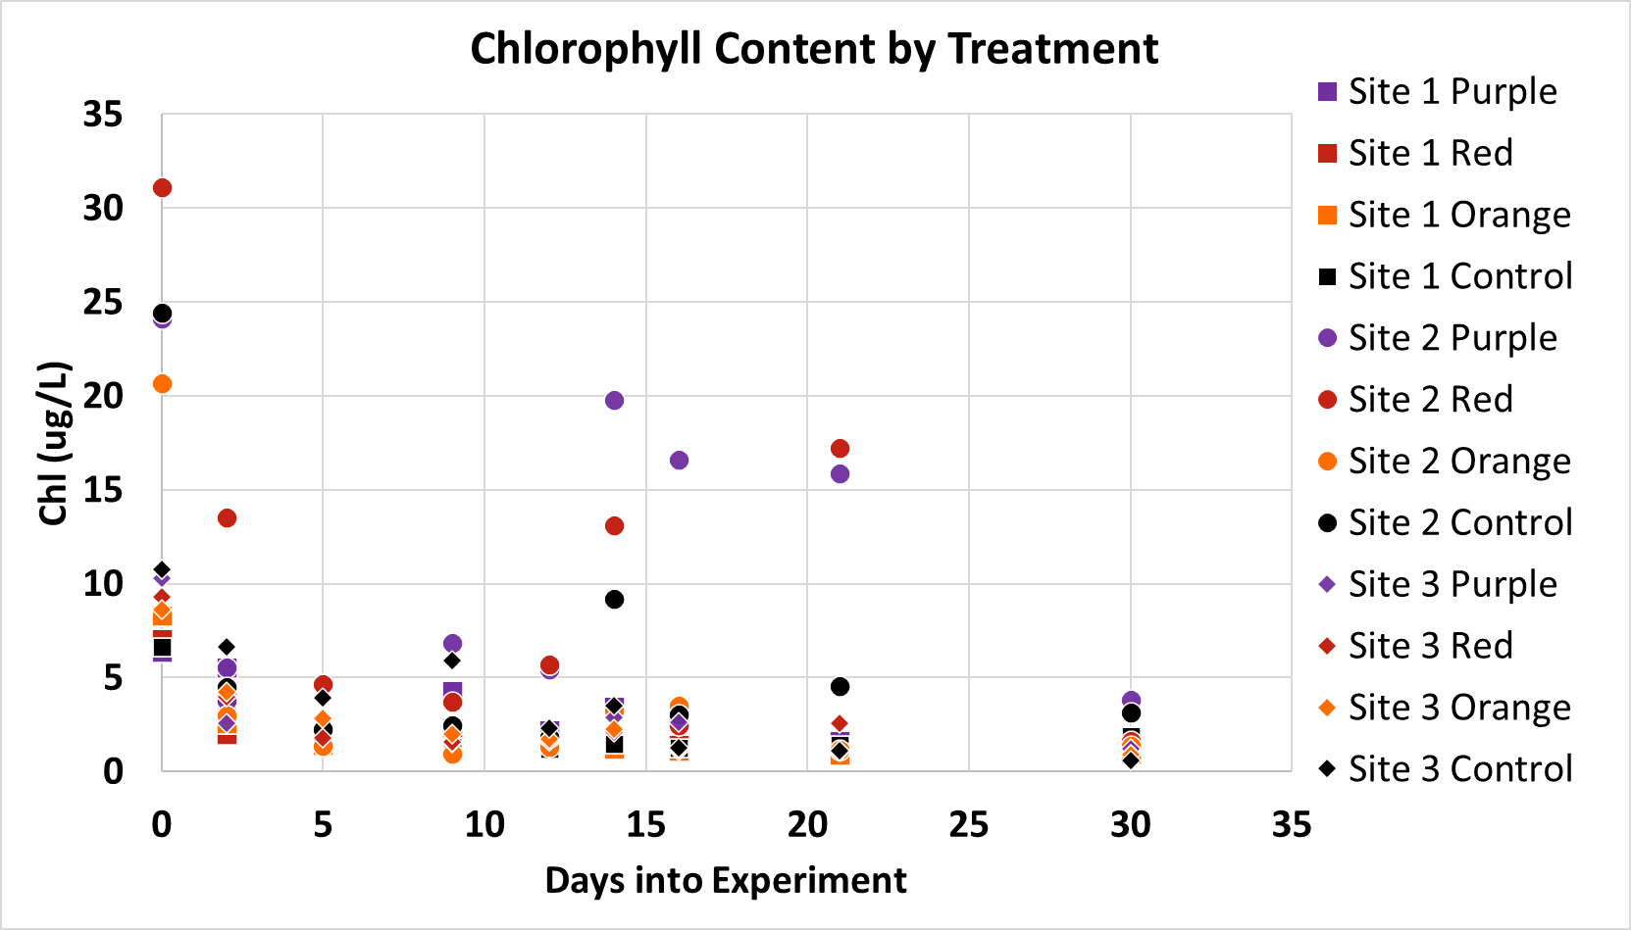
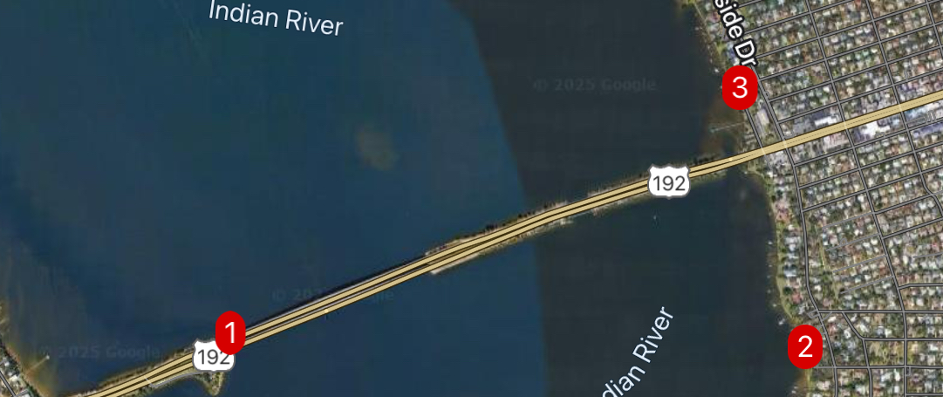
The Effects of Artificial Light on IRL Chlorophyll Content
Julia Lonks
Faculty Advisor: Dr. Austin L. Fox, Dept. of Ocean Engineering and Marine Sciences, Florida Institute of Technology
INTRODUCTION
Marine phytoplankton are responsible for over 50% of Earth's global photosynthesis, and are vital for carbon drawdown, and form the base of the aquatic food webs. During the daytime, less than ten percent of the sun's energy is converted and available to primary consumers. In the past 150 years, the invention and proliferation of the light bulb have led to abundant artificial light at night (ALAN). All organisms, from humans to phytoplankton, rely on light to control internal biological functions; the most important for this study is the effect of ALAN on photosynthetic activity. As ALAN intensity's extent increases at about two percent per year, understanding the impact of nighttime light on phytoplankton and marine ecosystems is increasingly critical. The increased intensity and varying wavelength of light may impact the extent of artificial light influence on phytoplankton populations in coastal ecosystems.
ad
OBJECTIVES
This study aimed to analyze the effects of different wavelengths of ALAN in the Indian River Lagoon, near the Melbourne Causeway, through laboratory experiments. The expected results were for phytoplankton growth to be greater when exposed to light at night and most significant for purple, orange, and then red. Our objective was to determine the extent that different wavelengths of ALAN impact local phytoplankton communities.
METHODS
We collected IRL water samples by bucket and transitioned 1500 mL samples into glass jars stored in a water bath by treatment. Four treatments with three sample jars were enclosed in blackout plastic. We attached purple, orange, and red color films to the lights and dimmed the intensity with neutral masking tape to mimic ALAN. The samples were cultured for four weeks in a 12:12 hour light:ALAN cycle. A Sonde YS1 measured DO, pH, salinity, temperature, and chlorophyll concentration. Data points were averaged over five random consecutive points using Google Sheets and Scripts.
RESULTS
DISCUSSION & CONCLUSION
There was no significant change across treatments and a gradual downward trend over time. We expected there to be a greater chlorophyll content in the tanks with ALAN compared to the dark control; however, the only difference occurred with Site 2; it started at a higher chlorophyll content and had a spike after additional water was added to ensure accurate readings due to evaporation loss. None of the other treatments had a noticeable change, likely because of the lower phytoplankton content. The lack of abundance of phytoplankton in the collected samples and the insignificant effect of ALAN on the surface waters is notable in that lights may not significantly impact marine life due to light attenuation and low incidence of phytoplankton.
Figure 3. Chlorophyll content throughout the experiment by site and treatment. Graph produced using Microsoft Excel.
Source | Sum of Squares | df | F-Value | p-Value
C(Treatment) | 135.4671 | 3 | 1.4804 | 0.2242
Residual | 3172.3196 | 104
Figure 1. Sample locations along the Indian River Lagoon. Map produced using MGRS.
Figure 2. ANOVA results produced using Python.
SOURCES AND ACKNOWLEDGEMENTS
Kyba, C., Kuester, T., Sánchez de Miguel, A., Baugh, K., Jechow, A., Hölker, F., ... & Guanter, L. (2017). Artificially lit surface of Earth at night increasing in radiance and extent. Science advances, 3(11), e1701528.
Smyth, TJ, et al. (2022). Disruption of marine habitats by artificial light at night from global coastal megacities. Elem Sci Anth, 10: 1. DOI: https://doi.org/10.1525/elementa.2022.00042 Jechow A, Hölker F. (2019). How dark is a river? Artificial light at night in aquatic systems and the need for comprehensive night-time light measurements. WIREs Water. 6:e1388. https://doi.org/10.1002/wat2.1388 Diamantopoulou C., Christoforou E., Dominoni D.M., Kaiserli E., Czyzewski J., Mirzai N., Spatharis S. (2021). Wavelength-dependent effects of artificial light at night on phytoplankton growth and community structure. Proc. R. Soc. B288:20210525. https://doi.org/10.1098/rspb.2021.0525 I would like to thank Dr. Fox and Ben Crews for their help throughout the design and implementation.

