Slide 1
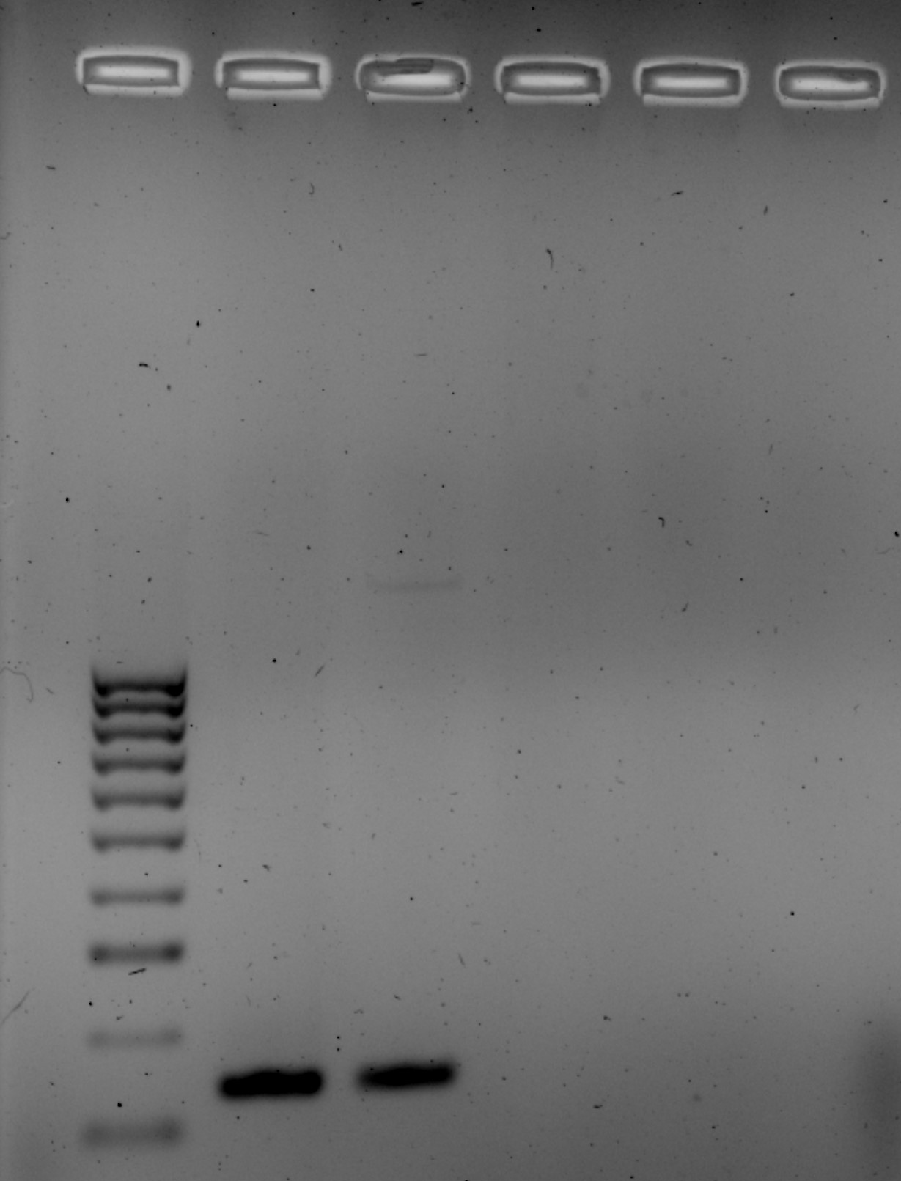
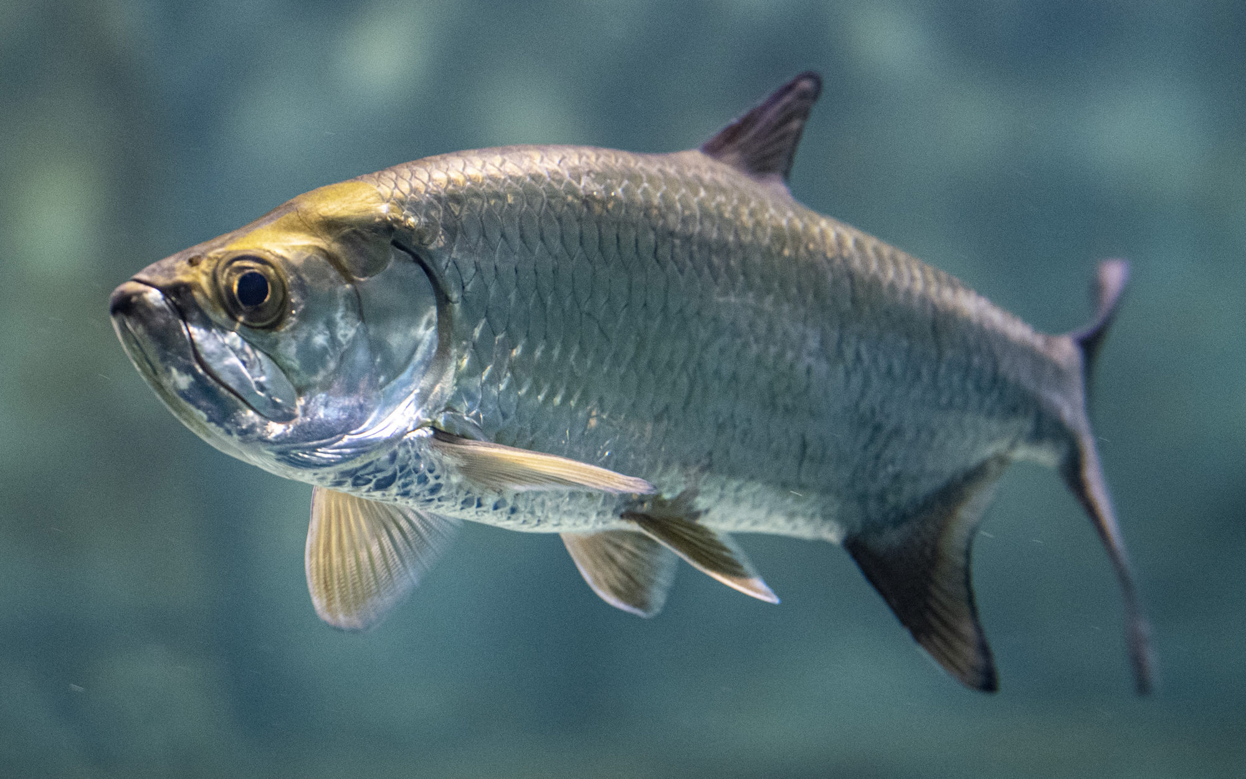
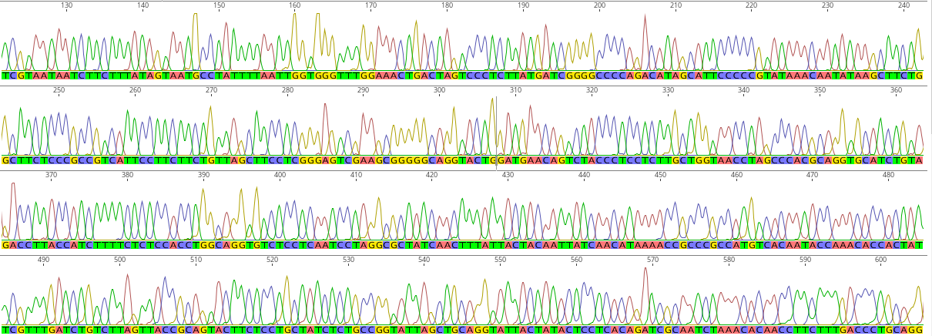
Species-specific eDNA detection of Atlantic Tarpon
Paolo A Soto
Faculty Advisor(s): Dr. Toby Daly-Engel, dept. of Ocean Engineering and Marine Sciences, Florida Institute of Technology
Dr. Jeff A. Eble, Florida Program Director, Hubbs Seaworld Research Institute
Introduction:
Florida’s sport fisheries are a vital economic resource for the state, providing $13.9 billion in revenue annually^{[1]}. The Atlantic tarpon (Megalops atlanticus) is among the most popular target fish in the state due to its large size and fighting ability. Though fishermen use catch-and-release, there are many fishing tournaments that target tarpon and other large species^{[6]}. Even when the fish is released, angling is known to cause increases in stress indicators such as lactate^{[2]}. Additionally, tarpon use structurally complex habitats as nurseries^{[4]}, making it difficult for scientists to collect DNA samples for assessing population dynamics. They have declined from overfishing and habitat loss and are listed as vulnerable on the IUCN Red List^{[5]}. We sought to create a tool for the remote genetic detection of tarpon using environmental DNA (eDNA), which is trace DNA shed by an organism into its environment. Instead of being taken from the animal, eDNA can be taken from filtered seawater, a noninvasive method that can be effective in areas where tarpon cannot be easily caught^{[3]}.
Specific Objectives:
Develop a targeted, single-species eDNA protocol for reliable detection of Atlantic tarpon.
Methods:
  Two juvenile Atlantic tarpon provided by Dr. Jon Shenker.
  Nontarget tissue samples of ladyfish, Indo-Pacific tarpon, needle-tooth moray collected from various institutions.
  DNA was extracted with the EZNA blood and Tissue kit (Omega Bio-Tek, Norcross, Georgia).
  Species specific primers developed using the software Primer-BLAST (NIH).
  A 141 base pair region of the 12S gene was targeted for polymerase chain reaction (PCR). This was sequenced at the University of Arizona Genetics Core (Tucson, AZ).
Results:
Preliminary results show some primer binding to the non-target Indo-Pacific tarpon in the third well. Our next steps to increase specificity would be to add bovine serum albumin and MgCl to our PCRs.
Discussion:
For best management practices, it is important to understand the distribution and relative diversity of tarpon in Florida waters. As traditional catch methods put heavy physical strain on the animal, having an alternative non-invasive method of surveying would be useful. Additionally with a validated protocol it is possible to produce abundance estimates using sequence copy number. Our preliminary data shows our protocol can successfully target tarpon DNA. As the protocol is developed further, we hope to utilize it to survey tarpon diversity across their range and produce biomass estimates based on the number of DNA copies amplified.
Next Step:
Begin testing protocol for effectivity in a quantitative PCR environment. qPCR is commonly used in eDNA surveys due to its high sensitivity.
Acknowledgments:
We would like to thank Dr. Jon Shenker, and members of the Shark Lab for their support. Thank you to the Florida Museum of Natural History and the Scripps Institute of Oceanography for donating tissue material. Funding for this project was provided by the Florida Tech College of Engineering and sciences, and a generous donation from Mr. Ralph Lopez.
References:
Economic Contributions of Recreational Fishing -Florida.; 2023. https://asafishing.org/wp-content/uploads/2023/03/Florida/2023_ASA_Senate_Handout_Digital_Florida.pdf
Guindon K. Scholar Commons Evaluating Lethal and Sub-Lethal Effects of Catch- And-Release Angling in Florida’ S Central Gulf Coast Recreational Atlantic Tarpon (Megalops Atlanticus) Fishery.; 2011. https://core.ac.uk/download/pdf/154468698.pdf
Eble, J.A., Daly-Engel, T.S., DiBattista, J.D., Koziol, A. and Gaither, M.R., 2020. Marine environmental DNA: Approaches, applications, and opportunities. In Advances in Marine Biology (Vol. 86, No. 1, pp. 141-169). Academic Press.
Wilson, JoEllen K., et al. “Atlantic Tarpon (Megalops Atlanticus) Nursery Habitats: Evaluation of Habitat Quality and Broad-Scale Habitat Identification.” Environmental Biology of Fishes, vol. 102, no. 2 https://doi.org/10.1007/s10641-018-0835-y.
Adams, A., Guindon, K., Horodysky, A., MacDonald, T., McBride, R., Shenker, J. & Ward, R. 2019. Megalops atlanticus (errata version published in 2020). The IUCN Red List of Threatened Species 2019: e.T191823A174796143. https://dx.doi.org/10.2305/IUCN.UK.2019- 2.RLTS.T191823A174796143.en
Ault JS, Humston R, Larkin MF, Perusquia E, Farmer NA, Luo J, Zurcher N, Smith SG, Barbieri LR, Posada JM. 16 Population Dynamics and Resource Ecology of Atlantic Tarpon and Bonefish. Biology and management of the world tarpon and bonefish fisheries. 2007:217.
Figure 1: Gel Electrophoresis comparing amplification of target and non-target samples with 12S1 primers.
Meilenstein
Figure 3: Atlantic tarpon
Figure 2: Sanger sequencing results on target tissue visualized in Geneious Prime.
Description | Scientific Name | Percent ID | Accession
Megalops atlanticus Mitochondrion complete genome | Megalops atlanticus | 91.58% | NC_005804.1
Megalops atlanticus 12S ribosomal RNA gene partial sequence | Megalops atlanticus | 91.58% | DQ083541.1
Table 1: Amplified 12S sequences compared for likeness against NIH nucleotide database.

