Slide 1
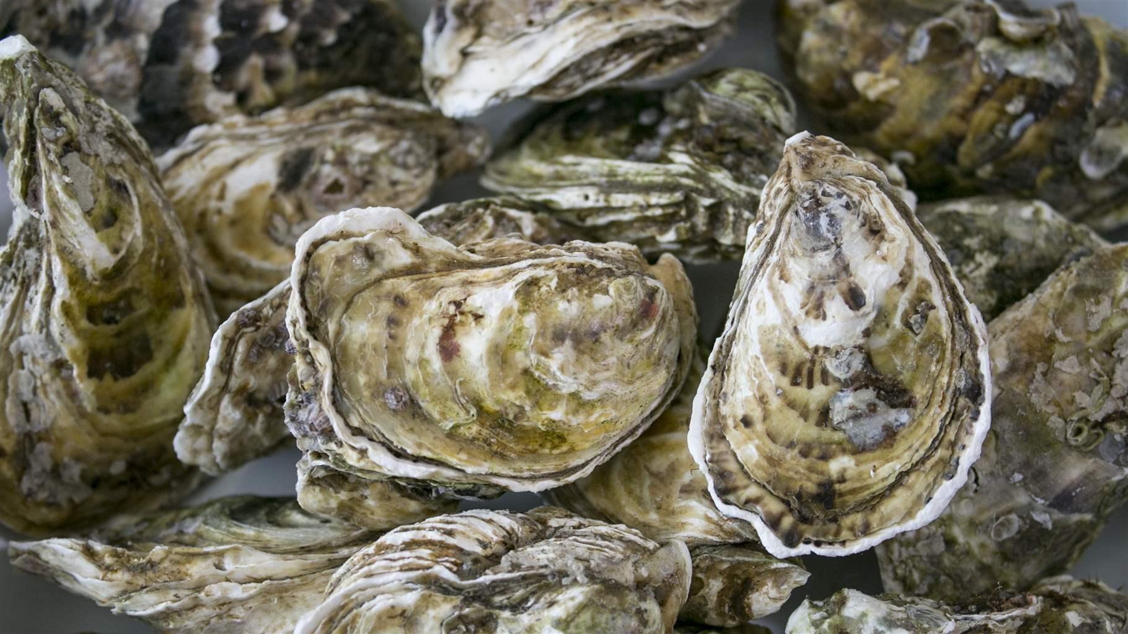
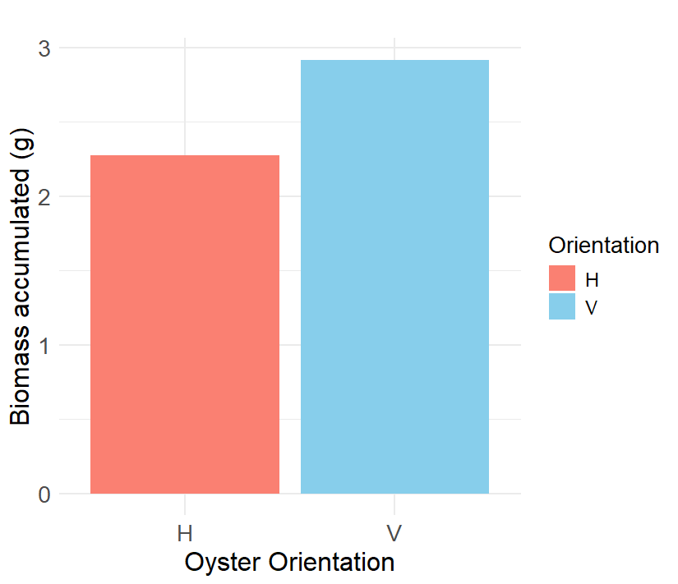
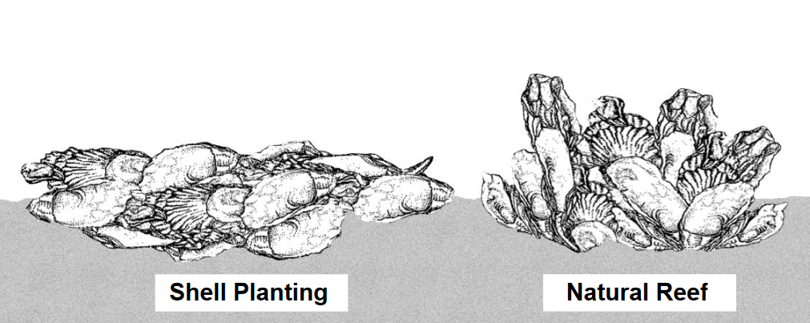
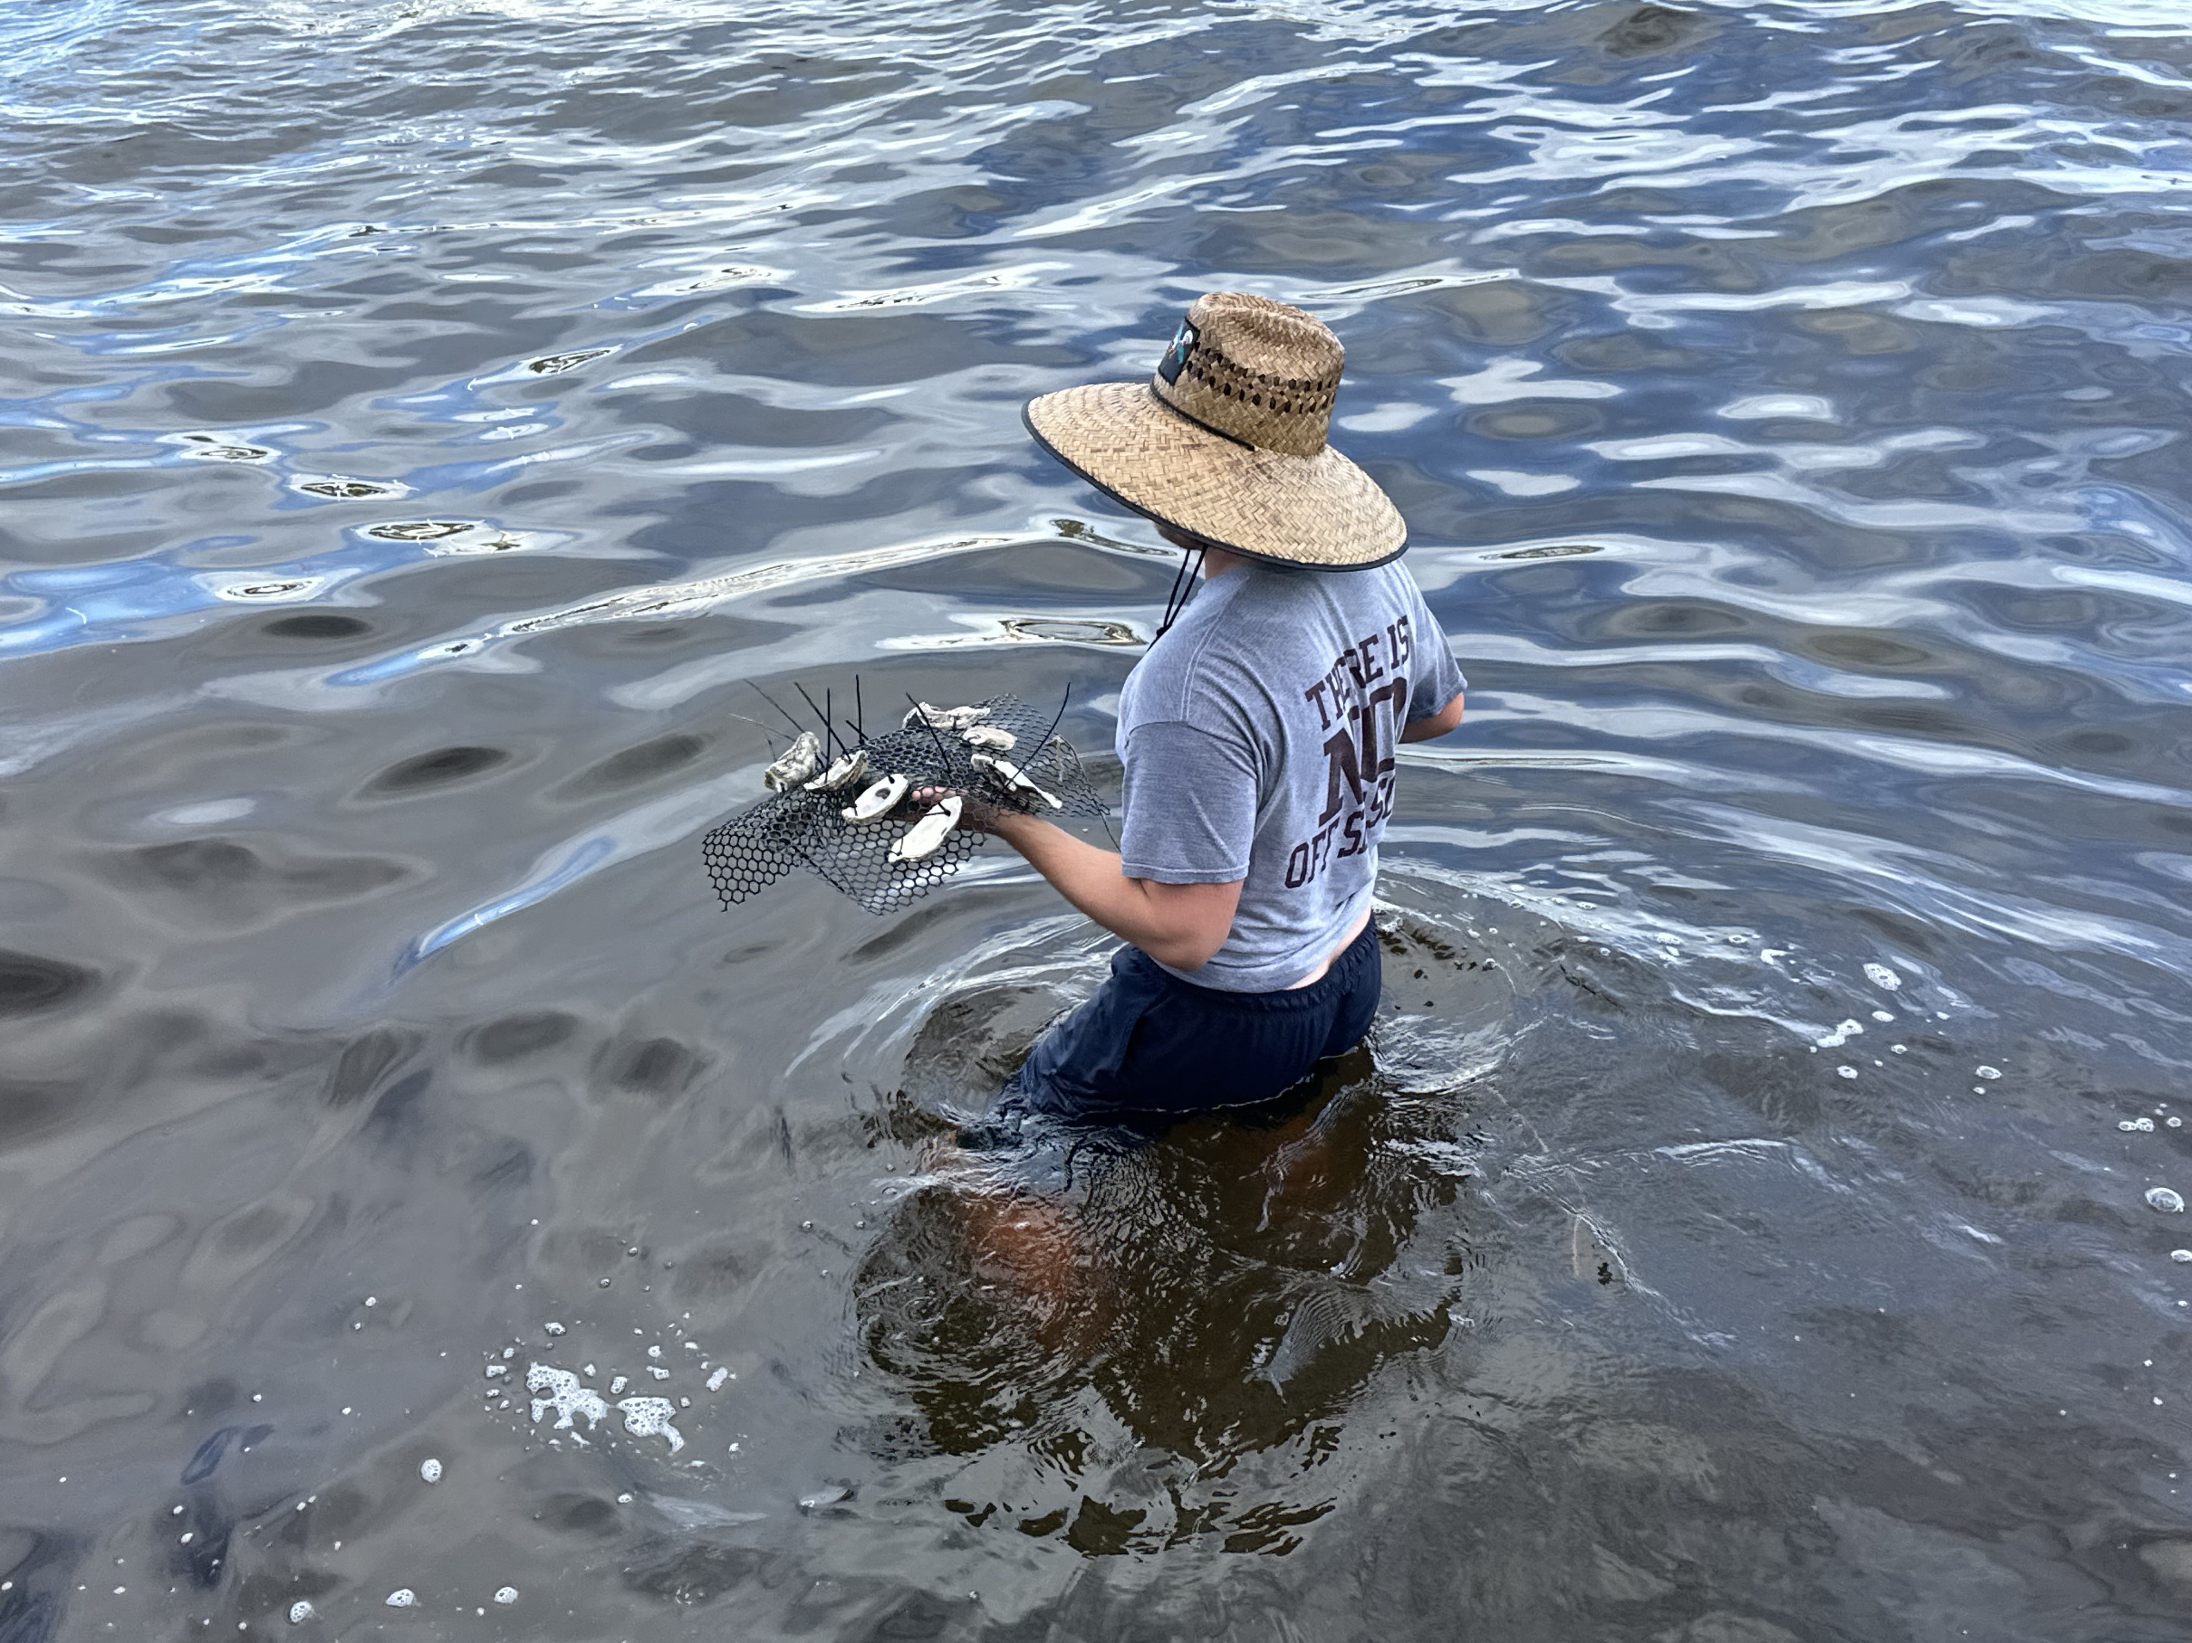
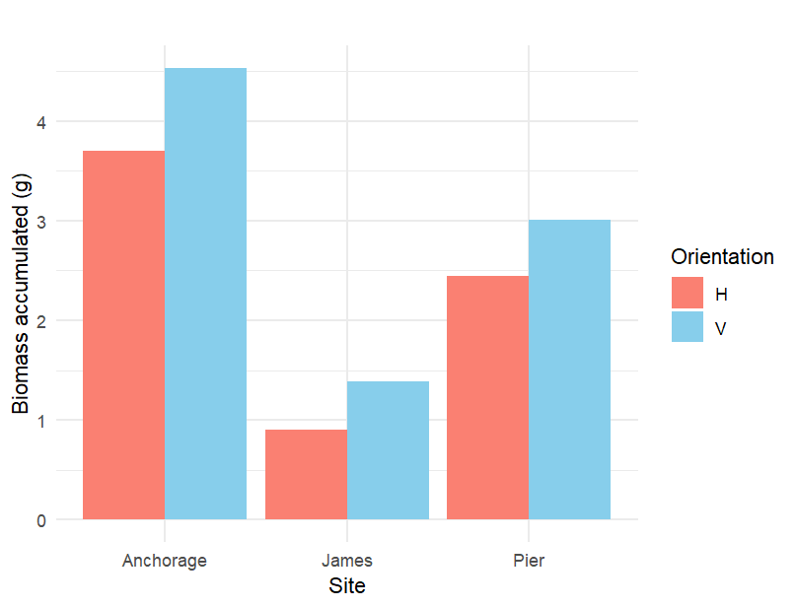
The Effect of Oyster-Shell Orientation on Biomass Accumulation
Robert Bossert
Faculty Advisor: Dr. Richard Aronson, Dept. of OEMS, Florida Institute of Technology
BACKGROUND
The Indian River Lagoon (IRL) contains heavy nutrient pollution due to stormwater runoff.
Oysters, Crassostrea virginica, are used to filter the resulting phytoplankton blooms (1).
These oysters attach to and grow on oyster mats placed in the IRL by different conservation organizations (2).
CONCLUSIONS
Hypothesis was supported.
Overall, the vertical shells accumulated biomass more effectively than the horizontal shells as seen in Fig. 1.
ANOVA comparing the treatments yielded a non-significant p=0.442.
Accumulation varied by site as
seen in Fig. 2.
With more resources and people this methodology has shown promising results for future lagoon restoration projects.
OBJECTIVES
RQ: Does the orientation of the oyster-shells impact the amount of biomass accumulation on each shell?
H1: Vertically oriented oyster-shells will create a better environment for recruitment like natural oyster reefs because they increase turbulent
flow (3).
Photo Credit: Getty Images
RESULTS
Horizontal
Vertical
METHODS
Built 30 mats containing Vertical or Horizontal shells (4)
Placed 10 mats of each type at each of 3 locations in the IRL
Waited 3 months for biomass to accumulate on the shells
Removed mats from the IRL
Scraped all biomass off the shells and dried all samples in a drying oven at 70°C for 6 hours
Weighed all dried samples
Compared accumulated biomass between sites and treatments in RStudio with an ANOVA test
Figure 1: Overall mean of biomass accumulated between the two treatments.
Photo Credit: Brice Smith
ACKNOWLEDGEMENTS
I thank the following people for their advice and assistance: Dr. Weaver, Dr. Kelli Hunsucker, Dr. Miller, Brice Smith, Shannon Bone, Summer Smith, Irene George, Mike Gigliotti, Anna Barcala, Philip Wince, James Lacey, Matthew Poirier, The Brevard Zoo staff, and my parents
Biomass Accumulated (g)
Horizontal
Vertical
Figure 2: Mean of biomass accumulated from each treatment at each site.

