Slide 1
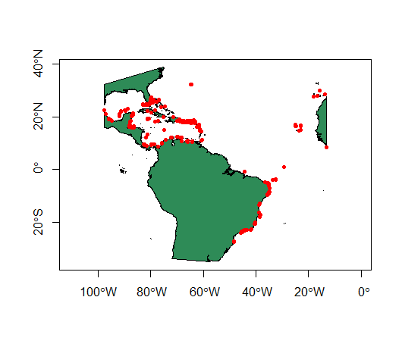
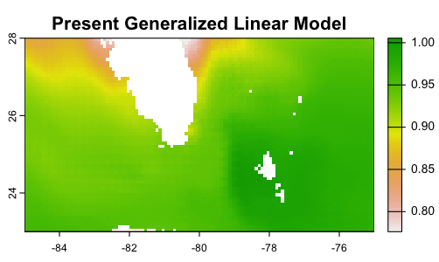
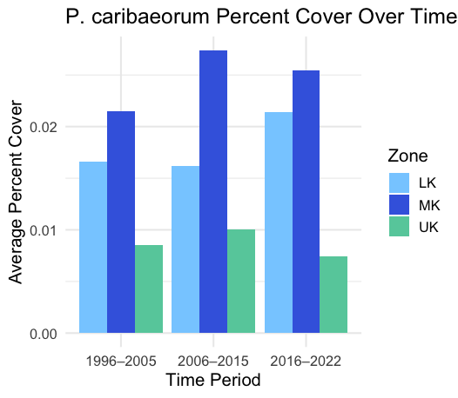
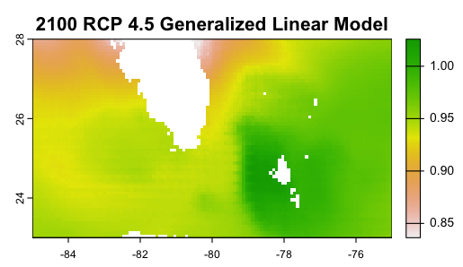
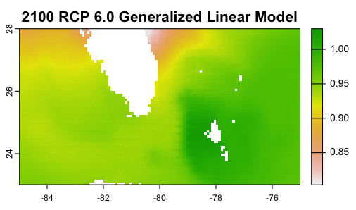
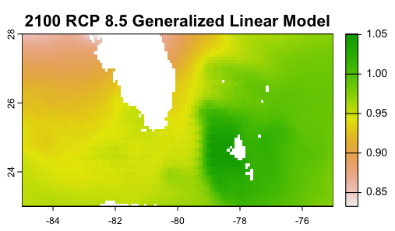
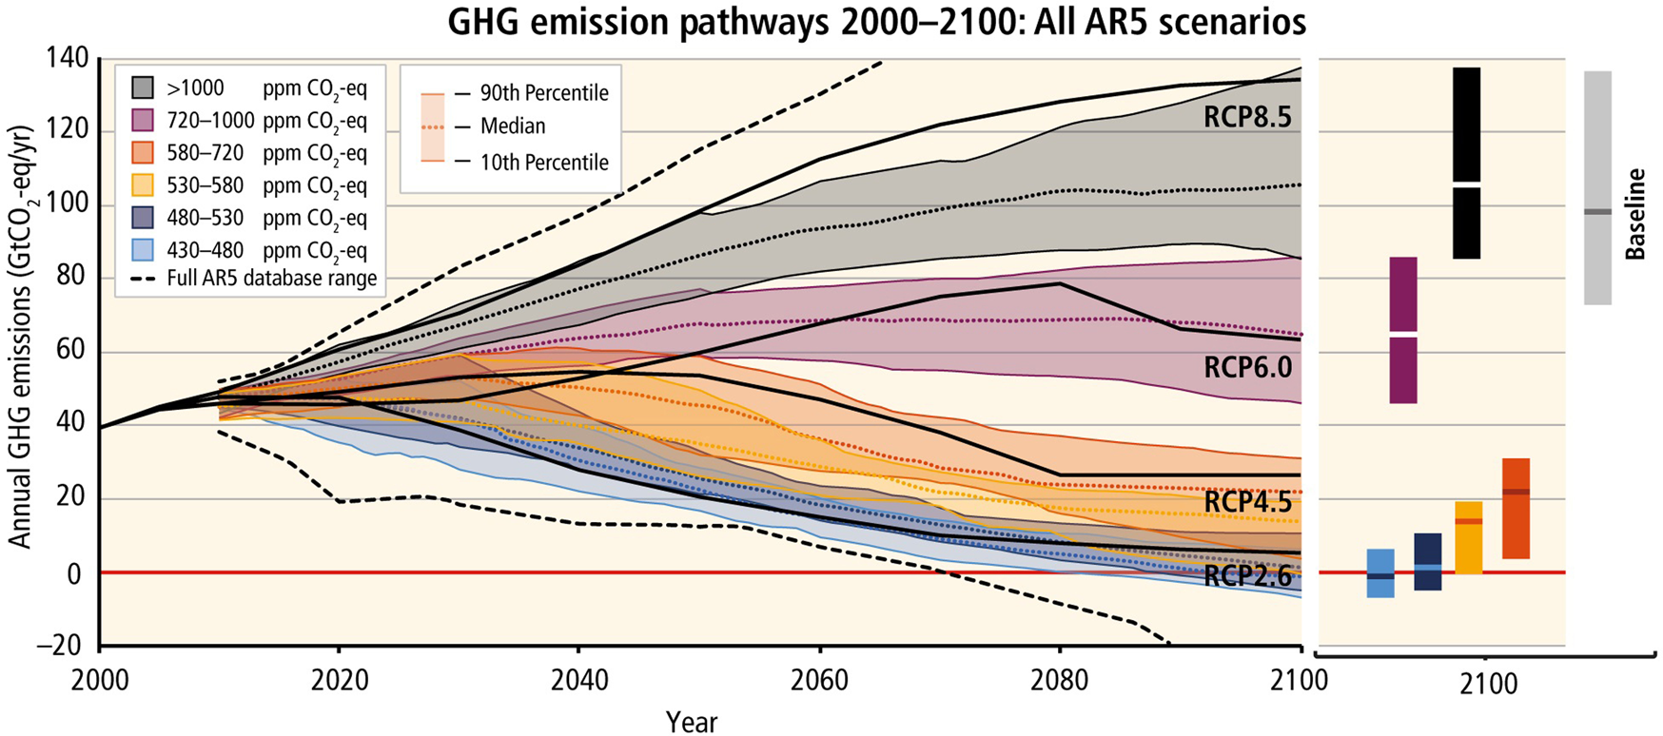
Climate Change and the Biogeography of a Critical Component of Coral Reefs
Summer R. Smith
Faculty Advisor: Dr. Richard Aronson, Dept. of OEMS , Florida Institute of Technology
Abstract
Results
Coral reef ecosystems are
facing shifts in community
composition because of
climate change. Species
with higher environmental
tolerances have greater
survivability rates through
temperature anomalies.
Palythoa caribaeorum is
an encrusting colonial anemone with the ability to overgrow and outcompete neighboring benthic species, such as corals and sponges. Species-distribution models (SDMs) are an effective way to predict suitable habitats based on occurrence data and environmental variables. This study aimed to plot and identify the distribution of P. caribaeorum along Florida’s coast and project its distribution in the year 2100 based on climatic models. I predict that P. caribaeorum will maintain its distribution under increasing RCP levels because of its overall tolerance to changing environmental parameters.
Figure 1. Global distribution of P. caribaeorum
Figure 4. Percent cover of P. caribaeorum across Florida Keys Reef Tract (FKRT) zones over time
Conclusion
The present-day SDM predicts a high probability of P. caribaeorum along the FKRT, with moderate suitability extending along both the east and west coasts of Florida. Within the FKRT, current P. caribaeorum abundance is greatest in the Middle Keys. Projections under RCP 4.5 and 6.0 scenarios show a decline in suitable habitat throughout the FKRT and along the Florida coast, whereas the RCP 8.5 model indicates a substantial loss of habitat suitability across the entire region. These patterns likely reflect the combined effects of rising temperatures, increased salinity, and reduced chlorophyll-a concentrations. As conditions become less favorable, we should expect a decline in coral abundance throughout the FKRT, followed by a shift toward zoanthid- and macroalgal-dominated communities, until environmental stressors become too extreme even for these more resilient taxa. This research may be of consideration in future management and policy decisions regarding Florida’s reefs.
Introduction
-Little research has evaluated P. caribaeorum distribution in Florida.
-Increased zoanthid cover is indicative of an altered reef ecosystem.
- Representative Concentration Pathways (RCPs) are predictive climate-change scenarios for varying levels of global greenhouse-gas concentrations.
Figure 3. SDMs for P. caribaeorum from the present to 2100 under RCPs 4.5, 6.0, 8.5
Methods
Occurrence data were obtained from the Coral Reef Evaluation and Monitoring Project (CREMP) dataset. Environmental variable layers, including sea surface temperature, salinity, and chlorophyll-a concentration, were sourced from the Bio-ORACLE database. Predictive RCP layers were obtained through Bio-ORACLE. Mapping and statistical analyses were performed in RStudio.
Acknowledgments
Figure 2. RCP Pathways 2000-2100 (from Doulabian et al. 2021 Journal of Water and Climate Change)
Special thanks to Anna Barcala for her assistance with data analysis and helpful discussion.

