Slide 1
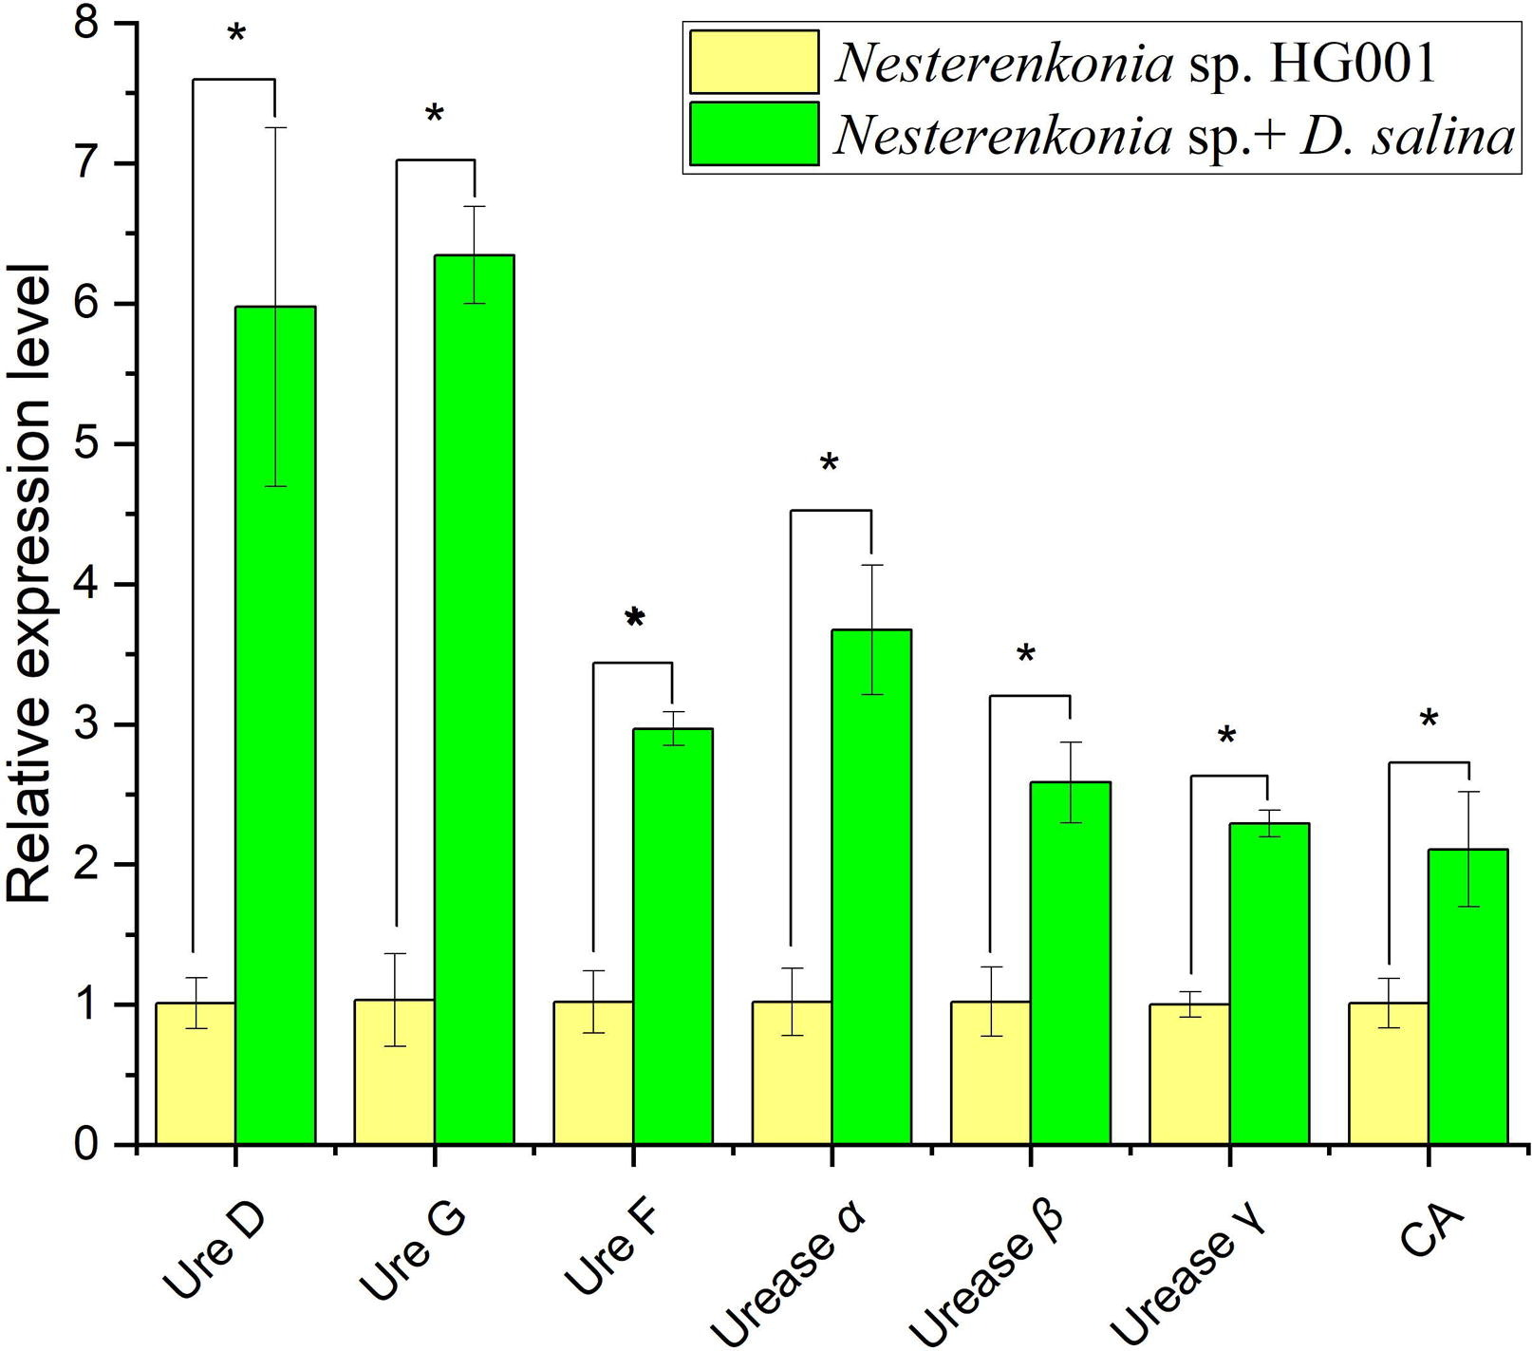
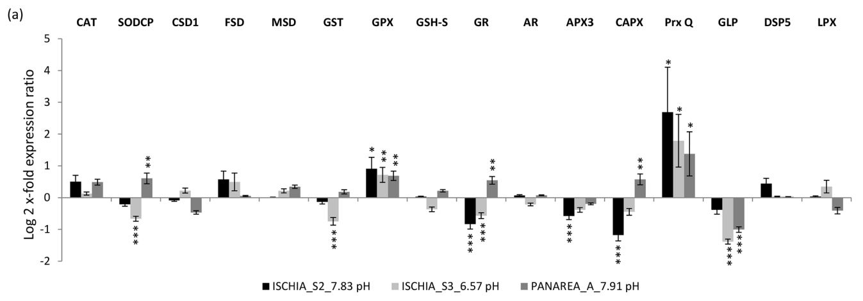
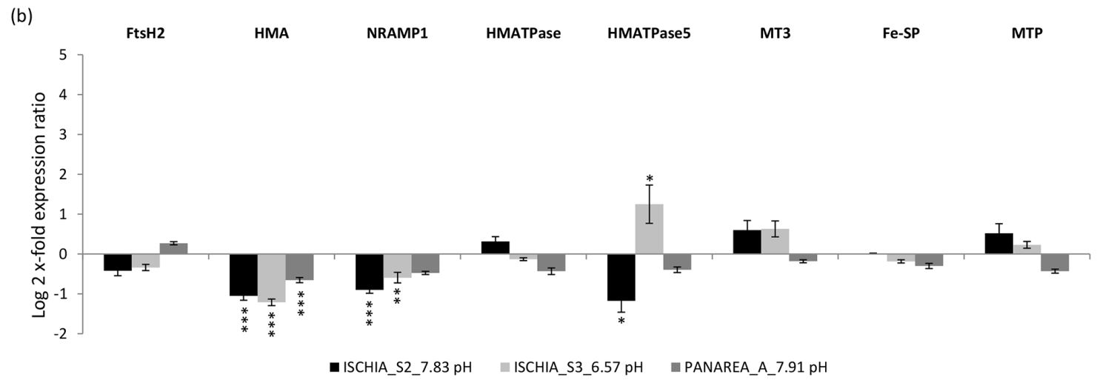
DAC Carbon Dioxide Enhances the Growth of Marine Algae and Seagrass
Marcel Pedrosa, Rana Alghorir, Juliann French, Brianna Romero, and Katelynn Zagami
Faculty Advisor: Ralph Turingan, Dept. of Biomedical Engineering and Science, Florida Institute of Technology
Introduction
Meta analysis
The relative expression level of the identified genes related to carbonate precipitation:
Carbon dioxide (CO₂) is a vital resource in multiple ecosystems in that its presence affects the growth and tissue development of photosynthetic organisms in aquatic ecosystems. Current real-world understanding of the relationship between CO₂ and aquatic environments with photosynthetic organisms, such as the seagrass Halodule wrightii and the algae Ulva lactuca, remains limited.
Photosynthetic organisms in aquatic ecosystems, such as microalgae, would be heavily reliant on the CO₂ levels in the environment for the expression of specific genes. With how closely related microalgae is to seagrass and algae, the effect CO₂ levels have on the gene expression of microalgae provides an idea of how CO₂ levels may affect the gene expression of seagrass and algae.
From researching the relationship between the level of CO₂ in the environment and gene expression of organisms such as seagrass and algae, we can learn how to create an aquatic agriculture system/model to cultivate Halodule wrightii and Ulva lactuca.
Expression levels of P. oceanica antioxidant and heavy-metal-related genes of plants:
Figure 2: The algae Dunaliella salina and its symbiotic partner, the bacteria Nesterenkonia sp., when placed in a CO₂-rich saline environment, shows changes to expression with the selected genes for both species. These genes are related to carbonate precipitation, process which collects CO₂. With each identified gene, the changes to their expression is displayed as significant, with their P values being P < 0.05 (*).
Conclusions
The stress of gene expression for seagrass such as Halodule wrightii does exhibit changes under different levels of CO₂.
The stress of gene expression for algae such as Ulva lactuca exhibit change under different levels of CO₂.
Methods
Utilizing the Florida Institute of Technology EBSCO search engine with keywords such as “seagrass”, “algae”, “Carbon dioxide”, and “gene expression”, various sources such as the ones that provided Figure 1 (Lauritano, C., et al. 2015) and Figure 2 (Wenhui Gu, et al. 2024), were found to assist with this project meta-analysis.
For these sources, it was made sure that the sources used were published within the past 10 years and were scholarly (peer-reviewed) academic journals.
From reviewing each source’s sections, which include background, analysis, and supplementary data, the correlation between CO₂ levels in the environment and gene expression of seagrass and algae were determined.
With further review of each paper’s procedures, gene extraction and analysis methods were isolated from each studies (both used RT-qPCR techniques).
Future Work
The specific effects that CO₂ has on the genes of Halodule wrightii and Ulva lactuca is still being investigated.
Further investigations are being conducted to identify if genes associated with growth factors and concentration mechanisms in Halodule wrightii and Ulva lactuca are affected by CO₂ levels.
Figure 1 : Expression levels of P. oceanica antioxidant (a) and heavy-metal-related genes (b) of plants that were collected from Ischia sites (2 and 3) and Panarea site, both being placed in low pH and high CO₂ environments, in relation to their control sites, shows with the selected genes, found in these sites, that 51% of genes analyzed were found to exhibit changes in stress of gene expression. From the 51% of genes found, some display significant change when compared to the control ranging from p values of P < 0.05 (*), P < 0.01 (**), and P < 0.001 (***) for up-regulation of gene and for the down-regulation of genes.
References
Lauritano, C., et al., (2015). Response of key stress-related genes of the seagrass posidonia oceanica in the vicinity of submarine volcanic vents. Biogeosciences, 12(13), 4185–4194. https://doi.org/10.5194/bg-12-4185-2015
Wenhui Gu, et al. (2024). Algal-bacterial consortium promotes carbon sink formation in saline environment. Journal of Advanced Research, 60(111-125), https://doi.org/10.1016/j.jare.2023.08.004

