Slide 1
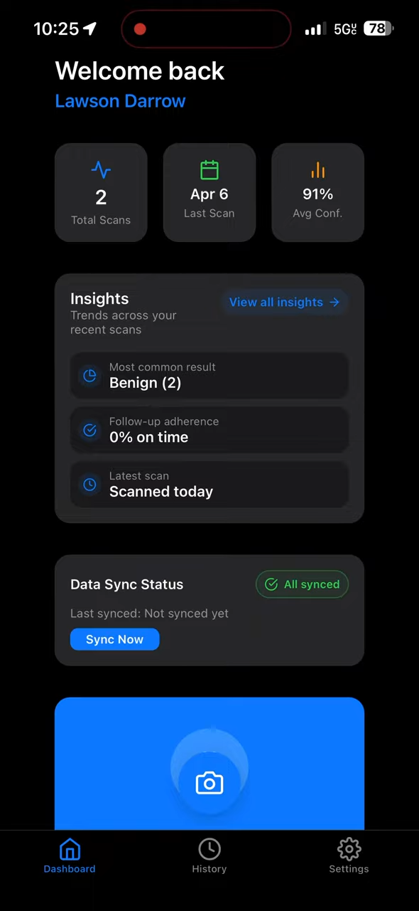
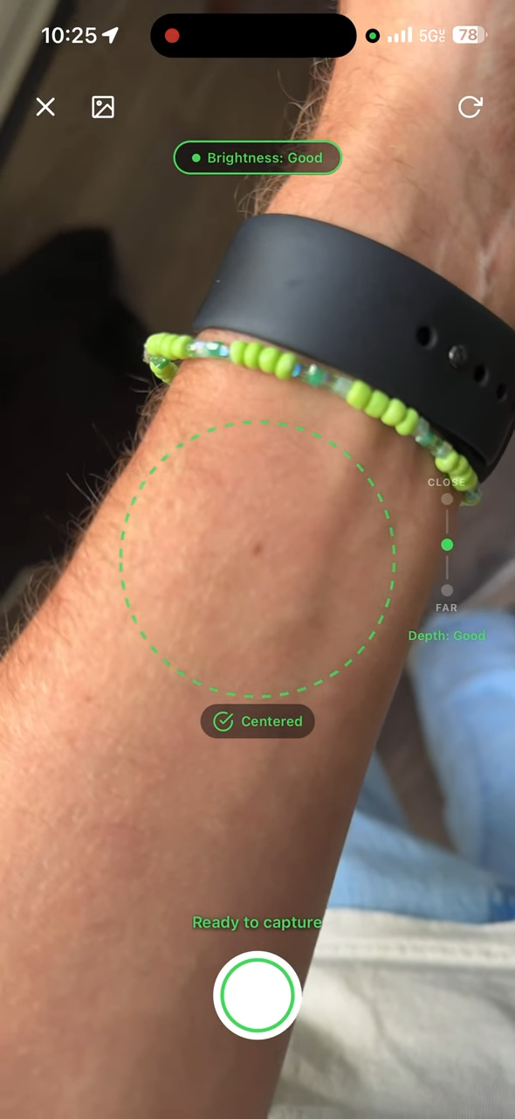
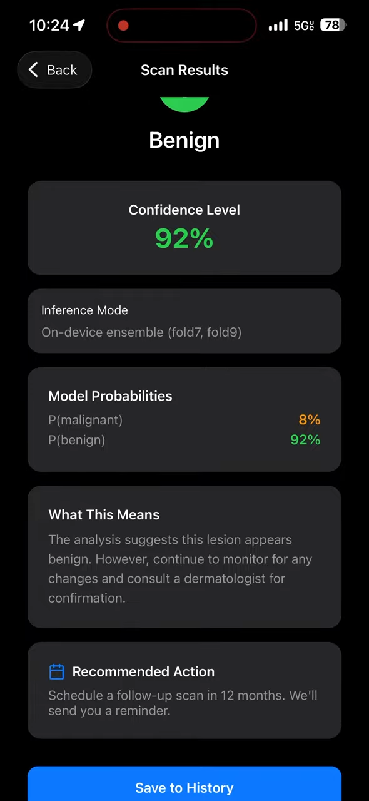
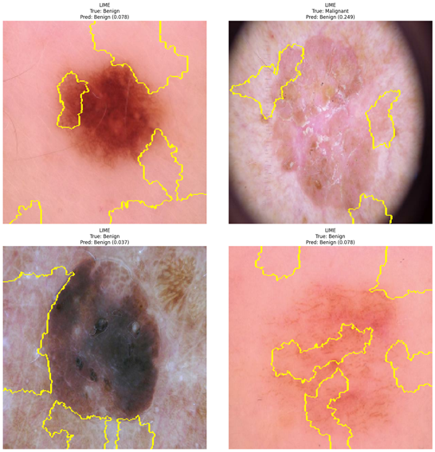
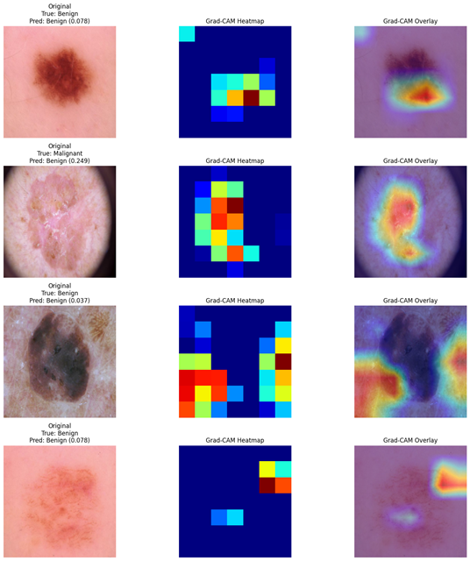
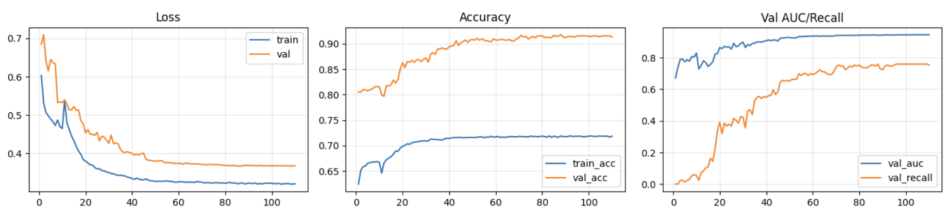
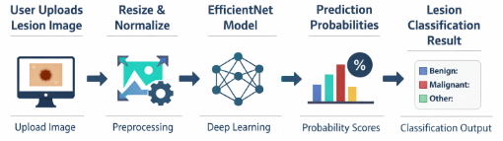
Skin Cancer Detection App
Nicolas Rincon-Speranza, Lawson Darrow, Nikiraj Konwar, Christian Stevens
Faculty Advisor(s): Dr. Zahra Nematzadeh, Dept. of Electrical Engineering and Computer Science, Florida Institute of Technology
Goal & Motivation
Skin cancer is one of the most common cancers, and early detection greatly improves outcomes.
Many people do not have quick or easy access to a dermatologist for an initial screening.
Our goal was to build a mobile app that can analyze a lesion image and provide a fast preliminary prediction.
This is not meant to replace a doctor, but to serve as an accessible screening aid that encourages earlier follow-up.
Project Progress
Collected and organized lesion image data from the HAM10000 dataset
Built and trained a deep learning classifier for benign vs. malignant prediction
Applied preprocessing and augmentation to improve robustness
Designed and implemented a mobile interface for image upload and prediction display
Integrated the trained model into an app workflow for user testing
Evaluated performance using test-set metrics and visual examples
System Architecture
The user uploads a photo of a skin lesion.
The image is resized and normalized to match the model input format.
The processed image is passed into an EfficientNet-based deep learning model.
The model outputs prediction probabilities for the lesion class.
The app displays the predicted result and confidence score back to the user.
Dataset & Preprocessing
We used the HAM10000 skin lesion dataset for training and evaluation.
The dataset includes images from several lesion categories.
Images were resized to 224 × 224 pixels for model input.
Data augmentation was applied to improve generalization, including:
  rotation
  flipping
  brightness variation
  MixUp
The data was split into training, validation, and test sets.
Class imbalance was addressed during preprocessing and training.
Results
The model achieved promising performance on the test set, showing that it learned useful visual patterns from skin lesion images. The sample images above provide examples of the types of lesions analyzed, while the training plots below show improving loss, accuracy, and validation performance over time.
AUC up to 0.961
Best-performing fold selected for deployment
Model training curves showing decreasing loss and improving accuracy, validation AUC, and recall over epochs
Mobile App/UserFeatures
Can scan or upload skin lesion images and receive results
Can view a score showing how likely the lesion is to be cancerous
Can get fast prediction feedback through the app
Can easily understand results through a simple interface
Explainability helps show which parts of an input image most influenced the model’s prediction, making its decisions easier to interpret.
Goal & Motivation
Dataset & Preprocessing
Mobile App/User Features
Project Progress
Results
Explainability
System Architecture

