Slide 1
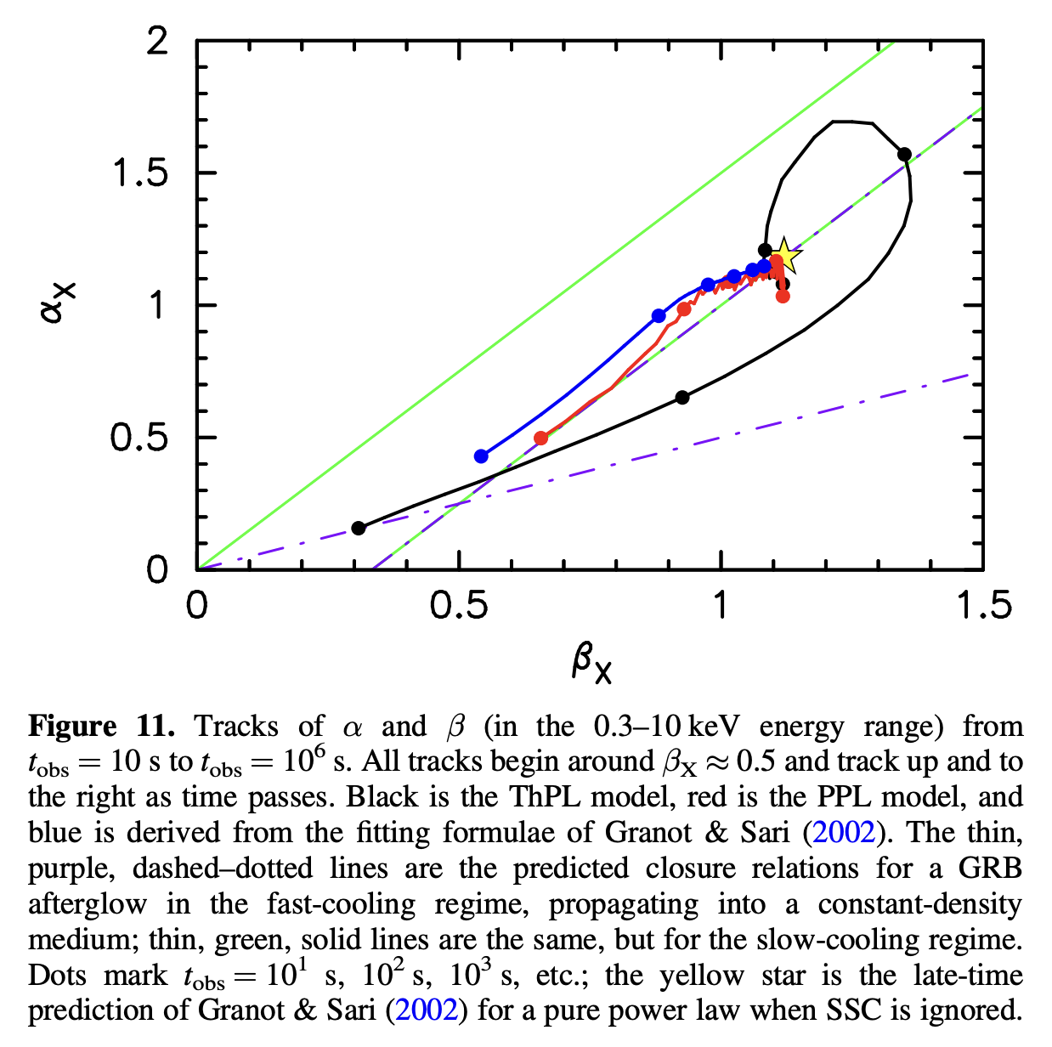
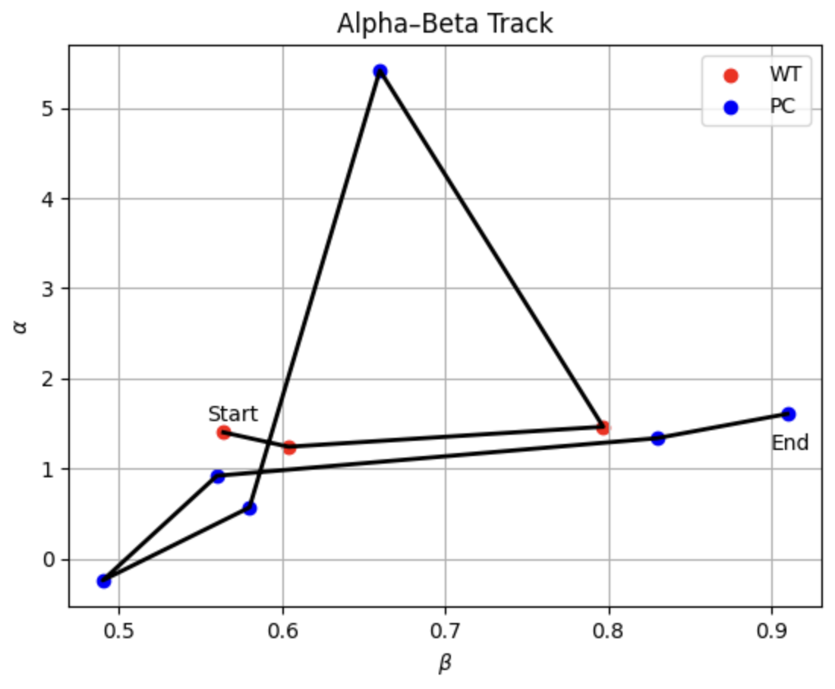
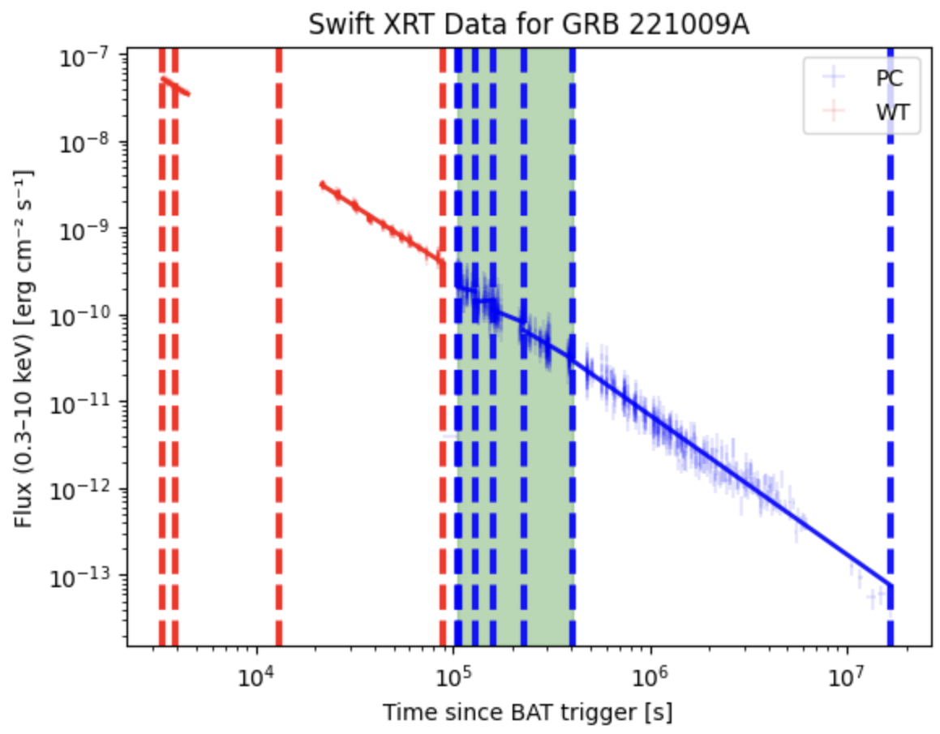
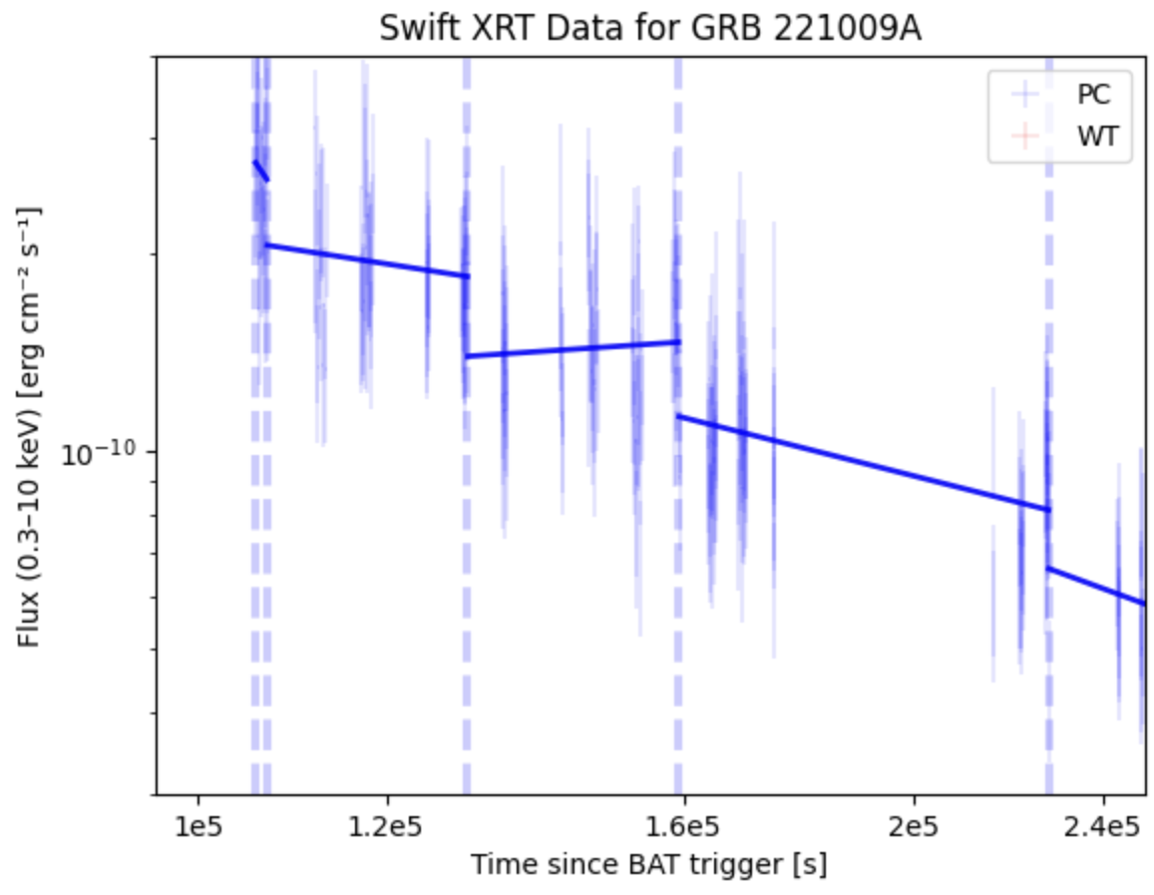
Gamma Ray Burst Afterglow Slopes
Brian Robbins
Faculty Advisor(s): Dr. Donald C. Warren Dept. of Aerospace, Physics, and Space Sciences, Florida Institute of Technology
Abstract:
The standard models for gamma ray bursts (GRBs) typically assume that shock-accelerated electrons follow a power law distribution of energies. However, this behavior is not what some gamma ray bursts show. In this project, it is suggested that the presence of thermal electrons causes temporal and spectral structure across the afterglow, which is significantly different from models assuming a pure power-law distribution of electrons. To model the afterglows, we decide on a large number of samples of GRBs from the Swift database and obtain the temporal and spectral indices at arbitrary times. By finding the temporal and spectral indices at arbitrary times for a large sample of GRBs, a plot can be created to track the behavior of the afterglows through time, and determine if the curves resemble those of figures 11 and 12 in Warren et al. (2022).
Figure 11 in Warren et al. (2022) showing ThPL model (black), PPL model (red), Granot & Sari (2002) fit (blue). Closure relations are shown for fast (dashed purple line) and slow (solid green line) cooling regimes. Yellow star marks late-time prediction when Synchrotron Self-Compton Emission is ignored
Methods:
Obtain sample from Swift XRT database
Create Light Curve
Using Bayesian Blocks, adaptive time bins are defined that follow changes in the GRB light curve
Since F ∝ t⁻ᵅ , plotting the light curve in log-log space and creating a linear least-squares fit yields a slope of -α, from which the temporal index α was determined
Using time-sliced spectra tool from Swift’s website, the photon index 𝚪 was obtained. The spectral index is then given by β = 𝚪 - 1
Comparing ɑ and β over time allows us to track the afterglow’s evolution
Figure 1: Track across the ɑ-β plane for GRB 221009A starting at the earliest time and evolving chronologically
Discussion:
Figure 1 does not reproduce the behavior displayed in Figure 11 of Warren et al. because the α values were obtained from fits that do not align between adjacent time bins (as shown by Figure 3). By joint-fitting the full light curve, we will be able to obtain physically meaningful α values. By recreating Figure 1 with the α values obtained from the joint-fitted light curve, the expectation is that the α-β track will resemble the curves seen in Figure 11 of Warren et al.
Introduction to GRBs:
Most energetic explosions in the universe
GRB afterglows are the radiation that follows the initial flash of a GRB
Causes of GRBs: Massive Star Collapse & Neutron Star Mergers
Figure 2: Light curve for GRB 221009A with Bayesian Blocks & linear fit. Green shaded regions indicate bins with misaligned fits
Research Questions:
Do observed GRB afterglows show behavior consistent with theoretical predictions?
Are there deviations from the pure power law (PPL) model?
Do the curves resemble the thermal power law (ThPL) model?
Figure 3: A zoomed in view of the green shaded region in Figure 2. The lack of alignment between adjacent fits indicates discontinutites in the slope
Acknowledgements:
Special thanks to Dr. Warren and Tyler Robbins

