Slide 1

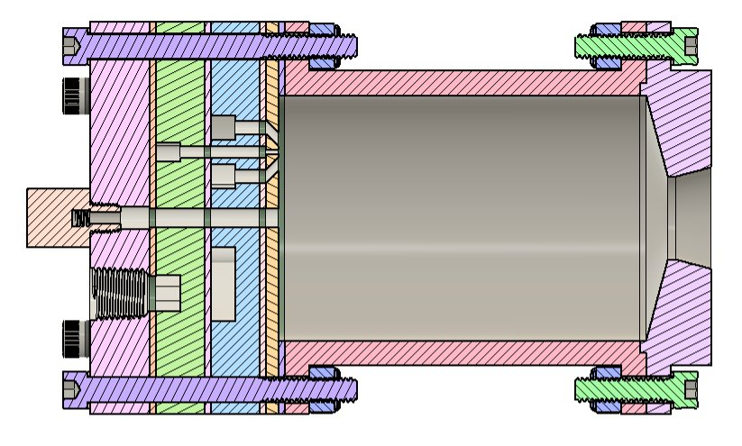
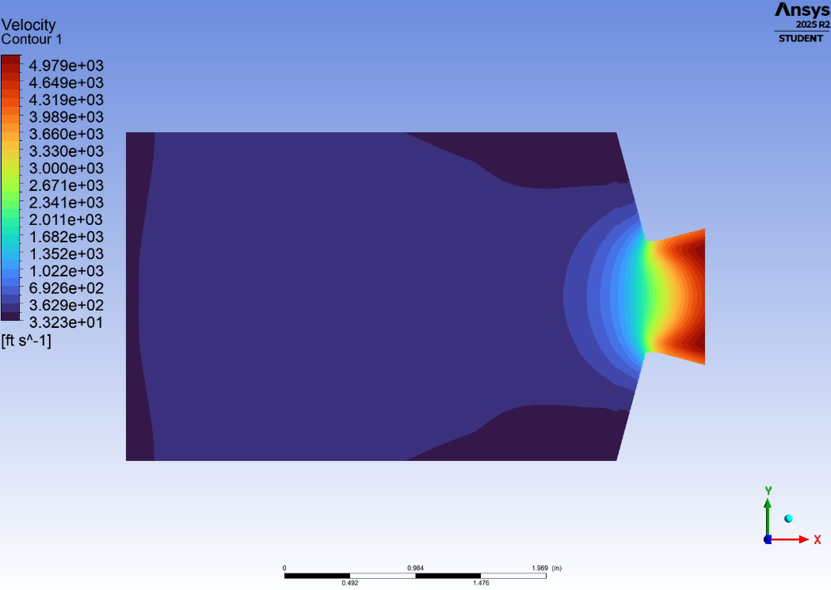
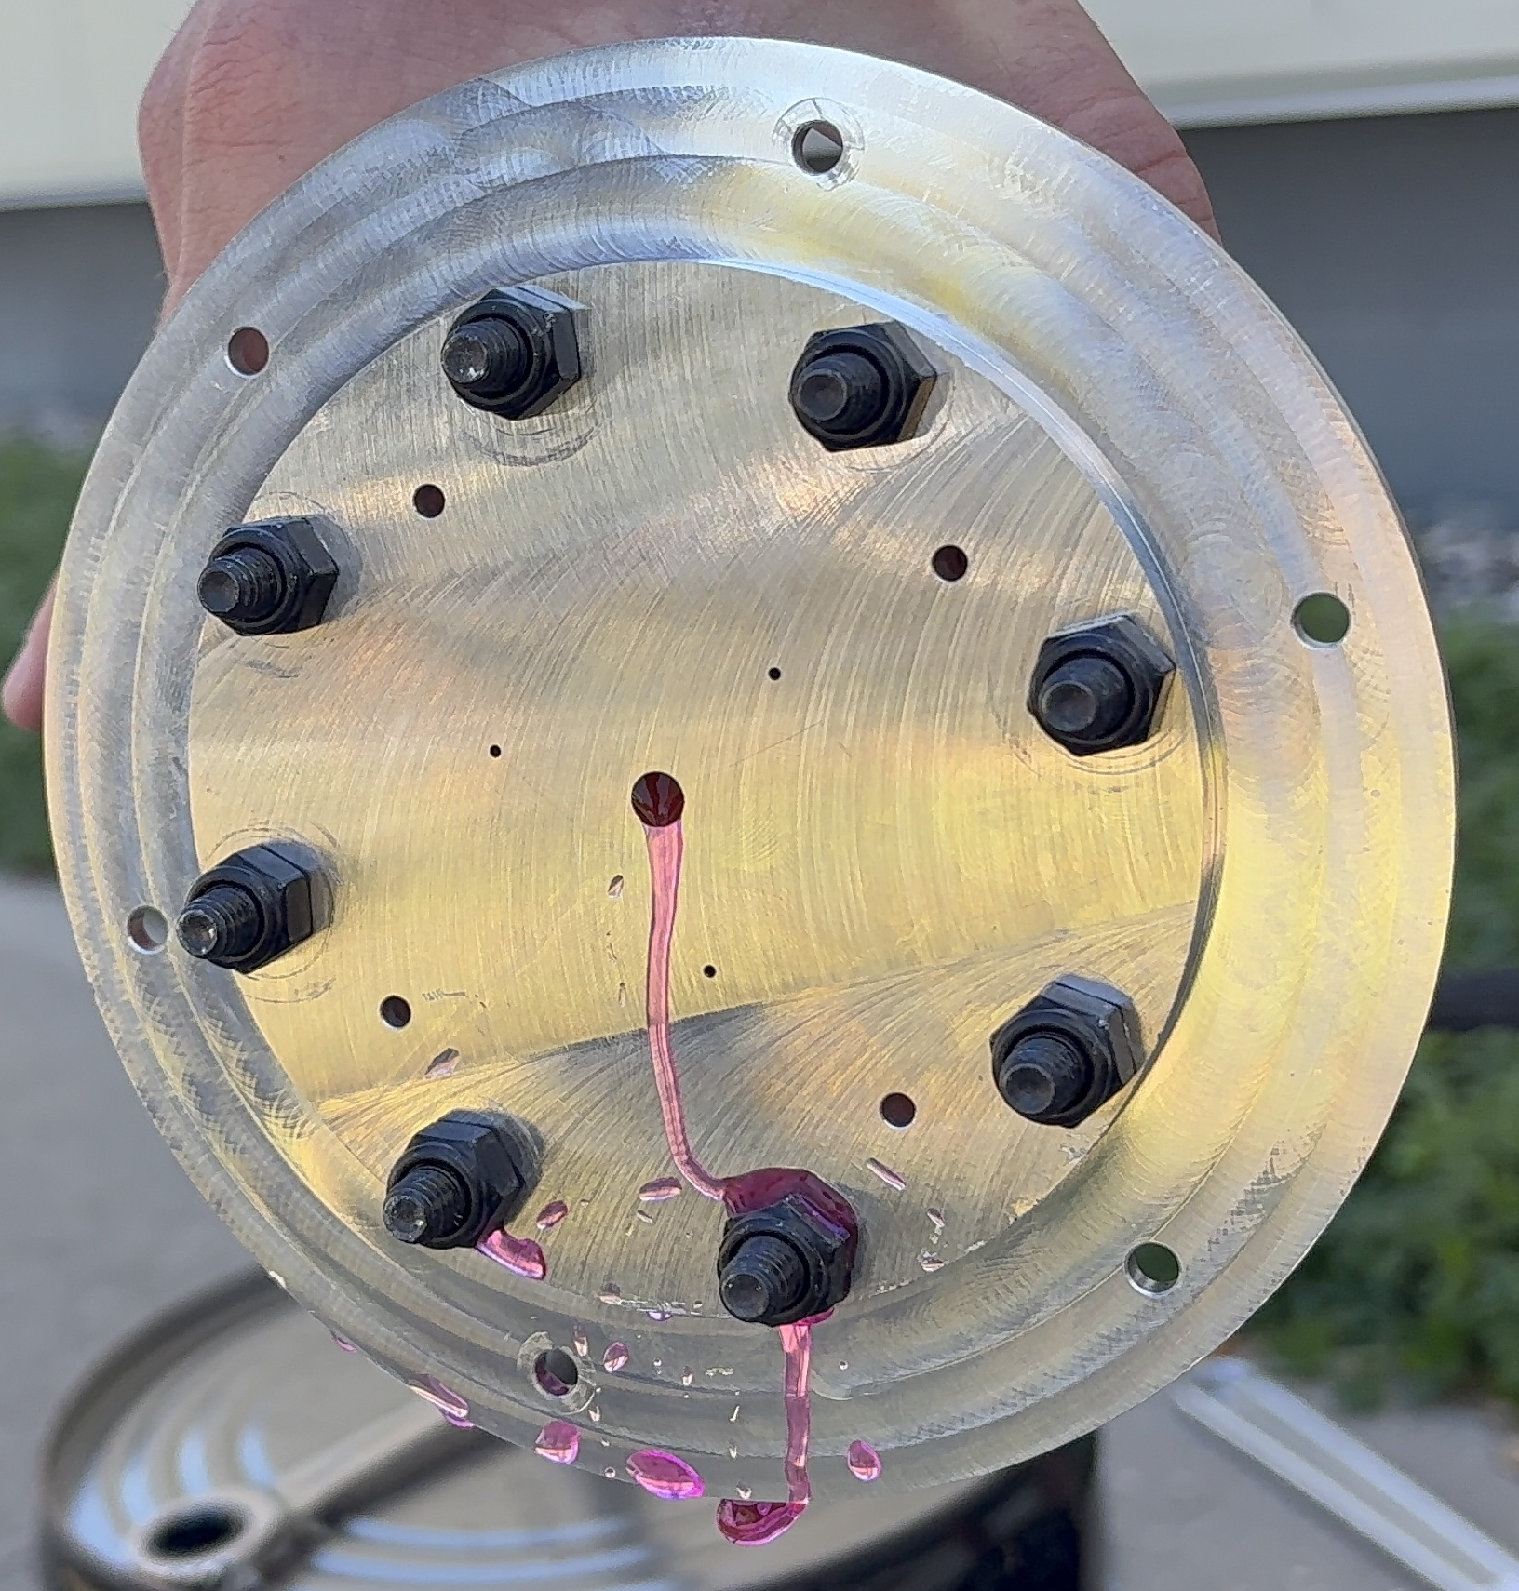
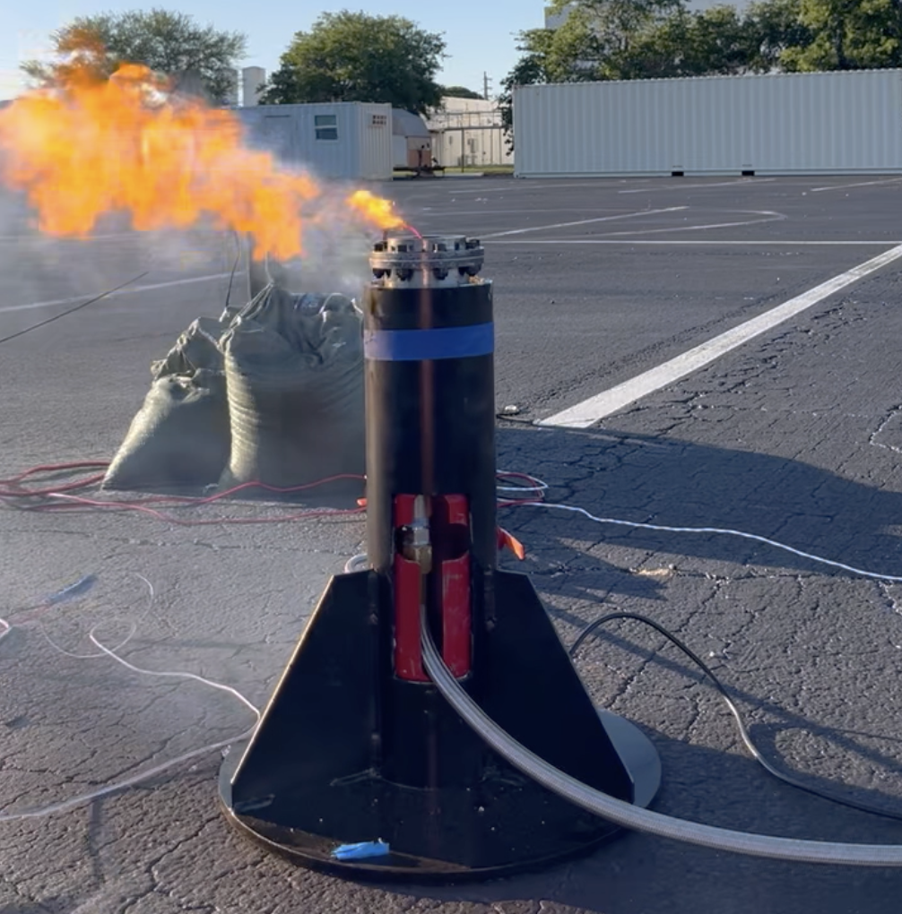
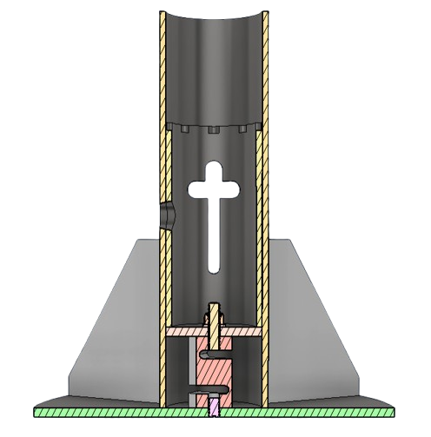
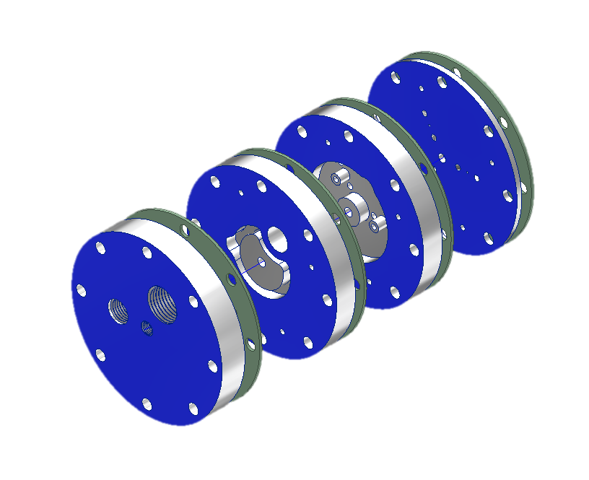
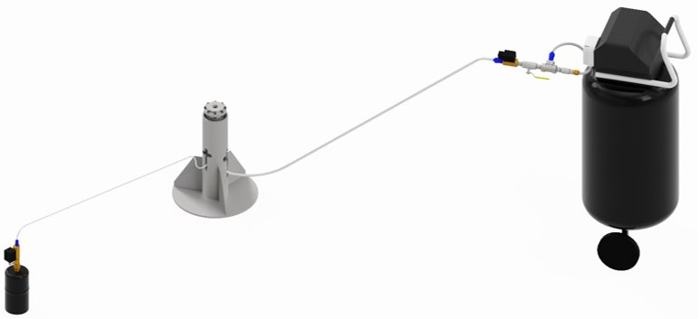
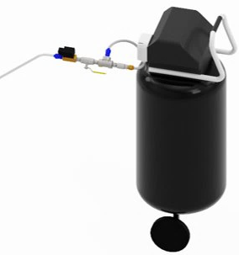
SABER – Stability Analysis through Bipropellant Engine Research
S. Conley, R. Gaulin, E. Lucas, A. Ramirez, N. Reese, W. Reinkoester, J. Sadler, W. Tinelli, B. Varozza
Faculty Advisor: Dr. Firat Irmak, Dept. of Aerospace Engineering, Florida Institute of Technology
Summary
Concept of Operations
Impact and Future Work
Stability Analysis through Bipropellant Engine Research (SABER) is a small-scale, compressed air and propane bipropellant rocket engine designed as the test subject of a combustion instability analysis. Through various static fires at varying combustion chamber lengths, the project demonstrates that less combustion instabilities are experienced at smaller characteristic lengths.
Pre-Ignition
Ignition
Cool Down
The bipropellant engine designed serves as a test bed for a combustion instability analysis – enabling further research into methods to reduce combustion instabilities and contribute to safer space vehicles. The project works to expand Florida Tech's ability to research various propellants and engine geometries. Future works include optimizing mass for a flight configuration.
Connect DAQ
Fill propane tank from reservoir
Fill air compressor tank
Connect feed lines
Open ball valves
Verify safe distance
Light igniter
Open fuel solenoid
Open ox solenoid
Monitor burn until flame burnout
Close solenoid valves
Wait for system to cool down
Disconnect feedlines
Save recorded data on DAQ
Engine Design and Analysis
Testing & Validation
The engine is made of three main components: a multi-plate impinging injector, a combustion chamber which varies in length throughout the study, and a C-D nozzle.
Chamber Inner Dia.: 2.5 in
Chamber A Length: 3.686 in
Chamber B Length: 2.738 in
Chamber C Length: 1.789 in
Pneumatic Tests
Verify structural integrity and that system is leakage free by pressurizing full system to 200 psia using an air compressor.
Hydrostatic Tests
Verify structural integrity and that system is leakage free by pressurizing full system to 200 psia using a pump and water.
Static Fire Tests
Verify engine can produce thrust and gather relevant data for instability analysis.
Injector
Combustion Chamber
Nozzle
Velocity CFD of
combustion chamber A.
Structures System
Fluids System
Testing System
Conclusions
Injector: triplet impinging jet with mutually perpendicular elements, ox-fuel-ox, utilizes a plate system and was manufactured from Al-6061 using a 3- and 3.5-axis CNC mill.
Combustion Chambers and nozzle manufactured on the manual lathe using mild steel with 2.0 FOS.
Oxidizer hose travels from an air tank to the injector's oxidizer intake.
Fuel hose travels from a propane tank to the injector's fuel intake.
2 solenoids connect to the controller, allowing propane and air-flow control from a distance.
2 ball valves are placed between the solenoids and propellant tanks, allowing for manual fluid control.
The test stand consists of four components: the static coupler which is 16.50 in tall , the dynamic coupler which is 8.875 in, the gussets, and a base plate which has a diameter of 16 in.
The data acquisition system was used to aid in our combustion instability studies. This DAQ measured pressure, temperature and thrust through a PCB.
Combustion instabilities increase as the characteristic length decreases.
Minimizing combustion instabilities contributes to safer, more efficient engines.
Engine safety is important as there is an increase in manned missions.
The SABER team thanks our faculty advisor, Dr. Firat Irmak, our graduate student assistant, Niall Harris, and the Florida Tech L3HSDC staff.
Fuel Manifold
Oxidizer Manifold
Static Coupler
Dynamic Coupler
Solenoid
Acknowledgements
Propane Hose
Gussets
Fuel Inlet
Oxidizer Inlet
Gaskets
Air Hose
Ball Valve
Ball Valve
Solenoid
Propane Tank
Air Tank and Compressor

