Slide 1
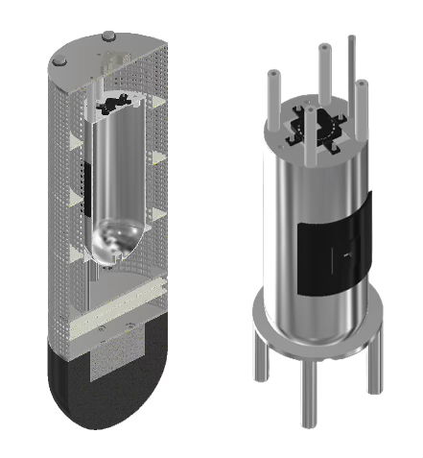
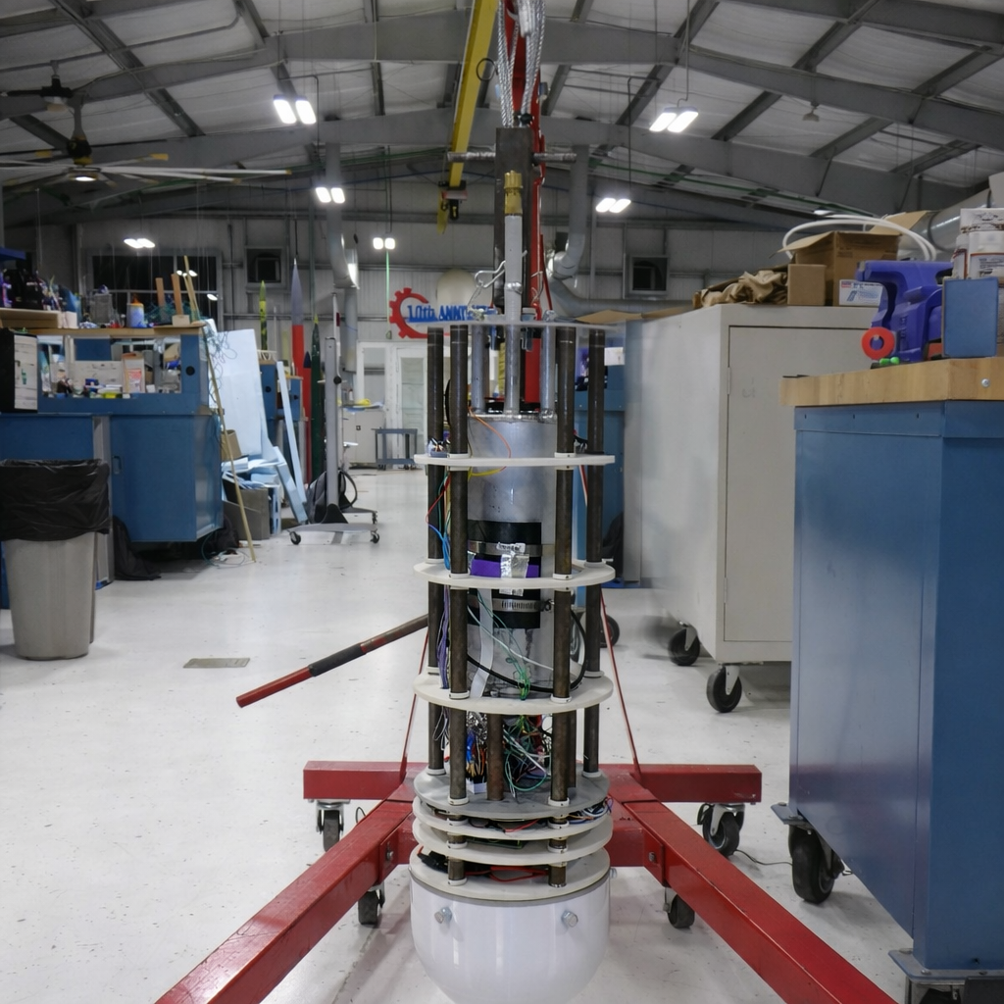
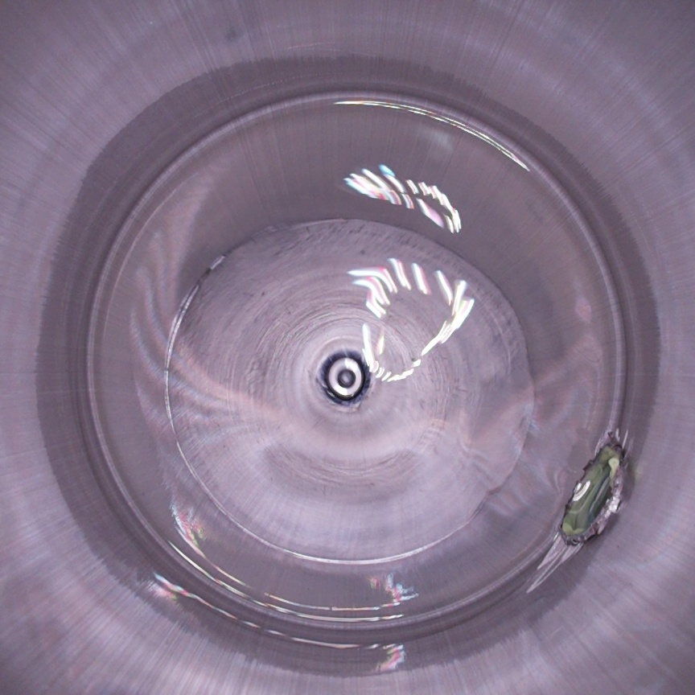
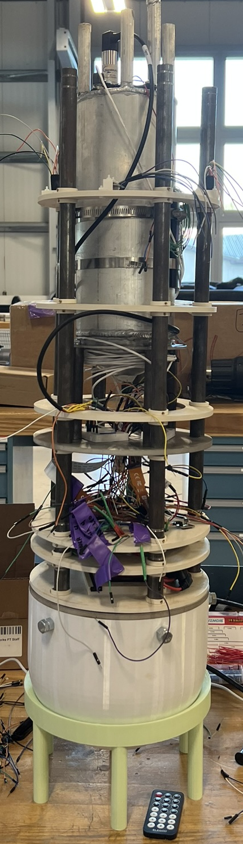
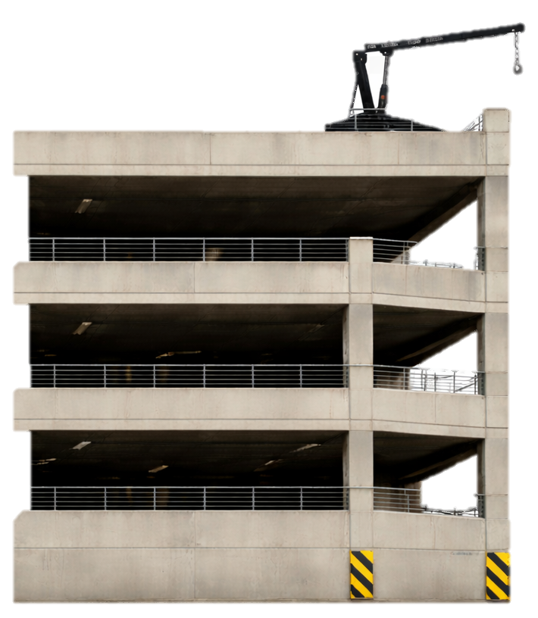
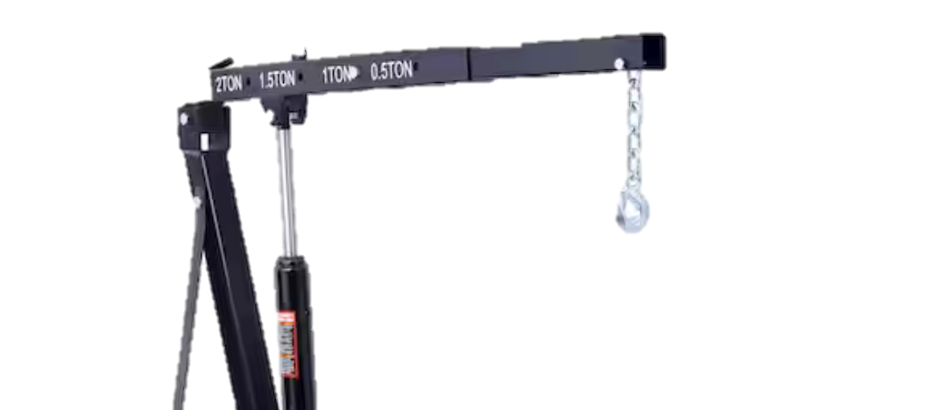
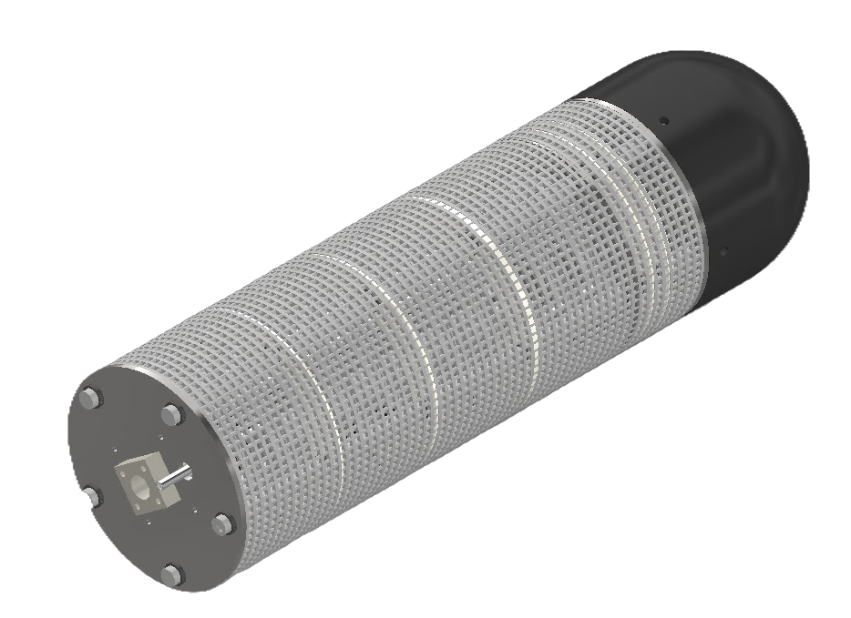
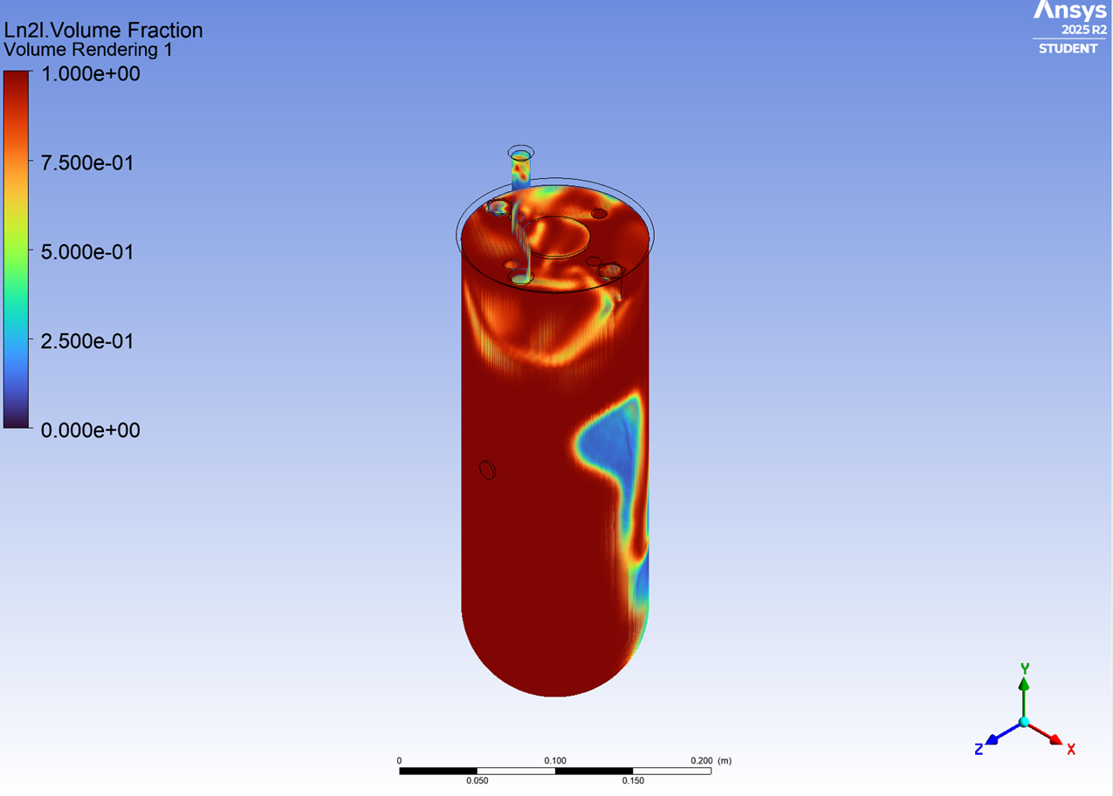
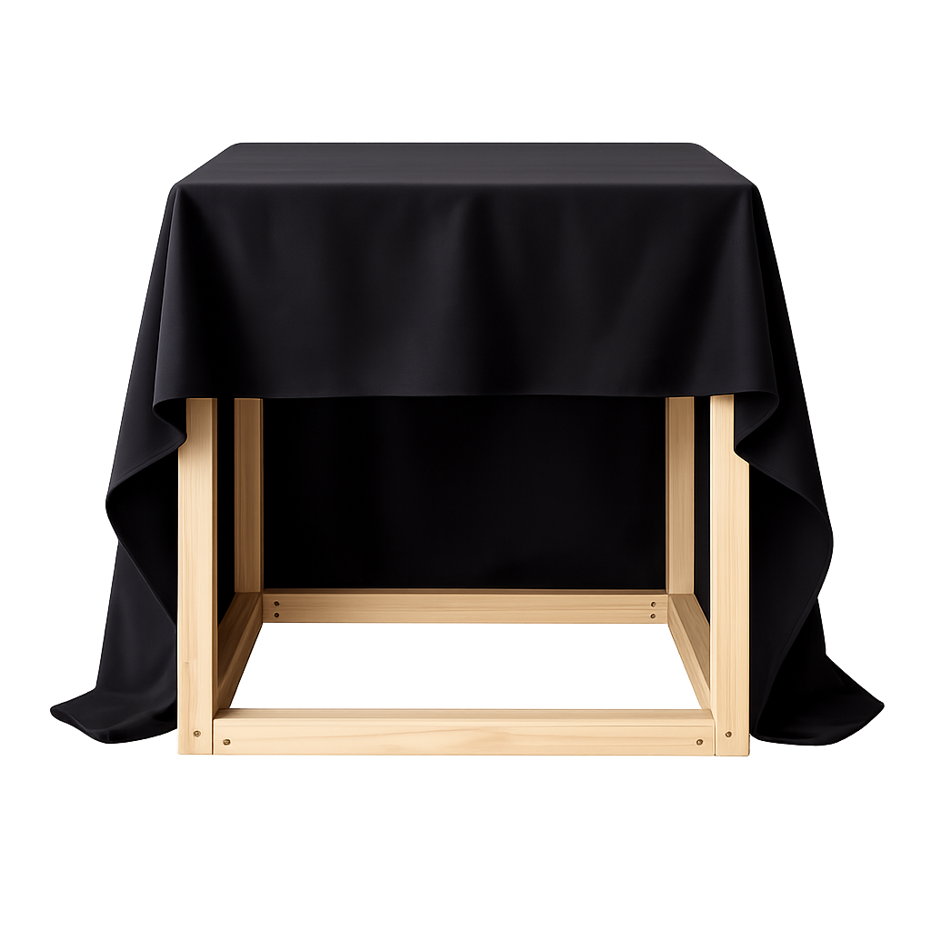
CryoSlosh
K. Barrett, J. Dembinskischeif, C. Gonzalez, A. Hardesty, I. Johnson, R. Niebuhr, M. Page, B. Shaw, M. Tristan
Faculty Advisor(s): Dr. Daniel R. Kirk, Dept. of Aerospace, Physics and Space Sciences, Florida Institute of Technology
Problem Statement
Vehicle Design
Testing
A lack of experimental data on cryogenic fluid behavior in space limits the design of safe, efficient systems for space missions. The team is tasked with producing accurate data to validate current CFD simulations regarding the slosh of cryogenic fluids in reduced gravity effects.
The eight test plans were developed to validate the tank’s integrity and performance across operating conditions. These tests confirmed safe containment of fluids with varying properties, including isopropyl alcohol, 3M Novec 7100, and cryogenic liquid nitrogen. Instrumentation was evaluated to ensure accurate measurement of temperature, pressure, linear acceleration, and rotational velocity. Additional testing verified the performance of the drop system’s supporting components, ensuring controlled operation, reliable data collection, and safe recovery during testing.
Mission & Objectives
CryoSlosh is an experimental apparatus including a tank capable of holding cryogenic nitrogen, being subjected to drop testing, and measuring data on fluid sloshing behavior in a reduced-gravity environment.
OBJ-01: The team shall design, build, and test an experimental system that measures slosh behavior using cryogenic nitrogen* as the testing medium.
OBJ-02: The team shall design and build a test apparatus capable of measuring accelerations in six degrees of freedom.
OBJ-03: The team shall compare experimental data to CFD simulation results and quantify the agreement between the two.
The design features an aluminum tank (pictured right) enclosed in a shell (pictured left) that houses all electronics. Five carbon steel rods run the length of the apparatus, providing primary structural support and securing plates for electronics, insulation, and the tank. A 3D-printed TPU-95A nose cone at the base serves as impact damping. Inside it, a stainless-steel weight lowers the center of mass for stability and anchors the rods with bolted connections.
3.
Controls Design
Analysis
CONOPS
The controls subsystem handled sensing, data acquisition, power, and data processing. Sensors were selected to capture acceleration and angular velocity at rates exceeding ten times the slosh frequency, along with pressure and temperature at 10 Hz and imaging at 60 fps, with internal lighting for visibility. Key components include IMUs, pressure and temperature sensors, cameras, and an LED light, enabling reliable data collection during testing.
A comprehensive CFD analysis was conducted to evaluate the accuracy of the simulation. The model was executed in ANSYS Fluent using specified initial conditions and Z-axis acceleration parameters.
Fill with liquid
Align over drop zone and begin data acquisition
Release pin and drop
Recover apparatus
End data acquisition
Compile data and compare to simulated results
*Liquid nitrogen can be substituted for another simulant fluid

