Slide 1
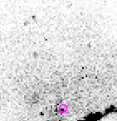
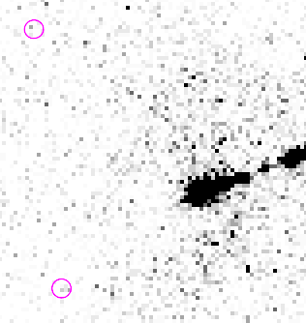
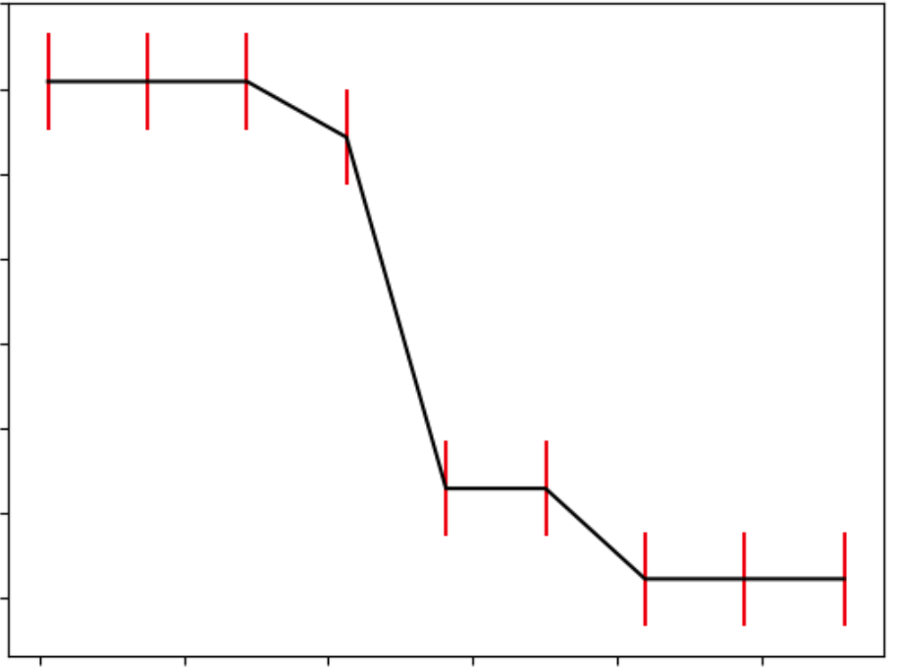
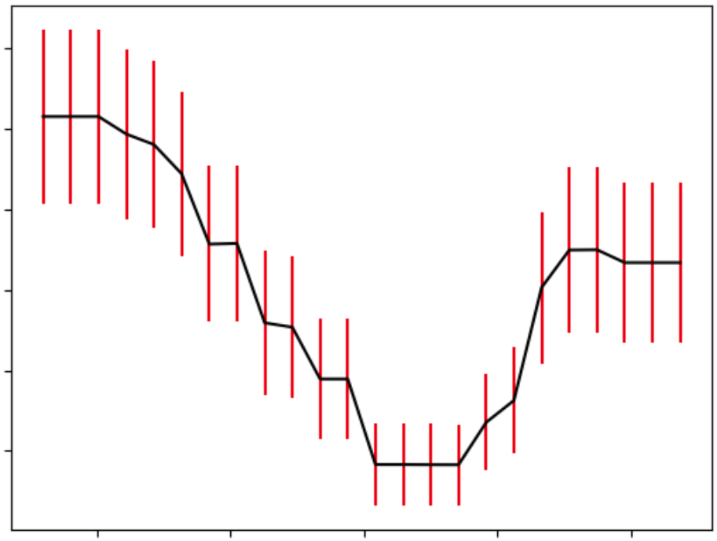
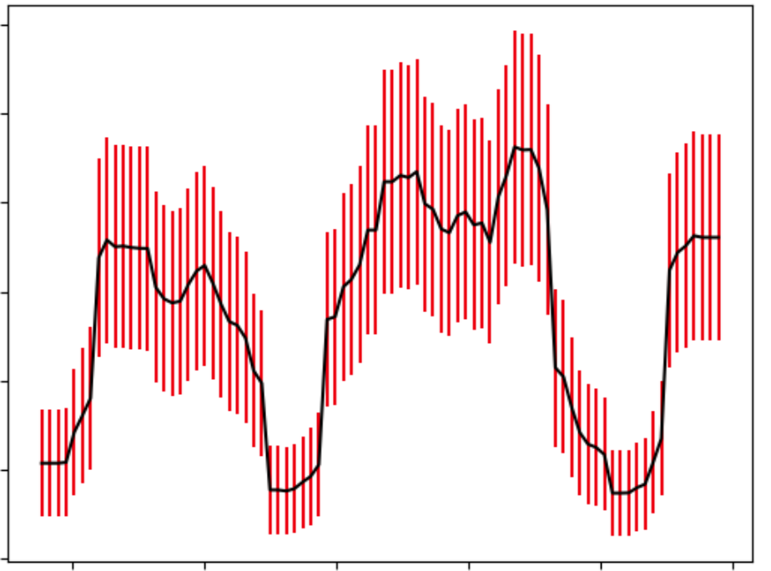
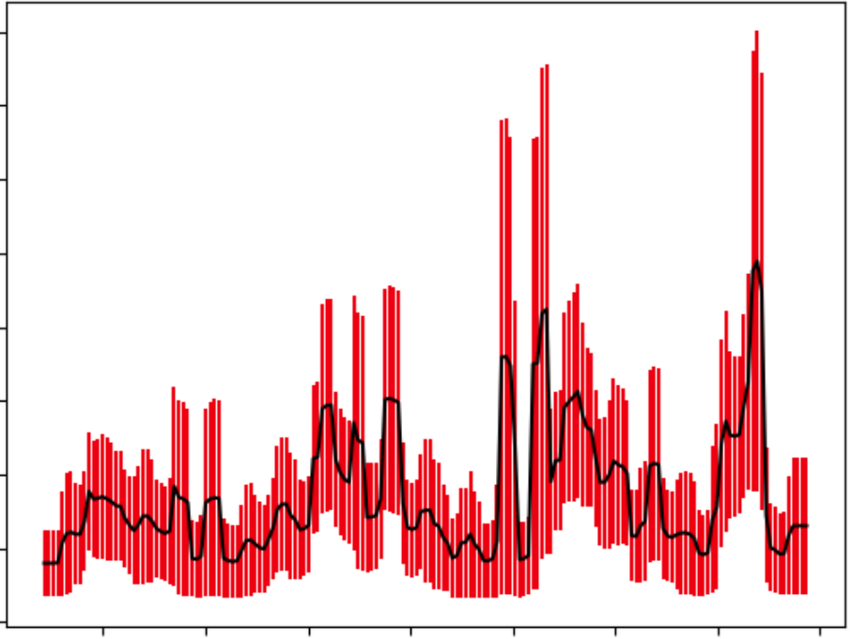
Automation of Data Analysis of The Chandra M87 Data
Jack Becker, Kylee Fout
Faculty Advisor: Dr. Eric Perlman, Dept. of Aerospace Physics And Space Sciences, Florida Institute of Technology
Introduction
Messier 87 (M87) is an elliptical galaxy known for its central black hole, and has been observed frequently over the last 20 years by the Chandra X-ray Observatory. Sourcing of the reduced observational data was done through the Chandra Data Archive, a collection of data from the Chandra Telescope.
The main goal of this project was to create a data analysis pipeline that identifies spectra to search for supernovae.
In addition, we would like to publish the code on GitHub, which may aid future research on transient X-ray events.
Results
After running our data through the pipeline, we were left with 178 candidate sources from 27 observations. This list was further refined by removing false positives, such as any sources with large errors or low photon counts.
From here, we arrive at a final list of 42 variable sources across 17 observations. Of these sources, 18 were transient, 6 were periodic, and the last 18 appeared to be longer-term sources that could not be identified.
Discussion
We found many false positives because sources in M87 are fairly dim due to their distance from our galaxy. This low luminosity can cause photon counts to fluctuate significantly, often mimicking the behavior of variable sources.
Although none of the variable sources we found were supernovae, some produced light curves similar to those of less intense, recurring novae.
Most variable sources had a score near 6, with the highest at 8. All sources with a score above 8 were false positives due to their large errors.
Figure 1: Source near M87’s core
Figure 4: Two sources in M87
Methods
Five data analysis modules:
1) User Input: Handles all user interaction
2) Source Detection: Matches a list of M87 sources to the input data
3) Variability: Uses an algorithm to search for variable sources, gives sources a variability “score” (0 to 10)
4) Spectral Analysis: Extracts the photon count at different wavelengths
5) Visualization: Plots and visualizes all data from each module
0.019
Score: [8/10]
0.006
Score: [6/10]
Conclusion
Despite not detecting any supernovae in our M87 data, we found many variable sources and some periodic sources. In future research, a larger dataset would increase the likelihood of detecting supernova candidates.
Future work on this project includes implementing a user interface, optimizing the code, and allowing it to work with objects other than M87.
This new code will be used along with X-ray data from 10 other galaxies to search for and categorize supernovae based on their spectra.
Photons / s
Photons / s
0.012
0.001
70000
Time (s)
120000
66000
Time (s)
74000
Figure 2: Variable source light curve
Figure 5: Variable source light curve
0.030
Score: [6/10]
0.020
Score: [5/10]
Photons / s
Photons / s
0.000
58000
Time (s)
63000
0.000
30000
Time (s)
44000
Figure 3: Periodic source light curve
Figure 6: False positive light curve
Acknowledgments Broos 2010 ApJ 714 p. 1582
We want to thank our graduate student advisor, Meagan Porter, for providing guidance on code Fikri 2019 J. Phys.: Conf. Ser. 1245 012016
implementation and data analysis, as well as the Chandra X-ray Center for the data and the CIAO software package. Kumaran 2023 RAS 520 p. 5065

