Slide 1
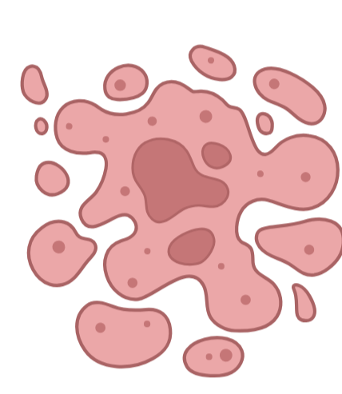
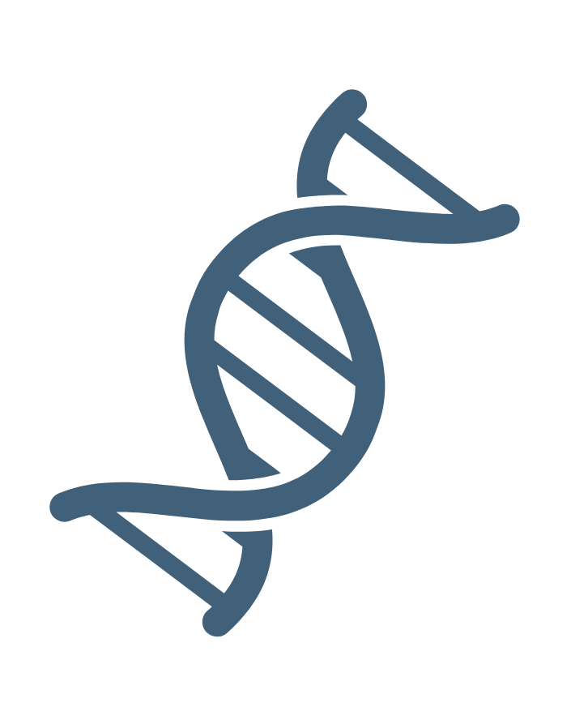
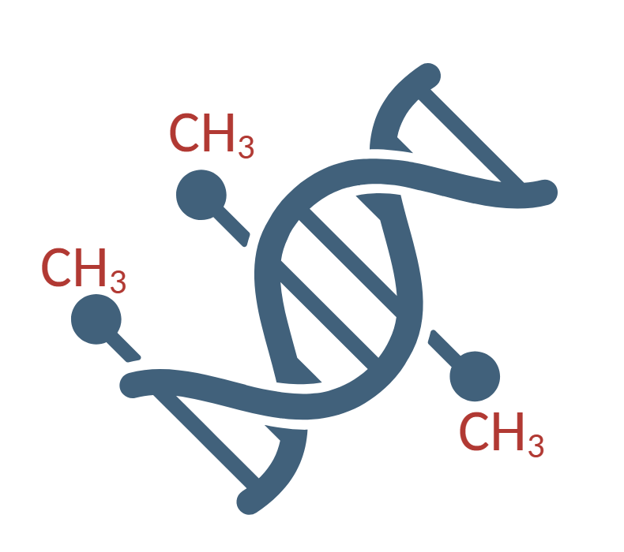
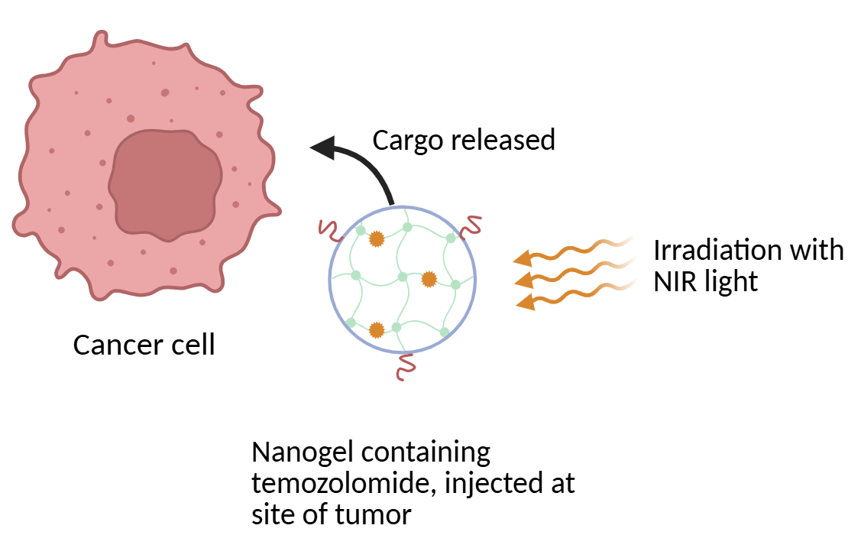
Photochemical Activation of Cyanine-Based Nanogels for Controlled Drug Delivery
Presley Clary
Faculty Advisor: Dr. Nasri Nesnas, Dept. of Chemistry and Chemical Engineering, Florida Institute of Technology
Introduction
Results
Cyanines are highly conjugated molecules with useful properties, such as ease of aggregation and fluorescence. In this project, they were incorporated into an acrylamide-based nanogel made through organic synthesis to exploit these properties for controlled drug delivery. Exposing the nanogel to near-infrared (NIR) light causes it to react with reactive oxygen species (ROS), forming an unstable intermediate. The intermediate splits into two fragments, releasing the nanogel's cargo.¹ The cargo, temozolomide, is an alkylating agent which can be used to disrupt the DNA of cancer cells.²
NIR light (780nm) induces photolytic fragmentation of the nanogel as shown in Scheme 3, triggering the controlled release of the encapsulated temozolomide, which then alkylates DNA strands leading to cell death as seen in Figure 1.
Chemical Process
Methyl diazonium ion
Figure 2. ¹H NMR Spectrum of Nanogel Precursor.
Future work includes imaging the completed nanogel with a scanning electron microscope and sending to biologists to test the effectiveness of temozolomide release.
Temozolomide
Conclusions
Methylated DNA
Cell death
Scheme 1. Temozolomide Alkylation of DNA Mechanism.
Methods
The nanogel was synthesized as shown in Scheme 2. Temozolomide will then be encapsulated in the nanogel by adding its ethanol solution dropwise and purified with centrifugation and water washes before suspending in PBS.
Cyanine-based nanogel
Temozolomide
Methylated DNA
After synthesis, cyanine nanogel is loaded with temozolomide and photochemically activated, causing released cargo to disrupt cancerous DNA at tumor site.
Synthesis of Cyanine-Based Nanogel
Scheme 3. Nanogel Photolysis Mechanism.
Acknowledgements
Biological Process
Thank you to my advisor, Dr. Nasri Nesnas, for the support on this project and to graduate student Julian Vlad for guiding me in the lab. This work was supported by the National Institutes of Health (NIH) under 9R15MH139078-03.
References
[1] Tapia Hernandez, R., Lee, M. C., Yadav, A. K., & Chan, J. (2022). Repurposing cyanine photoinstability to develop near-infrared light-activatable nanogels for in vivo cargo delivery. Journal of the American Chemical Society, 144(39), 18101-18108.
[2] Danson, S. J., & Middleton, M. R. (2001). Temozolomide: a novel oral alkylating agent. Expert review of anticancer therapy, 1(1), 13-19.
Scheme 2. Synthesis of Cyanine-based Nanogels.
Figure 1. Targeted Delivery of Temozolomide.

