Slide 1
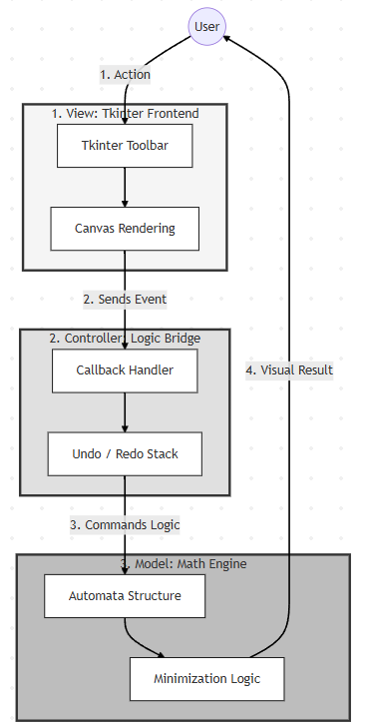
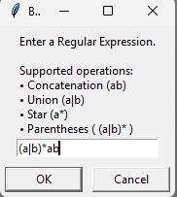
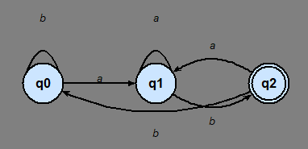


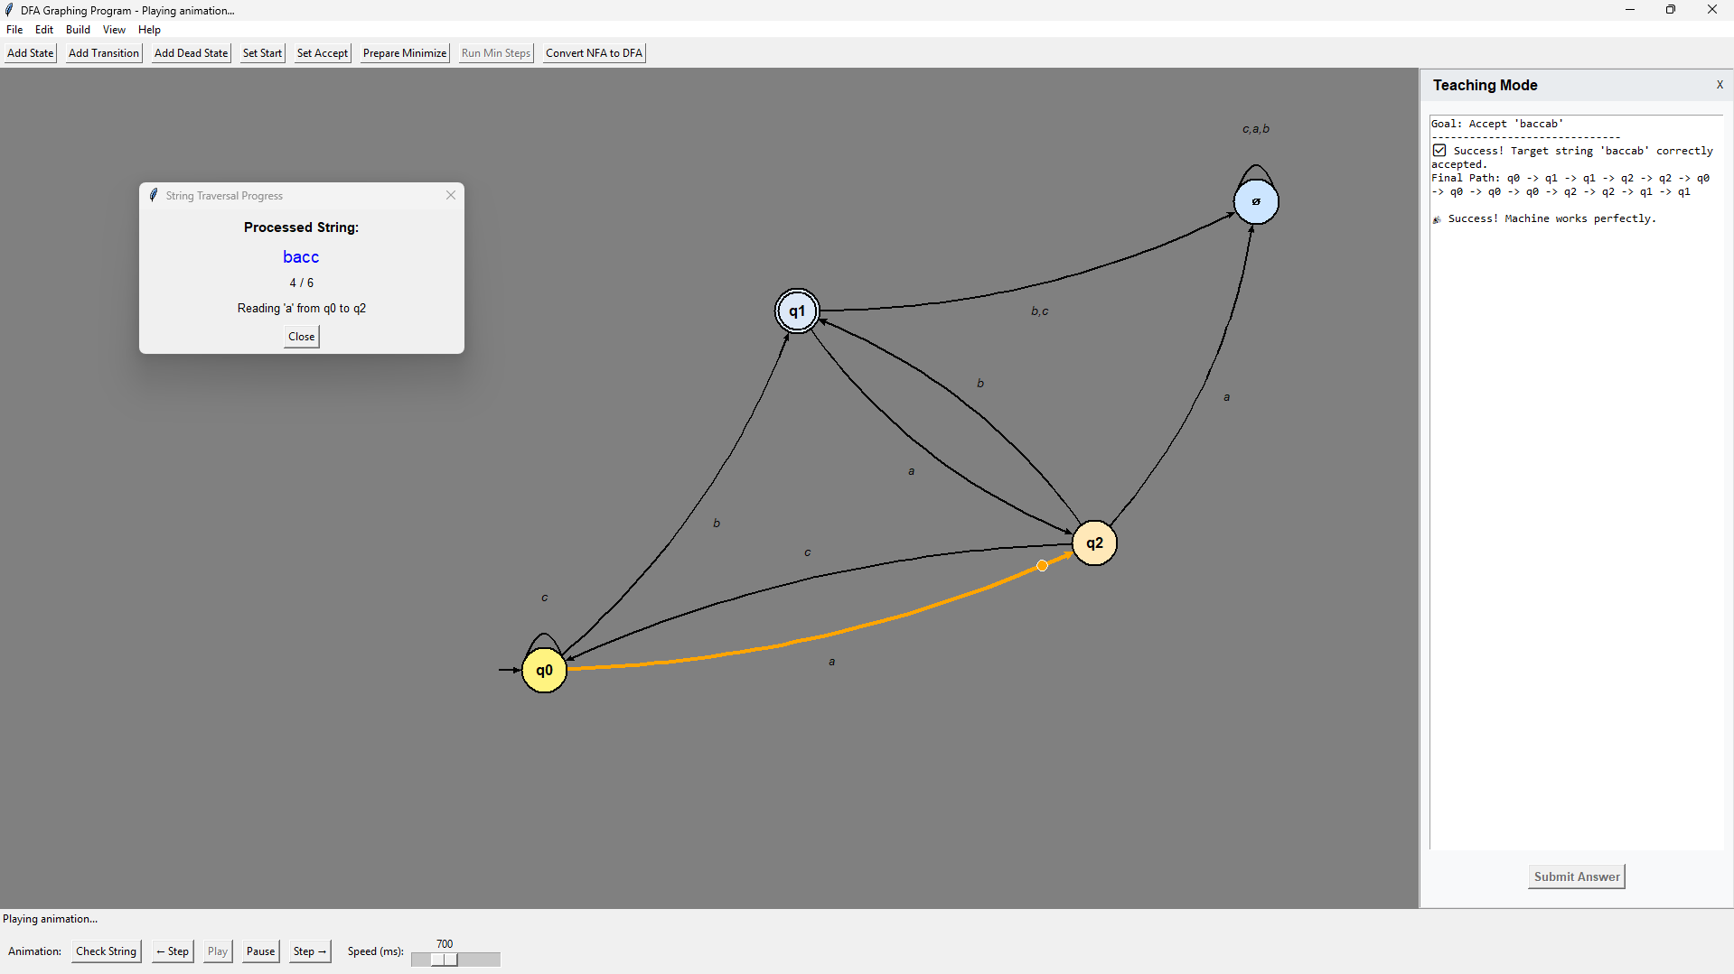
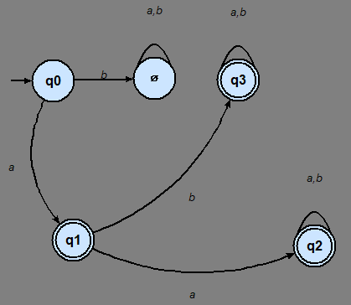

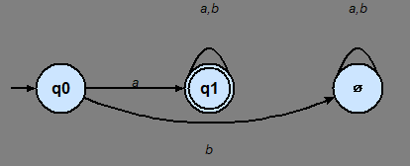
VISUALIZATION FOR FORMAL LANGUAGES
Chris Pinto-Font, Andrew Bastien, Vincent Borrelli, Keegan McNear
Faculty Advisor(s): Dr.David Luginbuhl, Dept. of Computer Science, Florida Institute of Technology
Motivation/Goal
The primary goal is student comprehension of complex DFA concepts.
This project is important for students and professors because being able to visualize Deterministic Finite Automota (DFA) and how it is created and expressed can lead to better understanding of how parsing and computation works.
Approach/Features
Modify states in an interactive dynamic workspace.
Draw using point and click state and transitions.
Traverse states given a string input and accept or reject based on DFA with real-time animation.
Reverse engineer a DFA from string input using teaching mode. (Figure 1)
Minimize a DFA. (Figure 2)
Input a regular expression to create a matching DFA. (Figure 3)
Convert from NFA to DFA.
Input a string to create a matching DFA.
Implementation/Tools
System Architecture
Evaluation Results
Accuracy:
  Convert NFAs to DFAs using construction logic.
  Minimize deterministic machines to their most efficient state.
  Manage string and regular expression conversion correctly.
Performance:
  Ensure GUI responsiveness by handling canvas updates.
  Optimize memory usage through efficient data structures.
  Utilize UUID generation with O(1) time complexity.
Stability:
  Prevent application crashes through error handling and input validation.
  Prevent GUI errors using system architecture.
  Maintain machine integrity by preventing memory collisions.
Future Works
Limitations:
Dense graphs become visually cluttered
Limited to finite automata
Possible Improvements:
Implement a layout to have better visuals
Upgrade to support PushDown Automata
Visualizer Examples
(Figure 3)
(Figure 1)
(Figure 2)

