Slide 1
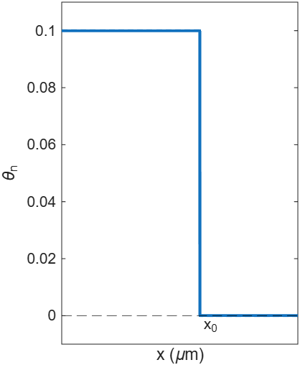
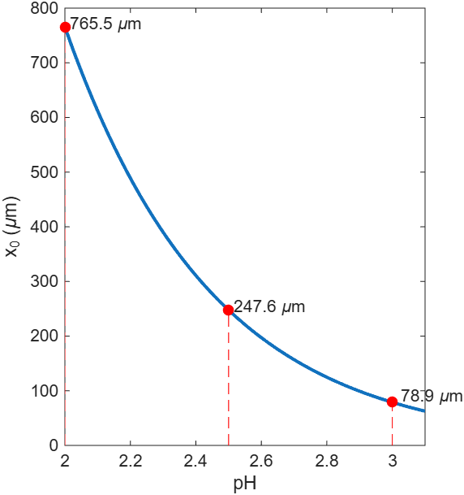
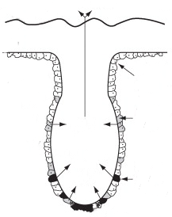
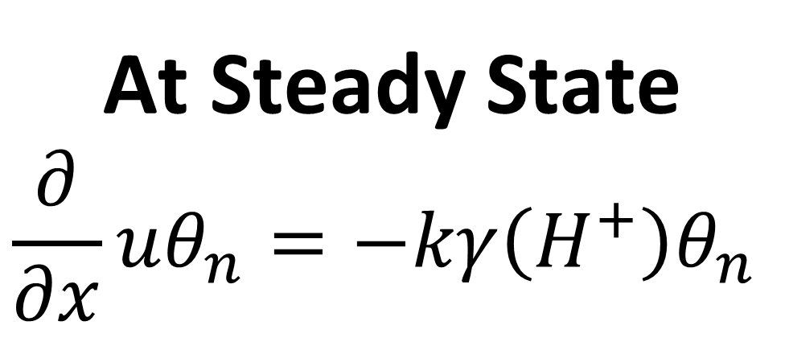
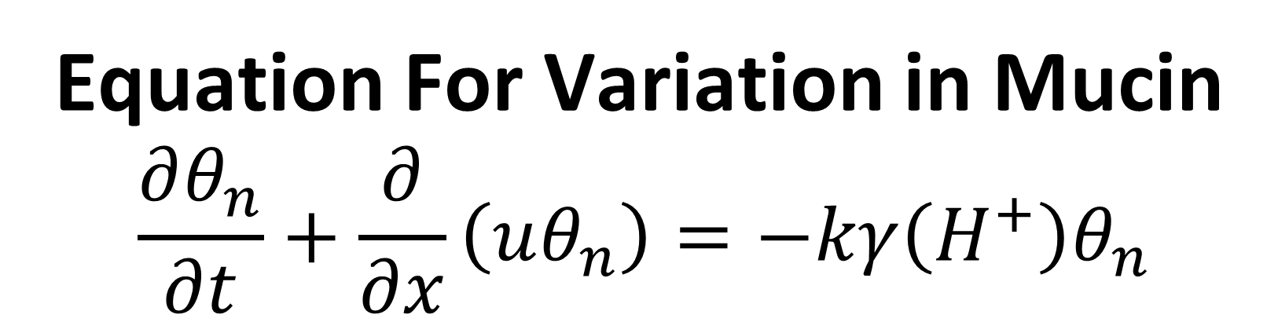
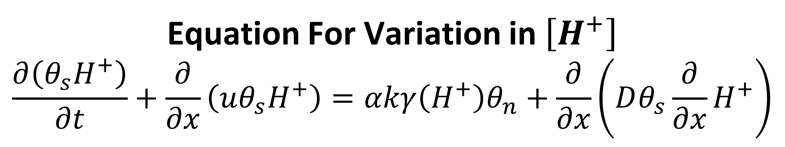
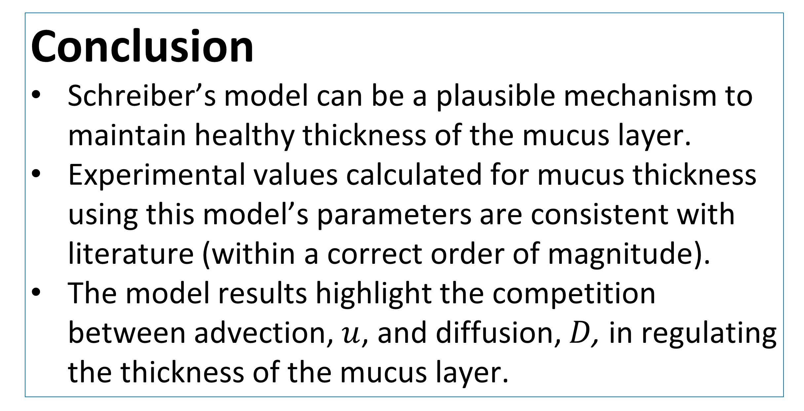
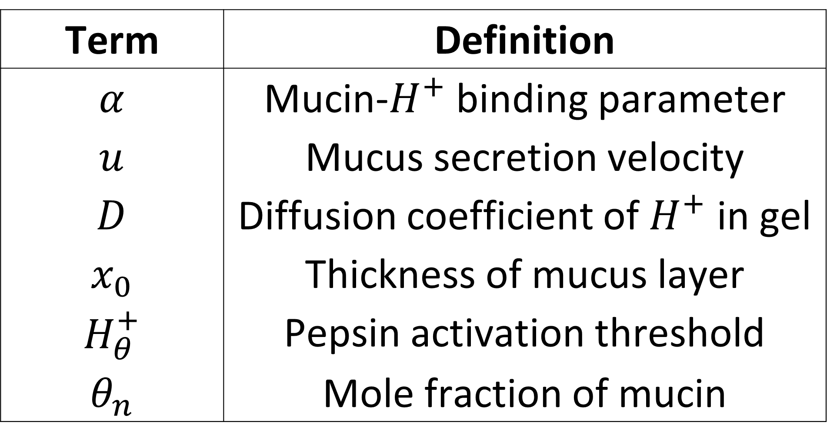

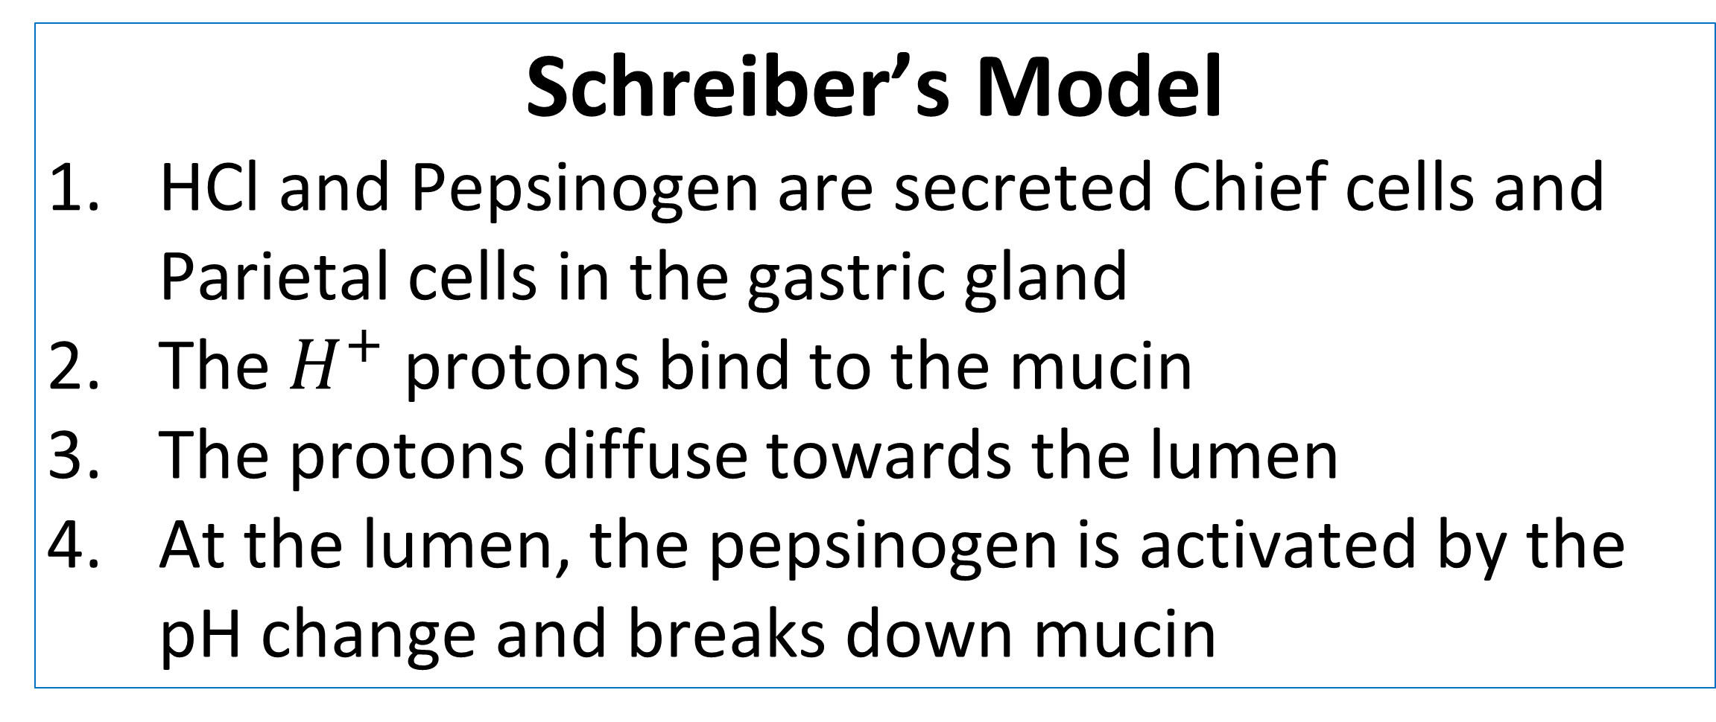
x = linspace(220,4000,2000);
The Invisible Shield: Why Our Stomach Doesn’t Digest Itself
Kevon Findley
Faculty Advisor: Dr. Jian Du
Dept. of Mathematics and Systems Engineering, Florida Institute of Technology
Background
The stomach contains highly acidic gastric fluid with a very low pH.
A thin mucus lining protects the stomach from self-digestion and keeps nearby epithelial cells near a pH 7.
A weakened mucus layer is associated with conditions such as Gastritis and Peptic Ulcer Disease.
1D Representation of Mucus Layer
Results & Discussion
Generated $H^{+}$Profile
$$H^{+}\left(x\right)=\left\{\begin{aligned}\left(e^{\frac{u}{D}x}−1\right)\frac{αθ_{0}}{1−θ_{0}},x<x_{0} \\ H_{θ}^{+}e^{\frac{u}{D}\left(x−x_{0}\right)}, x≥x_{0}\end{aligned}\right.$$
Mucus Thickness as Function of Pepsin Activation Threshold
$$x_{0}=\frac{D}{u}\ln\left(\frac{H_{θ}^{+}\left(1−θ_{0}\right)}{αθ_{0}}+1\right)$$
Secretion
Degradation
Problem Description
How can the protective mucus barrier be maintained and be of stable thickness?
Simplified Representation of Gastric Gland and Mucosal Lining
Schreiber’s Model
HCl and Pepsinogen are secreted Chief cells and Parietal cells in the gastric gland
The$H^{+}$ protons bind to the mucin
The protons diffuse towards the lumen
At the lumen, the pepsinogen is activated by the pH change and breaks down mucin
Pepsin + HCl
Lumen
Mucus gel barrier
Mathematical Model
Mucus-secreting cells
Equation For Variation in $\left[H^{+}\right]$
$$\frac{∂\left(θ_{s}H^{+}\right)}{∂t}+\frac{∂}{∂x}\left(uθ_{s}H^{+}\right)=αkγ\left(H^{+}\right)θ_{n}+\frac{∂}{∂x}\left(Dθ_{s}\frac{∂}{∂x}H^{+}\right)$$
With a realistic pepsinogen activation threshold (pH 2-3), the mucus layer has this expected thickness.
Equation For Variation in Mucin
$$\frac{∂θ_{n}}{∂t}+\frac{∂}{∂x}\left(uθ_{n}\right)=−kγ\left(H^{+}\right)θ_{n}$$
Gastric gland
Parietal cells
Conclusion
Schreiber’s model can be a plausible mechanism to maintain healthy thickness of the mucus layer.
Experimental values calculated for mucus thickness using this model’s parameters are consistent with literature (within a correct order of magnitude).
The model results highlight the competition between advection, $u$, and diffusion, $D$, in regulating the thickness of the mucus layer.
HCl
At Steady State
$$\frac{∂}{∂x}uθ_{n}=−kγ\left(H^{+}\right)θ_{n}$$
Pepsinogen
Term | Definition
$$α$$ | Mucin-$H^{+}$ binding parameter
$$u$$ | Mucus secretion velocity
$$D$$ | Diffusion coefficient of $H^{+}$ in gel
$$x_{0}$$ | Thickness of mucus layer
$$H_{θ}^{+}$$ | Pepsin activation threshold
$$θ_{n}$$ | Mole fraction of mucin
Chief (peptic) cells
HCl
References
Schreiber & Scheid (1997), Am J Physiol 272:G63–70.
Newton/Askari & Tovey, Gut (2004).

