Slide 1

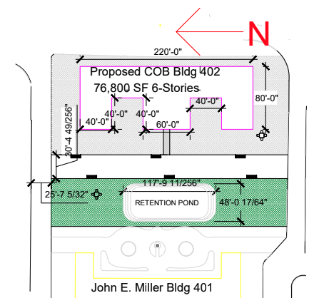
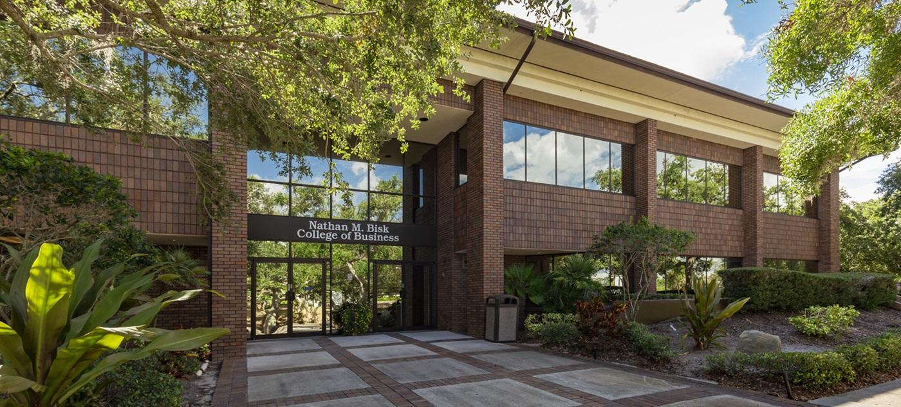
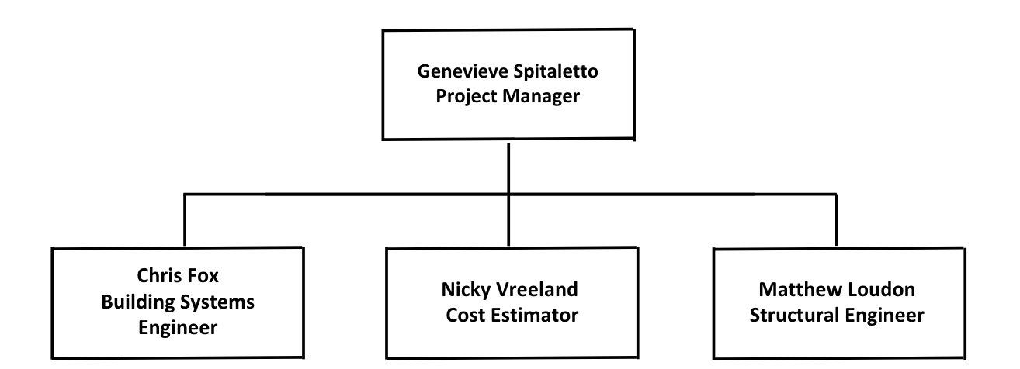
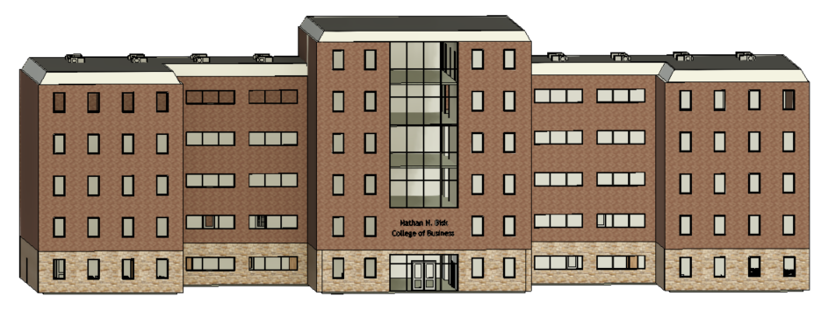
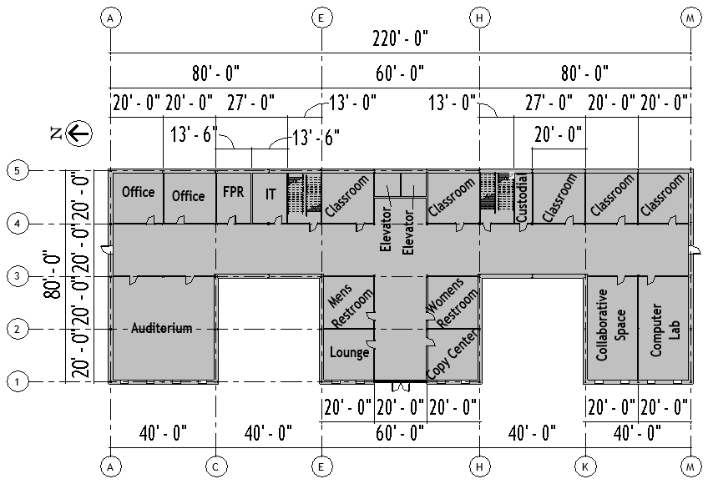
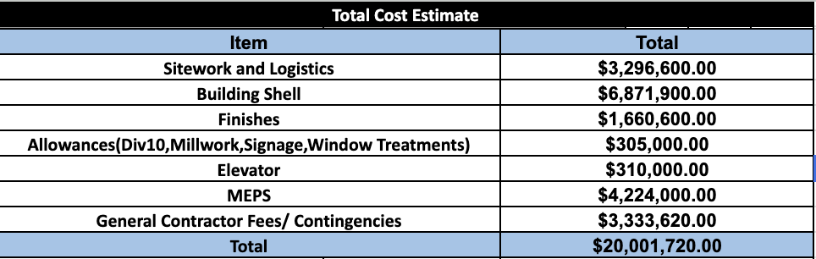
College of Business Relocation Project
Genevieve Spitaletto, Nicky Vreeland, Matthew Loudon, & Chris Fox
Faculty Advisor: Dr. Troy V. Nguyen, Dept. of Mechanical and Civil Engineering, Florida Institute of Technology
Project Site Location
Project Objective
Site Layout
Florida Institute of Technology
169 Florida Tech Dr, Melbourne, FL 32901
Construct a modern, six-story College of Business building at Florida Tech that provides functional, accessible, and collaborative learning spaces while meeting all code requirements and supporting long-term campus growth.
Conditions of Existing Building
Team Organizational Chart
Built in 1985, the existing two-story, 22,642 sq. ft. wood-framed facility is outdated, inefficient, and creates a noisy learning environment, no longer meeting modern academic and sustainability standards.
Proposed Exterior Design Models
Project Features
Project Schedule
Six-story academic building
76,800 sq. ft.
45 classrooms, 25 offices, 2 computer labs, and auditorium
Reinforced concrete foundation with steel frame
Natural lighting, low energy systems, and storm water retention pond
Pedestrian access improvements
ADA compliant, fire protection, and code compliant
Includes preconstruction, demolition, sitework, foundations, structural framing, building enclosure, interior construction, and final closeout. Key milestones include Notice to Proceed, completion of demolition, topping out, building dry-in, Substantial Completion, and project turnover, with an overall duration of 18 months.
Proposed First Floor Plan
Project Cost Estimate
Structural Analysis
The design of structural members follows AISC 16th Edition - (LRFD). All loading conditions shall be in accordance with ASCE 7-22. The design adheres to Florida Building Code and Florida Tech Design & Construction Standards.
A Special Thank You to Our Sponsor Lee Myers and the Florida Tech Facilities Team!

