Slide 1
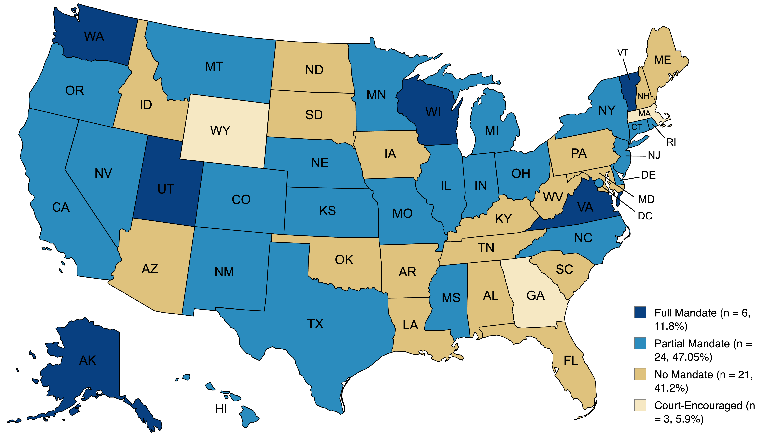
Electronic Recording of Custodial Interrogations: A Jurisdictional Analysis of U.S. State Requirements
Alyssa Fox
Faculty Advisor(s): Dr. Brandon May & Dr. Travis Conradt, School of Psychology, Florida Institute of Technology
Background
Custodial interrogations serve as the primary mechanism through which information is gained for evidence. Human memory is reconstructive rather than reproductive, leaving it vulnerable to contamination and suggestibility, especially with employment of psychological interrogation tactics and the inherently coercive nature of custodial interrogations. This causes false confessions, which lead directly into wrongful convictions. Juveniles and people with disabilities are particularly vulnerable to this, with heightened compliance and diminished decision-making capacity. Electronic recording of custodial interrogations has emerged as a safeguard against false confessions through documentation, accountability, and preservation; however, practical implementation remains limited.
Results
6 states have full recording mandates; 24 have partial mandates; 21 have no mandates; 3 have court encouragement. Full mandate jurisdictions show significant temporal variation, with Alaska being the first to mandate in 1985 and Vermont being the most recent in 2024. Partial mandate jurisdictions vary in terms of offense trigger, with 77.8% requiring recording for capitol offenses and 66.7% requiring for sex offenses. No states require recording for all witness/victim interviews, but 12 have specific laws regarding child victims. 2 states provide exclusionary remedy for noncompliance, and only 1 requires cautionary instructions for the jury. Body-worn camera policies are sparse, with some states requiring activation of BWCs for all interviews and others having specific deactivation protocols.
Present Study
The present study aims to create a systematic analysis of interrogation recording laws across the U.S. by: 1. Documenting current recording mandates across the U.S. 2. Examining mandate scope, including offense thresholds, custodial versus non-custodial applicability, and exceptions. 3. Examining whether jurisdictions provide further protections for vulnerable populations (e.g., juveniles and people with intellectual disabilities). 4. Assessing whether requirements extend to include interviews with witnesses and victims. 5. Analyzing consequences for recording failures. 6. Examining how consent laws (e.g., two-party consent states) interact with interview recording laws.
Figure 1. United States map indicating distribution of interview recording mandates.
Method
The review focused on identifying and documenting legal information regarding electronic recording of custodial interrogations in all 50 U.S. states and the District of Columbia, focusing on interviews involving suspects, witnesses, and victims. Information was gathered by searching the state name along with terms such as “electronic recording”, “custodial interrogation”, “interview recording”, “body-worn camera”, “suspect interview”, “witness interview”, and “victim interview”. All relevant information was organized in a spreadsheet and carefully reviewed prior to analysis.
Conclusions / Discussion
Mandatory electronic recording of custodial interrogations meets best practice suggestions, such as the Mendez Principles for ethical interviewing, and is formally recommended by the Major Cities Chiefs Association. Without proper recording, accounts become a “swearing contest” between police and defendants, further disadvantaging vulnerable suspects. Recording minimizes risk of false confessions, especially among vulnerable/juvenile suspects, and enhances accountability among officers. Limitations Focus on de facto versus de jure requirements Body-worn camera laws not examined

