Slide 1
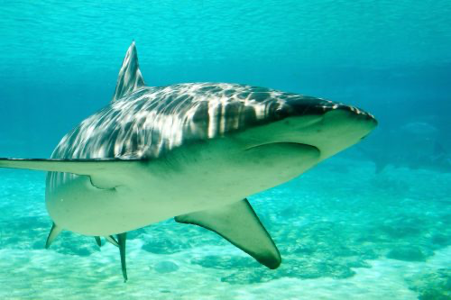
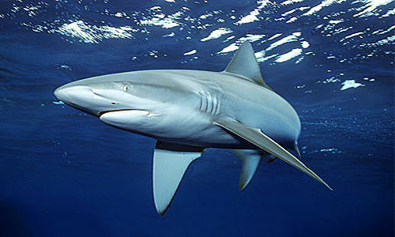
Finding Jaws: DNA Barcoding Shark Cartilage to Identify Species
Kenna Peters
Faculty Advisor: Dr. Toby Daly-Engel, Dept. of Ocean Engineering and Marine Sciences, Florida Institute of Technology
Introduction
Elasmobranchs (sharks and rays) are vital keystone predators that help regulate the health of marine ecosystems, and some of the largest and most wide-ranging fishes in the ocean¹. Elasmobranch identification is difficult due to morphological similarities between species, and the high risk of encountering cryptics. These are evolutionarily distinct, but physically identical to more common taxa, and can only be identified using genetics. Misidentification is a major obstacle to shark science, especially considering new data showing that >70% of all elasmobranchs have been lost in the past 50 years, and many sharks are now shifting ranges in response to global warming². Because of this, there is increasing urgency to pair ecological, trophic, and other types of studies on sharks with genetic identification.
Unlike traditional bony fishes, elasmobranch skeletons are comprised of cartilage and soft tissue that degrades relatively quickly, but contains DNA that can be used for genetic identification. Little work has been done on sequencing DNA from preserved jaw cartilage, but some research has shown that it is possible to do, depending on their age³. For this study, we sequenced DNA from 28 dried, preserved shark jaws that are part of an ongoing study on stable isotopes and trophic ecology, in collaboration with the Minorities in Shark Science’s ICONIC Oceans Project.
Results
The extractions produced viable DNA and proper species identification was conducted from the jaw samples. A phylogenetic tree was produced for all 28 samples with an outgroup to indicate species groupings (Fig. 1). The postrior or bootstrap values indicate the confidence of each individuals placement on the tree. The species identified include 7 blacktip (Charcarhinus limbatus), 13 sandbar (C. plumbeus), 1 spinner (C. brevipinna), 4 Galapagos (C. galapagensis), and 1 lemon shark (Negaprion brevirostris).
Methods
28 powdered jaw samples were collected from unlabeled jaws from sharks that were sampled from the coastal Northwest Atlantic. DNA was extracted using an E.Z.N.A Tissue DNA kit (Omega Bio-tek). 900-1000 bp of the NADH dehydrogenase 2 subunit (ND2) and 900-1000 bp of the displacement loop (D-loop) portion of the Control Region, both mitochondrial genes, were amplified through polymerase chain reactions (PCR) with the primers tMetShkND2_F and tAlaShkND2_R⁴ for ND2 and Pro-L and 282H⁵ for D-loop. Sequencing was done at the University of Arizona Genetics Core (Tucson, AZ) and sequences were cleaned by eye and aligned with Mafft⁶ using the sequencing software Geneious Prime (Dotmatics). These were then compared to existing sequences downloaded from the National Center for Biotechnology Information (NCBI)’s nucleotide database using the BLAST search engine for purposes of identification. We then constructed a Bayesian phylogenetic tree with MrBayes⁷ plugin for Geneious Prime, using the GTR model, to verify results.
Figure 1. Phylogenetic tree of 28 samples and an outgroup of Rhizoprionodon terranovae
Discussion
Our results indicate that this novel genetic process of jaw cartilage extractions can be used and trusted to produce genetic information, and to the same extent of tissue extractions. This is especially important in light of the conservation challenges facing most shark species, and opens new opportunities for elasmobranch conservation, species management, and population protections to be further developed.
Literature Cited
Ferretti, F. et. al, Patterns and ecosystem consequences of shark declines in the ocean, 2010.
Barry, S. et al., Sharks respond to climate change with a population-level shift in critical habitat, 2026.
Nielsen, E. et. al, Extracting DNA from ‘jaws’: high yield and quality from archived tiger shark (Galeocerdo cuvier) skeletal material, 2017.
O’Brien, SM. et. al, Effects of species biology on the historical demography of sharks and their implications for likely consequences of contemporary climate change, 2013.
Keeney, D.B. et. al, Genetic heterogeneity among blacktip shark, Carcharhinus limbatus, continental nurseries along the U.S. Atlantic and Gulf of Mexico, 2003.
Katoh, K. et. al, MAFFT Multiple Sequence Alignment Software Version 7: Improvements in Performance and Usability, 2013.
Huelsenbeck, J.P., et. al, MRBAYES: Bayesian inference of phylogenetic trees, 2001.
Acknowledgements
This study was conducted in collaboration with the nonprofit organization Minorities in Shark Science (MISS), through its Integrated Coordinated Open Networked Inclusive Conservation (ICONIC) Oceans initiative. Thank you to everyone in the Daly-Engel Lab for support. This work was funded by Re:WILD and the Richard Turner Research Grant.
Image 1. Dusky shark
© Steve Garner Wikicommons
Image 2. Galapagos shark
© Doug Perrine
Notes:
The only font allowed is “Calibri”. It is available on all Microsoft products . Minimum font size is 48 pts. All images are at least 300 dpi.

